Slide 1
BREAKTHROUGHS IN
COSMOLOGY
AND
ASTROPHYSICS
IN THE LAST 100 YEARS
Supratik Pal
Indian Statistical Institute, Kolkata

Slide 2
A tribute to…
…the people of India who are working towards development of scientific temper of the country.

Slide 3
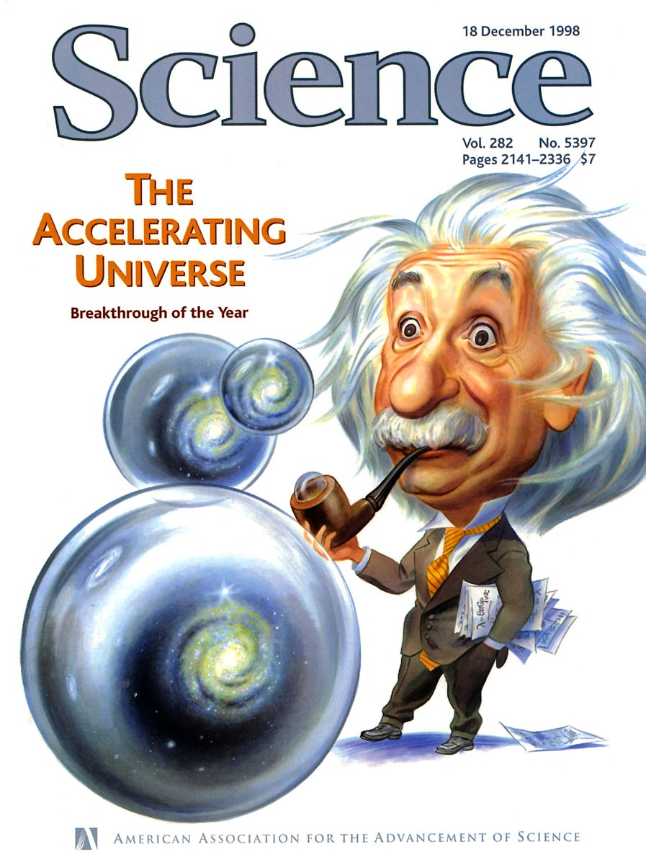

Slide 4
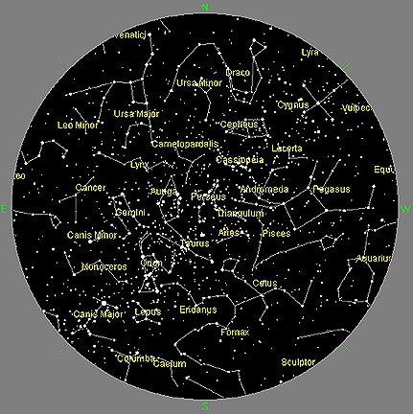
Night sky with naked eye

Slide 5
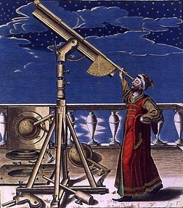
Beyond naked eye: Telescopes

Slide 6
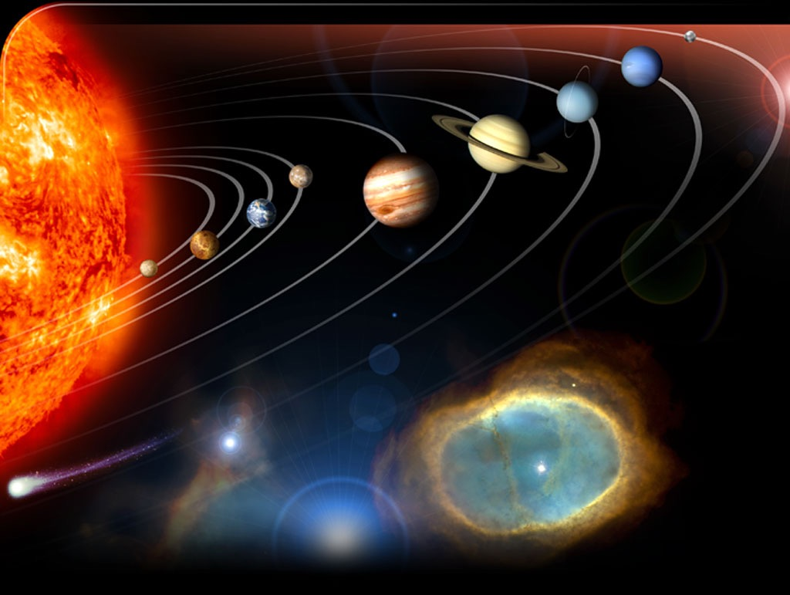
First Breakthrough with Telescope

Slide 7
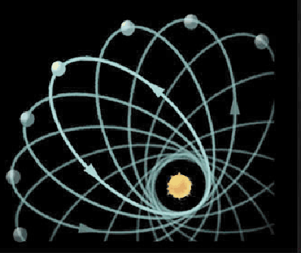

Enter Modern Era : 1
(1915)
1915 : Einstein proposed General Theory of Relativity
Explained : Paths of planets around the sun are not elliptical

Slide 8
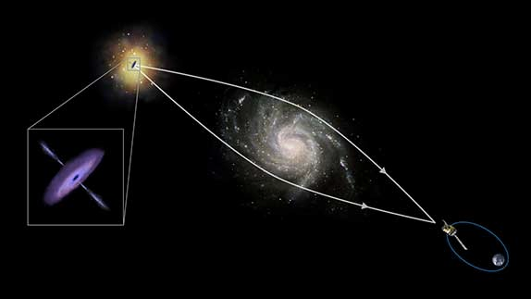
Enter Modern Era : 2
(1919)
Predicted : Light ray can be bent by gravitation !
Stars, galaxies etc act as lenses
Stronger the gravitation, more is the amount of bending
Found experimentally in 1919

Slide 9
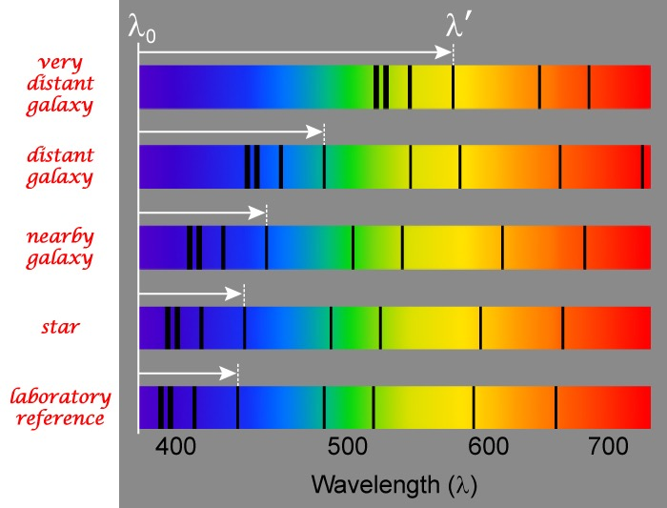
Enter Modern Era : 3
(1925)
Predicted : Objects moving away will look more red !
Found experimentally in 1925

Slide 10
The Expanding Universe
(1929)

Slide 11
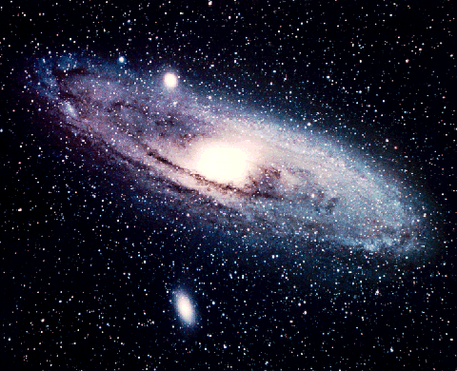
Our Galaxy : Milky Way

Slide 12
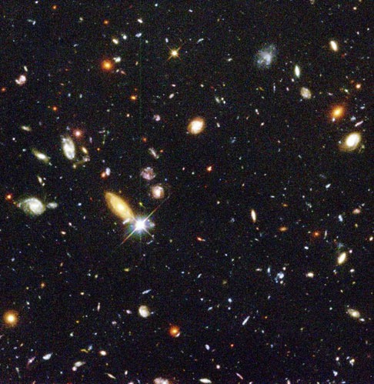
Our Galaxy is one among Millions

Slide 13
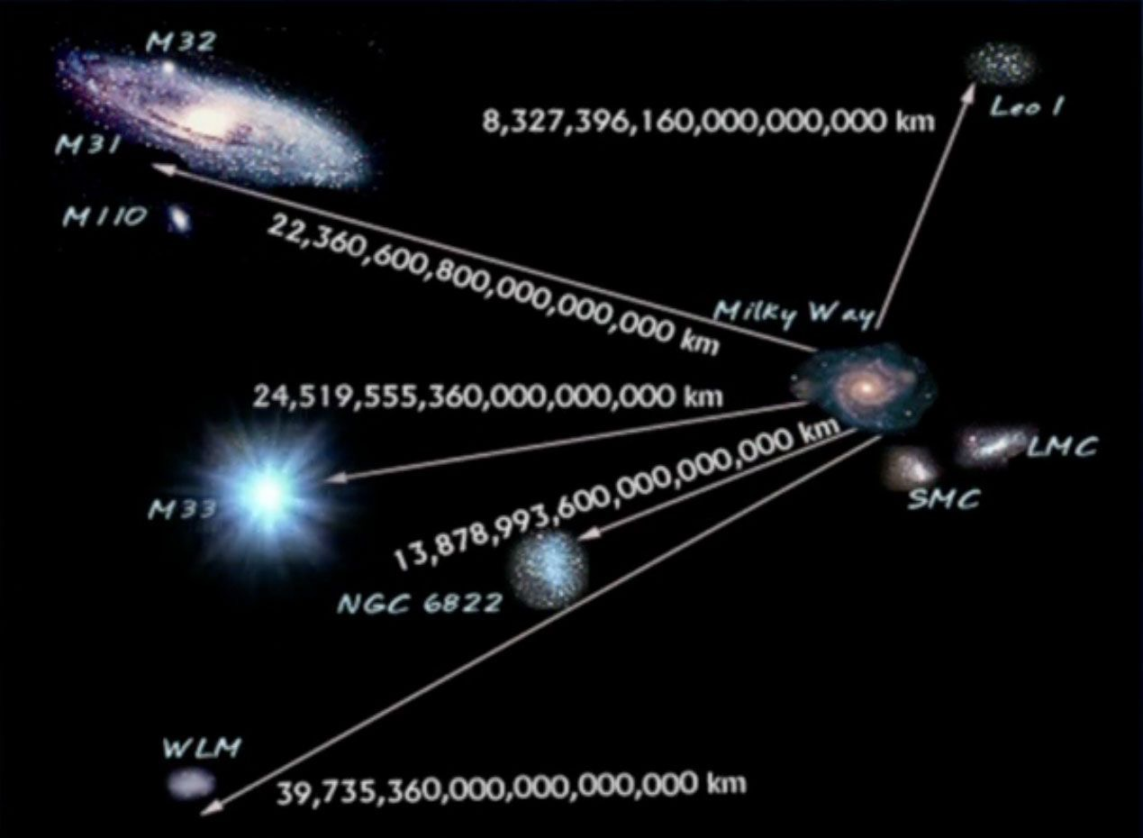
The grand old man of Observational Cosmology: Hubble (1929)

Slide 14
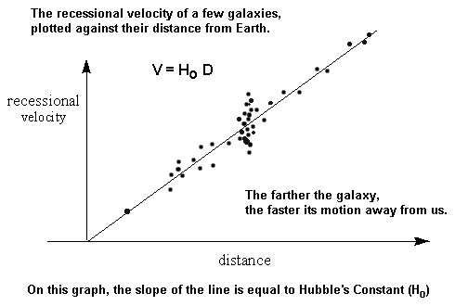
Farther the galaxy, greater is its velocity=>
Galaxies are moving away from each other

Slide 15
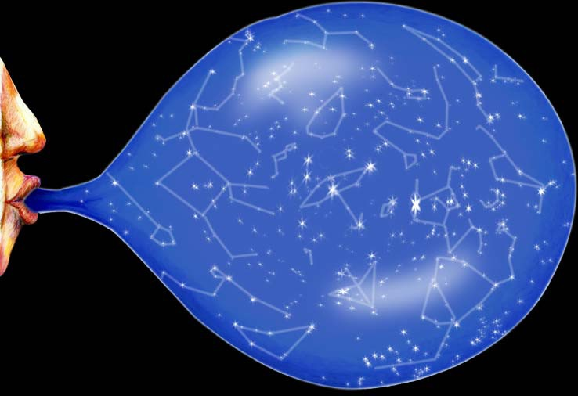
Our Universe is expanding!

Slide 16
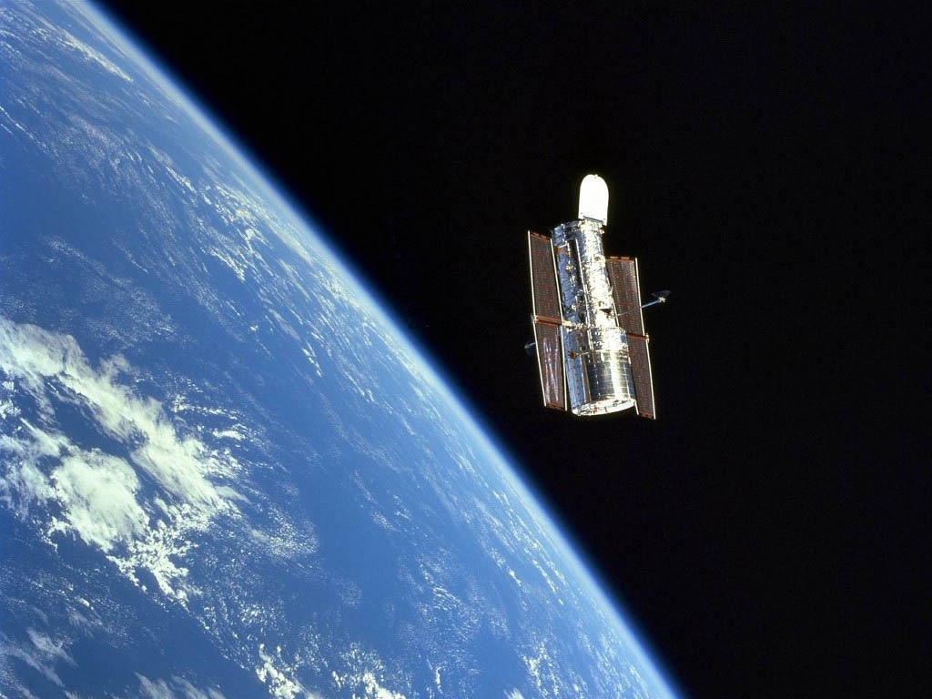
HST: Hubble Space Telescope

Slide 17
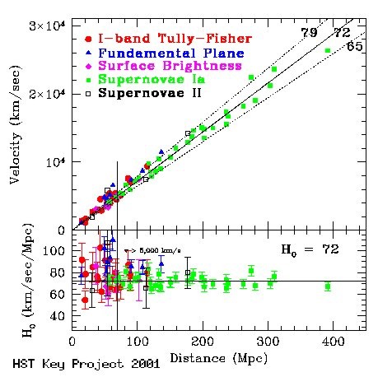
HST data give Expansion Rate

Slide 18
Dark Matter
(1933)

Slide 19
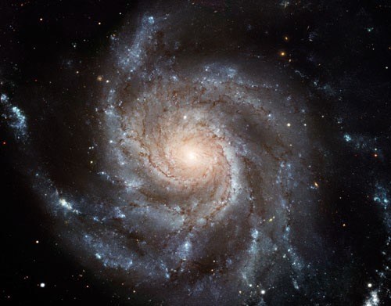
Our Galaxy
Milky Way

Slide 20
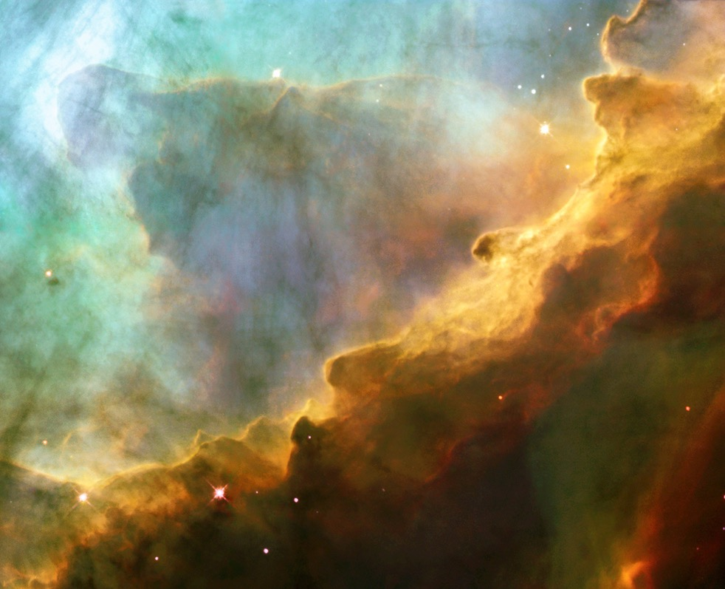
Cloud made of neutral Hydrogen (HI)

Slide 21
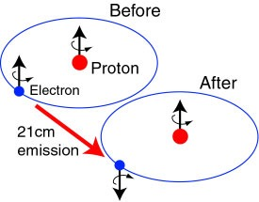
~80% of visible matter is Neutral Hydrogen
Neutral Hydrogen has singlet and triplet states
Spin flip (Hyperfine splitting)
Emits radiation with frequency 1420 MHz / wavelength 21 cm

Slide 22
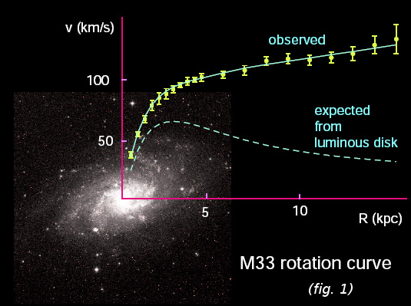
Measure rotational velocity

Slide 23
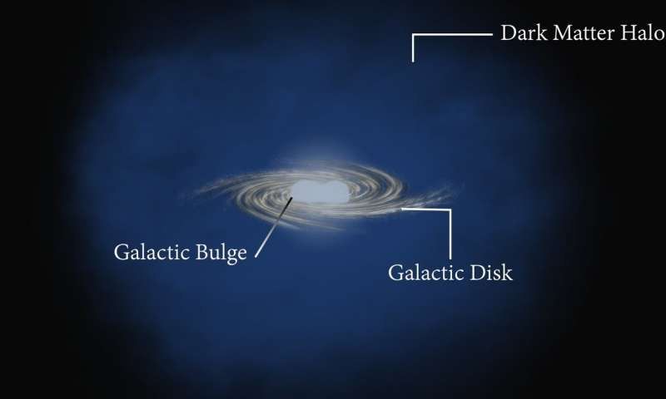
Even what we do not see also exists: Dark Matter!

Slide 24
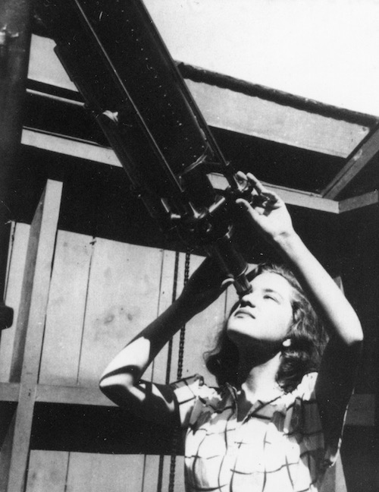
Who discovered that? : Vera Rubin

Slide 25
Our Our Galaxy is one among Millions: Clusters
Measure velocity dispersion, hence total mass of cluster
5 times mass of visible matter -> Dark Matter! (Zwicky, 1933)

Slide 26
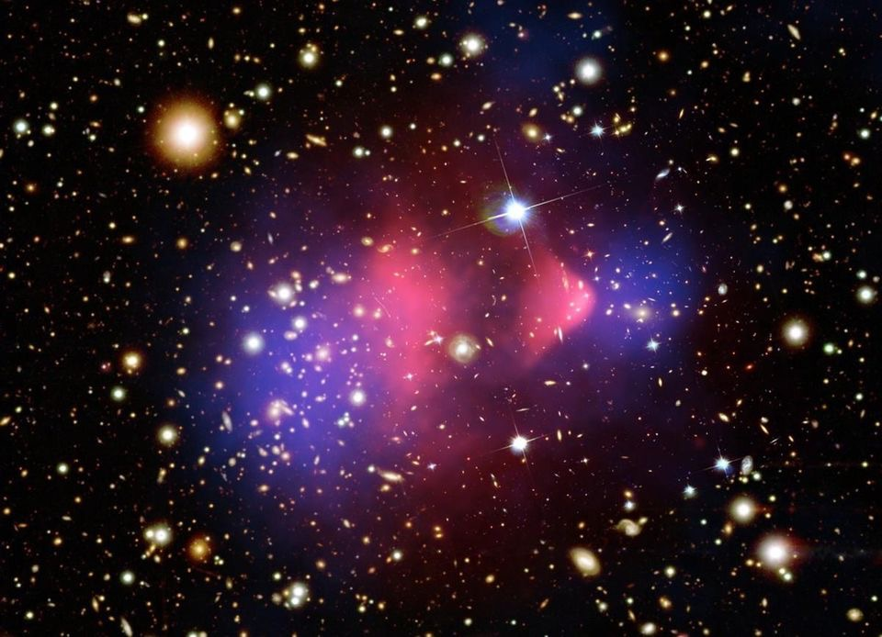
To see the unseen: Collision in the sky
(Bullet cluster)

Slide 27
Cosmic Microwave Background Radiation
(1964)

Slide 28
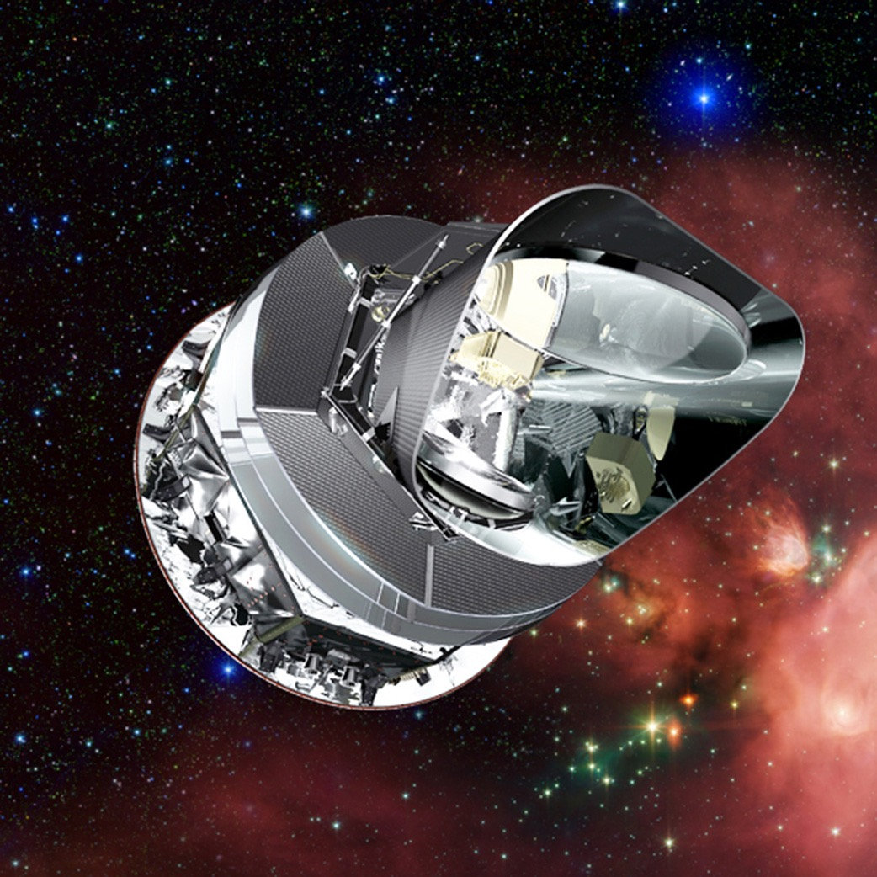
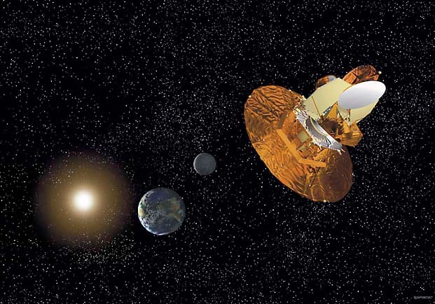
WMAP: Wilkinson Microwave Anisotropy Probe
and Planck (ESA)

Slide 29
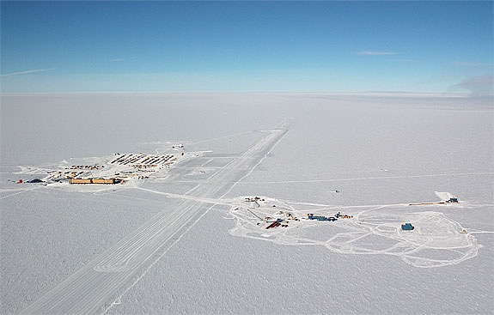
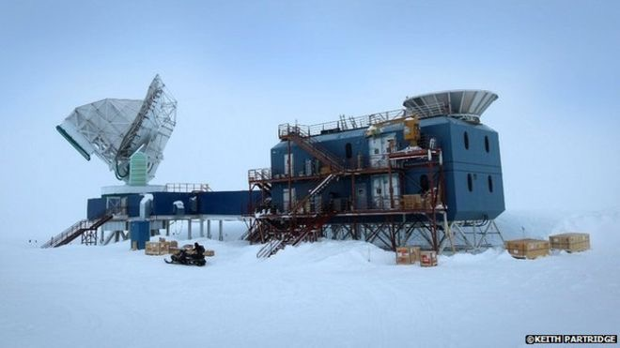
SPT: South Pole Telescope

Slide 30
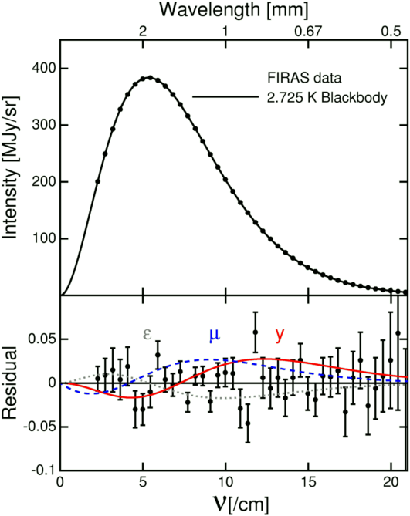
Universe is a Black-body (Penzias & Wilson:1965)

Slide 31
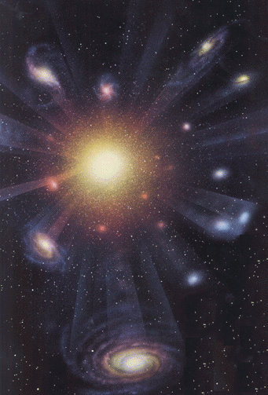
Happy Birthday to our Universe: 13800000000 Years Ago

Slide 32
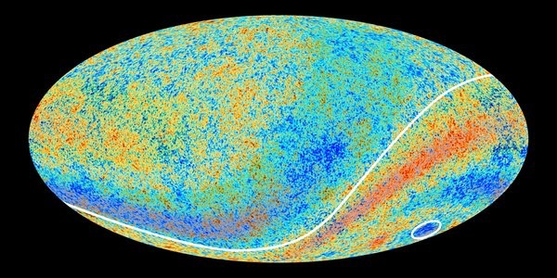
The First Sky: Cosmic Microwave Background
(Redshift=1100)
Very tiny temperature fluctuations

Slide 33
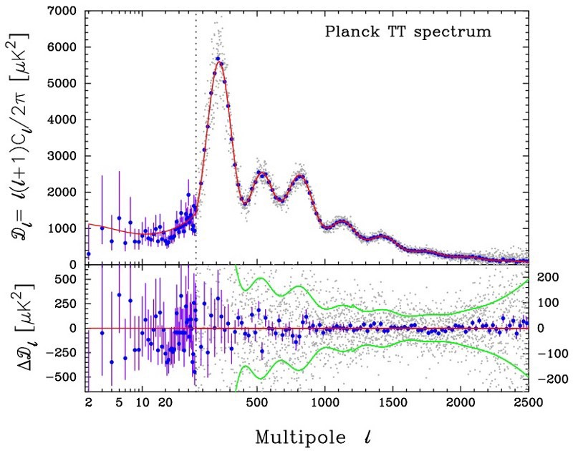
Everything in the universe originated from these
tiny temperature fluctuations

Slide 34
The Accelerating Universe:
Dark Energy
(1998)

Slide 35
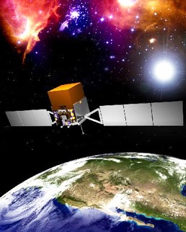
Supernova Cosmology Project (Riess, Perlmutter, Schmidt: 1998)
W

Slide 36
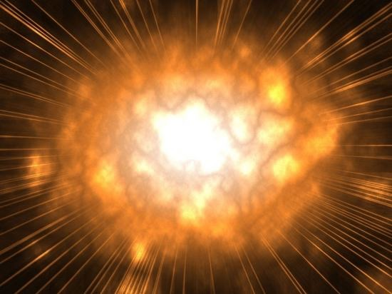
Death of a Star: Supernova Explosion

Slide 37
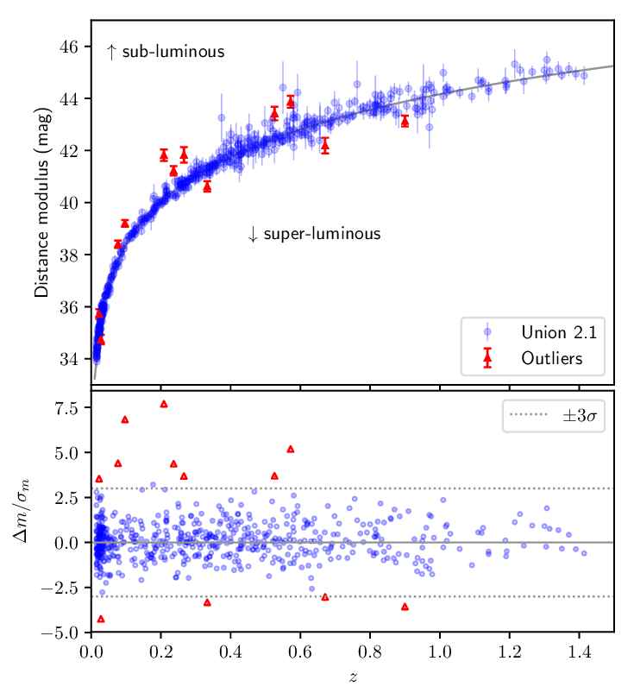
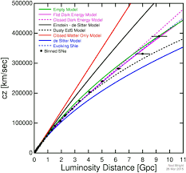
Supernovae Type Ia
(Redshift<1.5)

Slide 38
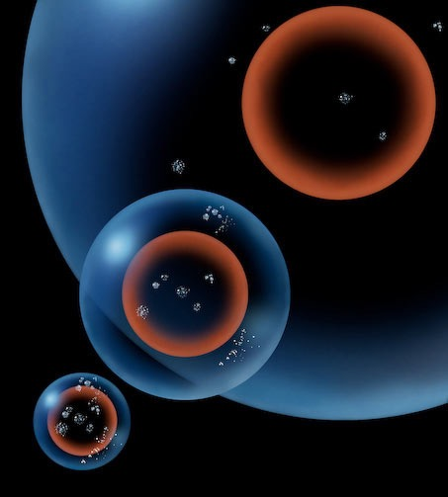
Universe is not only expanding but also accelerating!

Slide 39
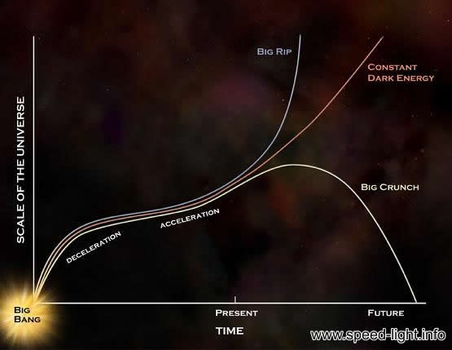
Require huge “anti-gravity” : Dark Energy!

Slide 40
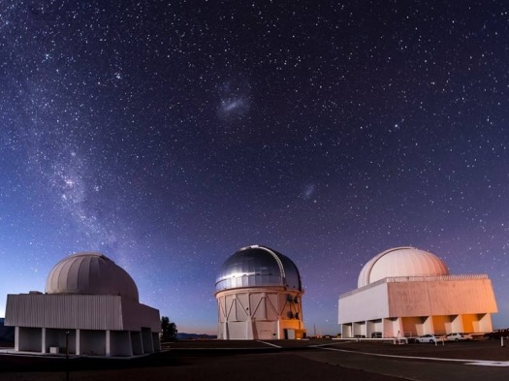
DES: Dark Energy Survey

Slide 41
HST: Hubble Space Telescope revisited
Independently proved by other experiments

Slide 42
Large Scale Structure
(Hubble:1926, Major survey:2000)

Slide 43
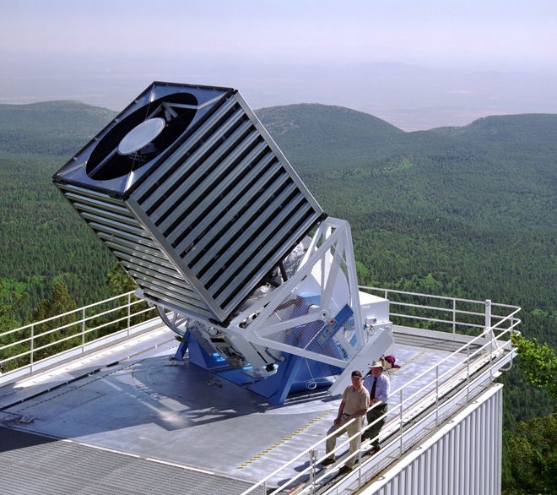
SDSS: Sloan Digital Sky Survey

Slide 44
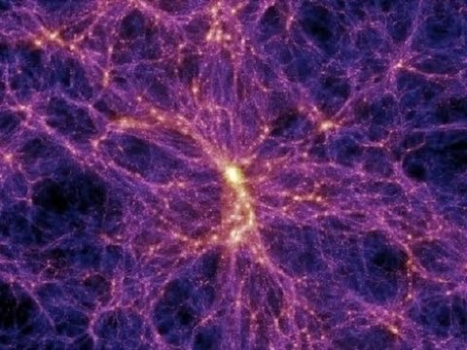
Large Scale Structure

Slide 45
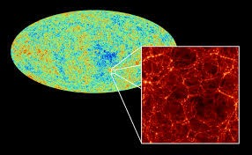
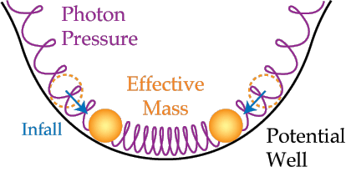
BOSS: Baryonic Acoustic Oscillation Spectroscopic Survey

Slide 46
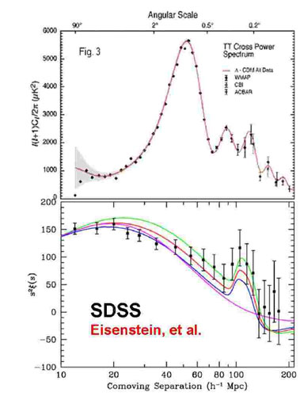
BAO data (Redshift<1) -> ~4%BM, 26%DM,70%DE

Slide 47
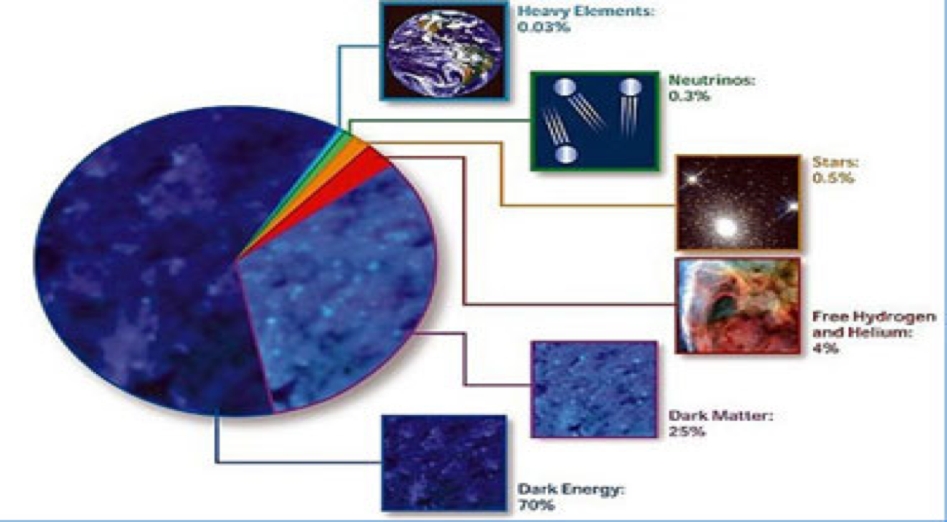
Cosmic Constituents: As of Now

Slide 48
Gravitational Waves
(2015)

Slide 49
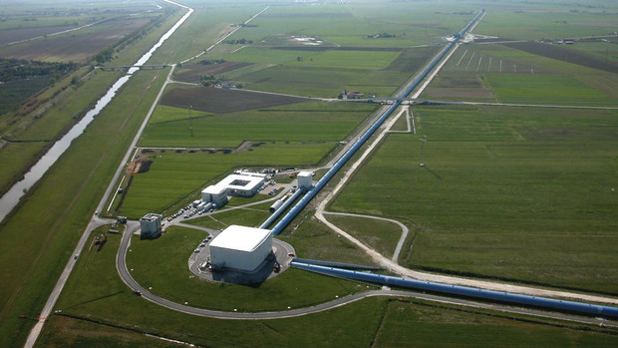
LIGO: Laser Interferometer Gravitational-wave Observatory

Slide 50
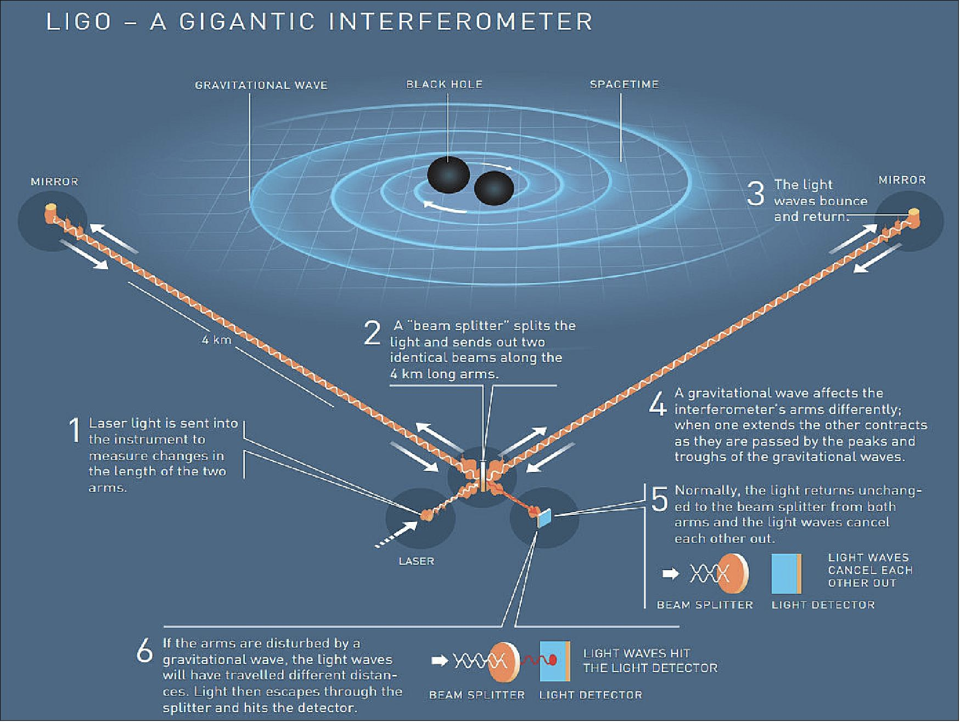

Slide 51
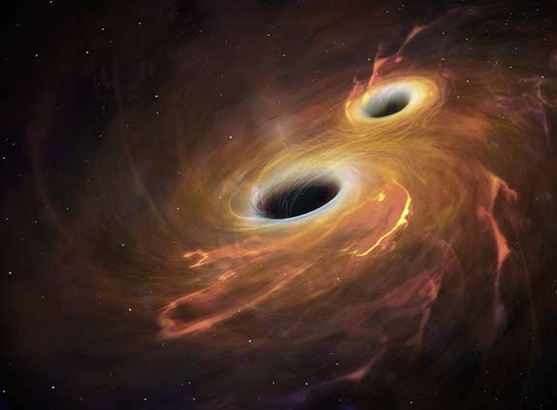
LIGO found Gravitational Waves from binary Black Hole merger (Sept 14, 2015)

Slide 52
Black Holes
(2019)

Slide 53
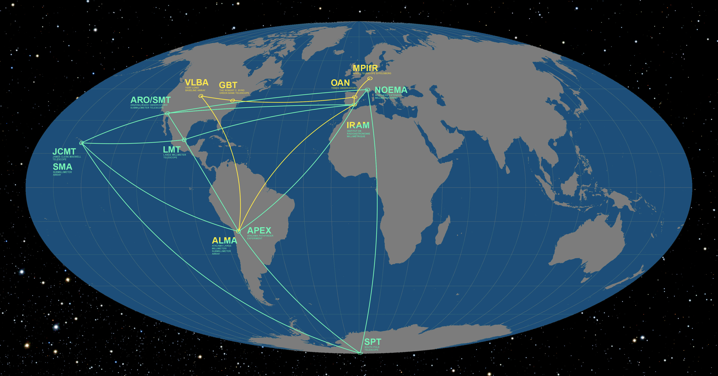
Event Horizon Telescope (EHT): 11 radio telescopes around the world, combined

Slide 54
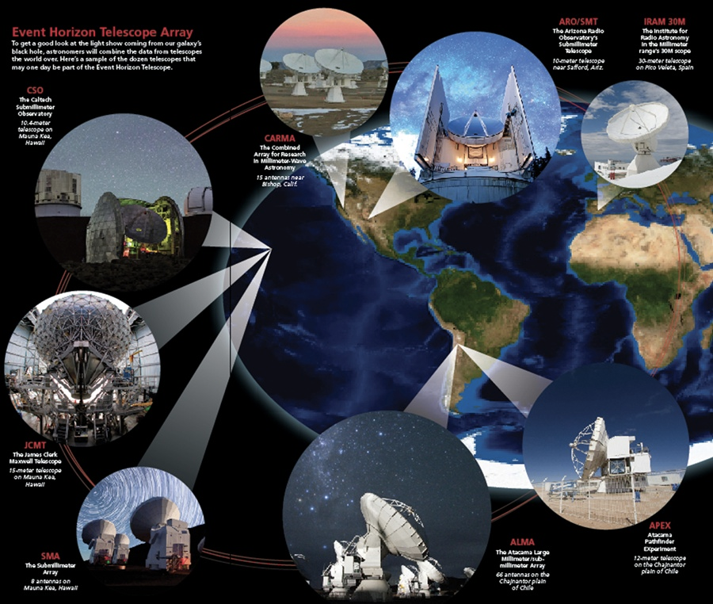

Slide 55
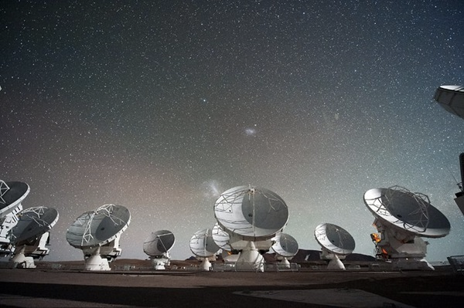
EHT : Each one is a collection of disk antennas

Slide 56
Back to our Galaxy : Milky Way

Slide 57
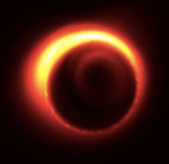
Sagittarius A* Black Hole at the centre of our Galaxy: Real image (shadow) in radio eye
Found in Event Horizon Telescope (April 10, 2019)
Led by Ghez & Genzel
4 million times heavier than the Sun

Slide 58

First ever image (shadow) of outside the Black Hole found in Messier 87 Galaxy
Image released by EHT (April 10, 2019)
Shows just outside the black hole, called Event Horizon

Slide 59
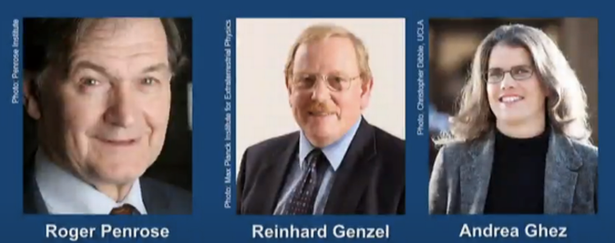
The Nobel Prize in Physics 2020
The Nobel Prize in Physics 2020 was divided, one half awarded to Roger Penrose "for the discovery that black hole formation is a robust prediction of the general theory of relativity", the other half jointly to Reinhard Genzel and Andrea Ghez "for the discovery of a supermassive compact object at the centre of our galaxy.”
- The Nobel Prize Committee

Slide 60

European Southern Observatory at Chile

Slide 61

Very Large Telescope (VLT) of European Southern Observatory : Optical

Slide 62

Stars dancing around Black Hole Sagittarius A*
in our Galaxy
Photo taken by VLT (April 16, 2020)
30 years of images combined
Proves Einstein’s General Relativity correct once again !

Slide 63
Black Holes:
Predicted 100 years back, discovered now !

Slide 64
How do we extract information using Telescopes? : A Scientist’s Perspectives
Collection of raw data from telescopes
Noise reduction/ cleaning using Statistical techniques
Extracting out scientific data
Analysis of scientific data using Statistics and Computer Programming
Estimation of error in the analysis
Scientifically drawing/mapping the image with high precision
Interpretation of data in terms of parameters
Explaining the data using Physics and Simulations

Slide 65
Future Missions
CMB-S4 : Cosmic Microwave Background
LiteBIRD
COrE
QUaD
CMBBharat…
JWST : Hubble Parameter
EUCLID : Large Scale Structure
Gaia…
SKA : 21 cm
eLISA : Gravitational Waves
Einstein Telescope….
Vera Rubin Observatory
Thirty Meter Telescope…

Slide 66


SKA: Square Kilometer Array in the making…
14 members countries, including India
Left: SA, Right: Australia, HQ: UK
1

Slide 67


Vera Rubin Observatory
&
Thirty Meter Telescope

Slide 68


Slide 69
Want to make it your career?
Be passionate
Be very passionate…..
Be very very passionate…………
BSc Physics/Mathematics with Computer Science/BTech
MSc Physics/Applied Mathematics/Astrophysics
MSc Specialization in Astrophysics/Cosmology
PhD & Post-doctorate in Astrophysics/Cosmology

Slide 70

“Yonder a maid and her wight
Come whispering by:
War’s annals will cloud into night
Ere their story die.”
- In Time of 'The Breaking of Nations’: Thomas Hardy

