Slide 1
Long Road to
Black Holes :
From Mystery to Reality
Supratik Pal
Indian Statistical Institute, Kolkata

Slide 2
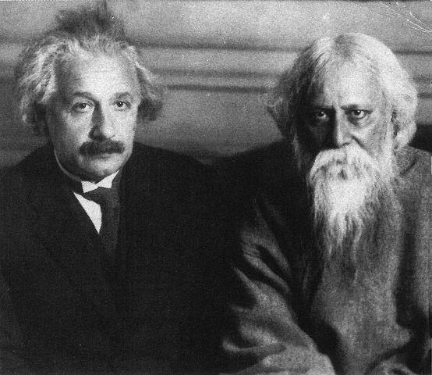
A tribute to….

Slide 3
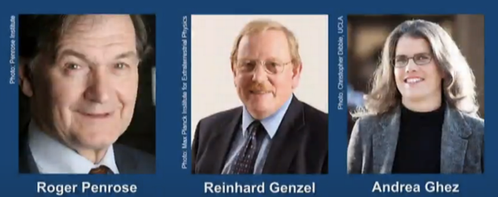
The Nobel Prize in Physics 2020
The Nobel Prize in Physics 2020 was divided, one half awarded to Roger Penrose "for the discovery that black hole formation is a robust prediction of the general theory of relativity", the other half jointly to Reinhard Genzel and Andrea Ghez "for the discovery of a supermassive compact object at the centre of our galaxy.”
- The Nobel Prize Committee

Slide 4
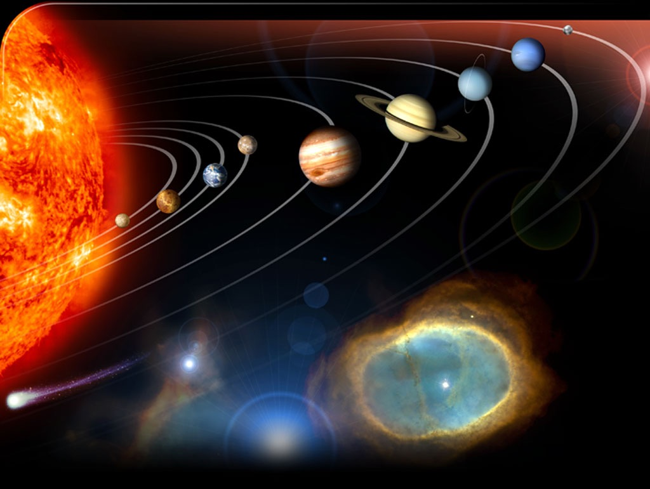

Slide 5
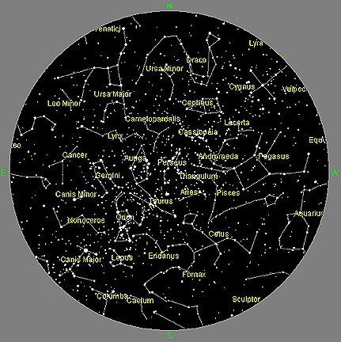
Night sky with naked eye

Slide 6
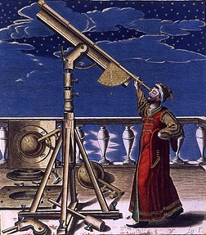
Beyond naked eye: Telescopes

Slide 7
Different types of Telescopes
Based on wavelength Based on location
Optical Ground-based
Soft X-ray Under-ground
Hard X-ray Space-based…
Infrared
Radiowave (Microwave)…

Slide 8
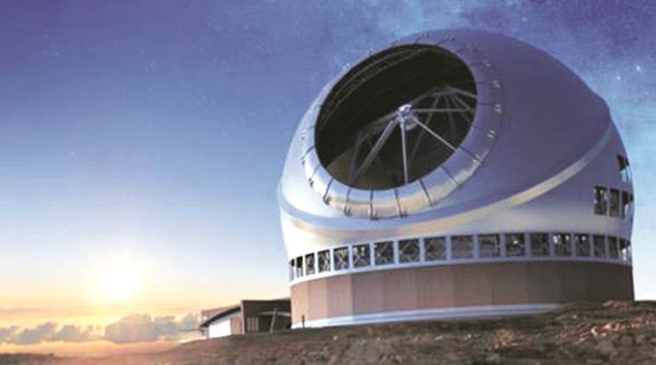
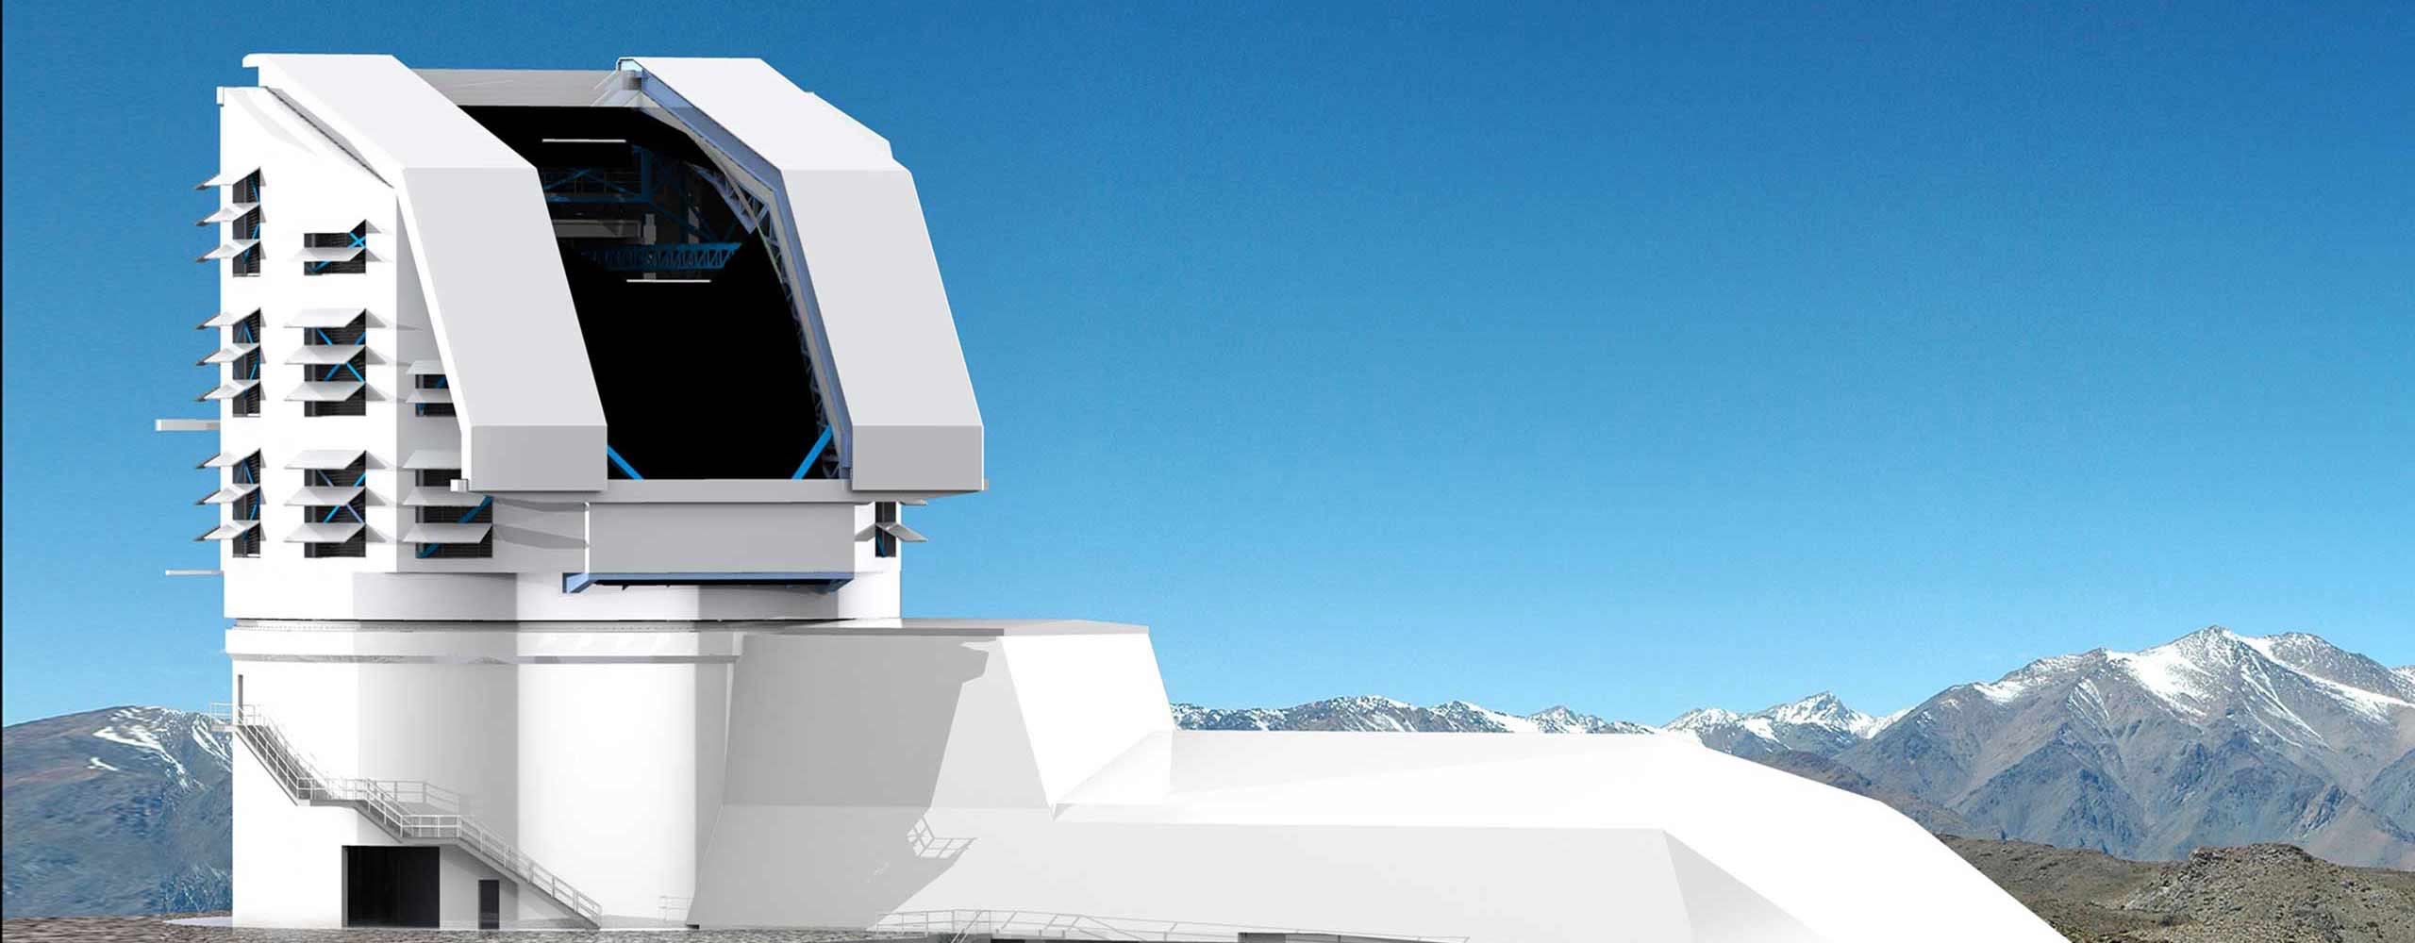
Example: Ground-based:
Vera Rubin Observatory & Thirty Meter Telescope

Slide 9
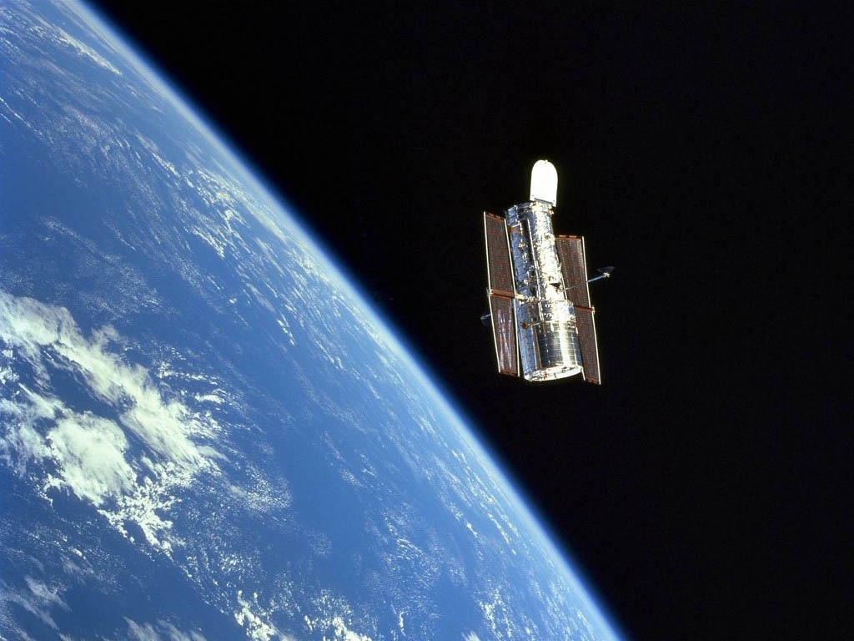
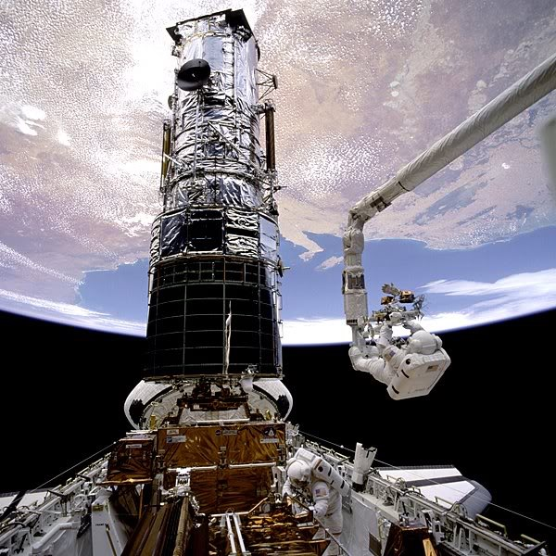
Example: Space-based: Hubble Space Telescope

Slide 10
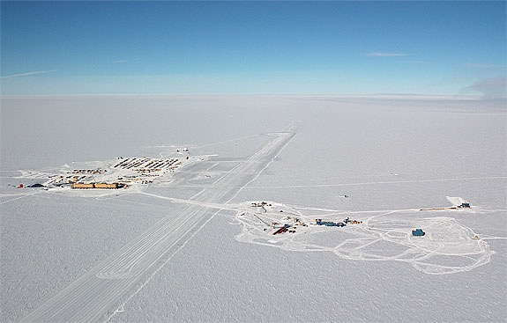
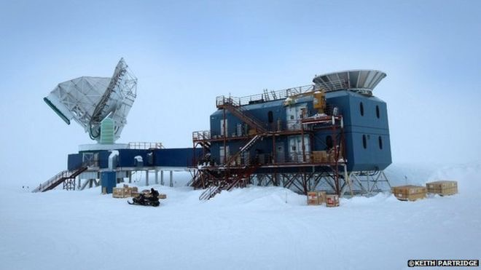
Example: Under-ground: South Pole Telescope

Slide 11
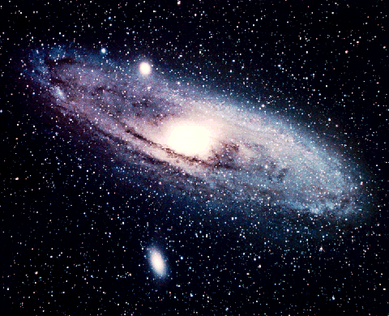
Our Galaxy : Milky Way

Slide 12
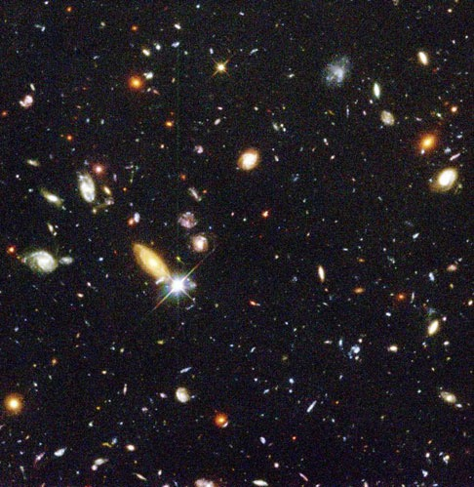
Our Galaxy is one among Millions

Slide 13
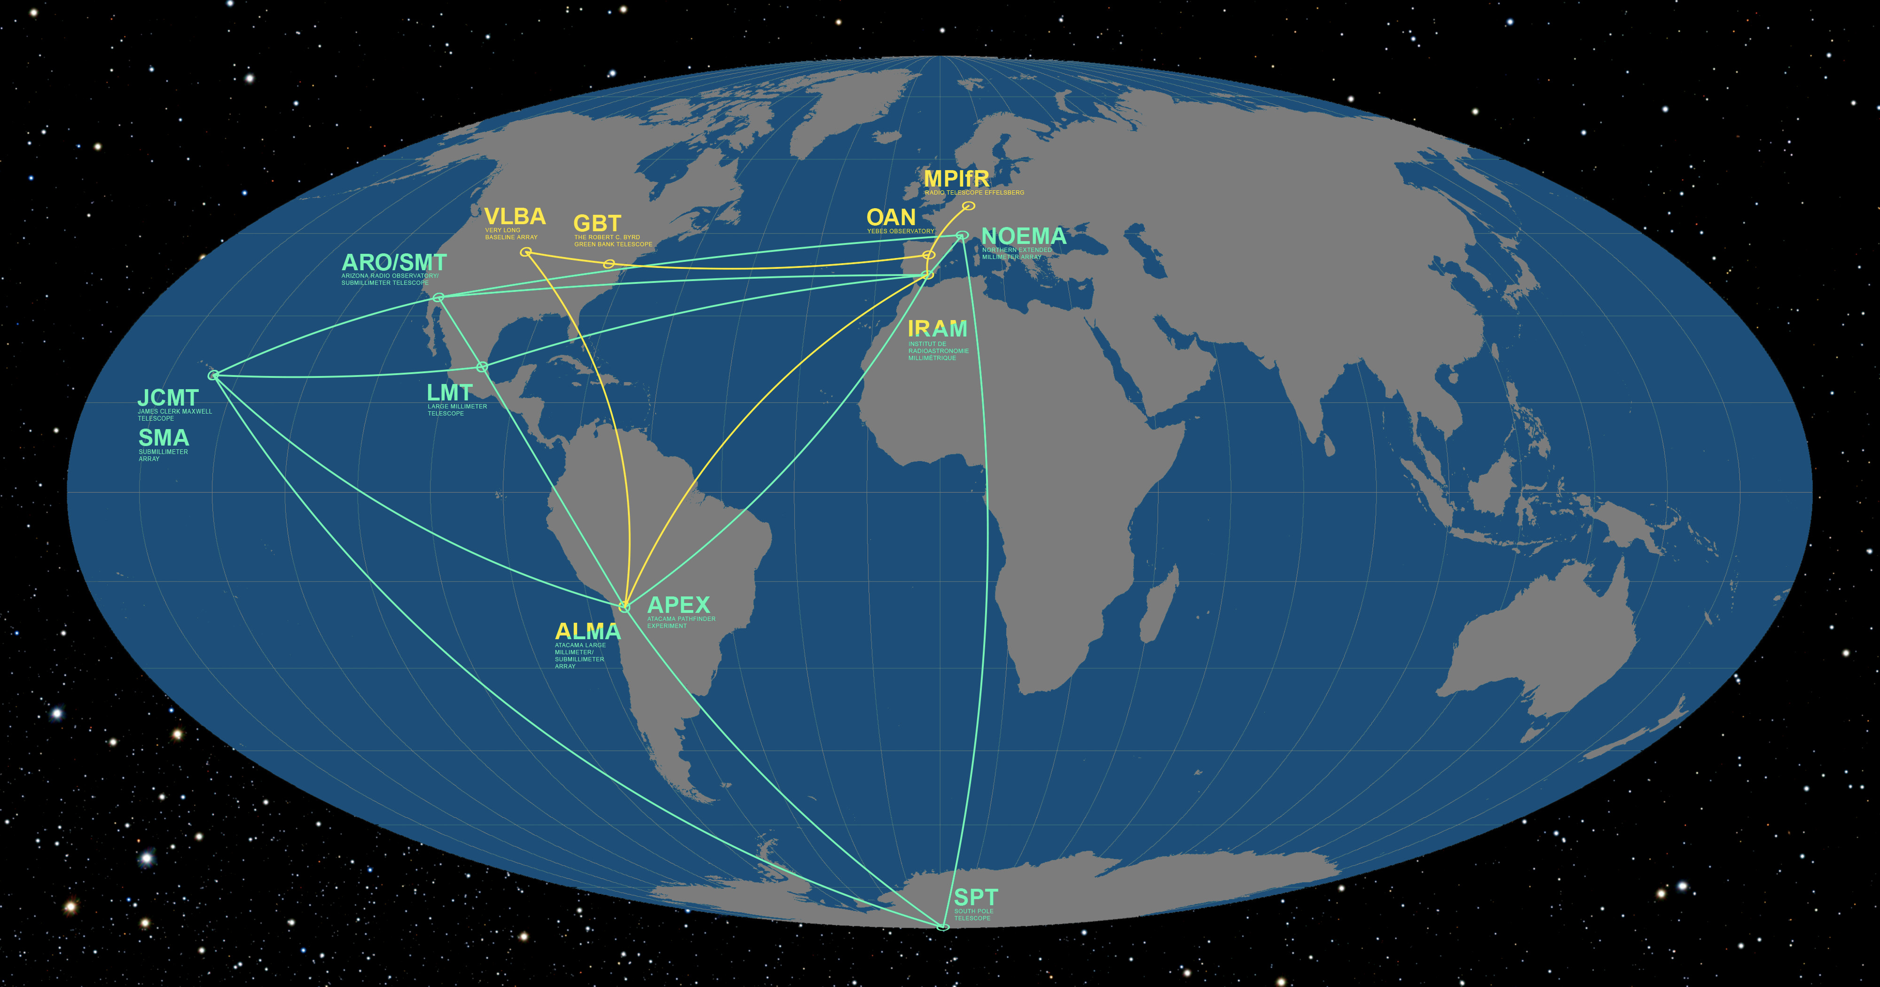
Event Horizon Telescope (EHT): 11 radio telescopes around the world, combined

Slide 14
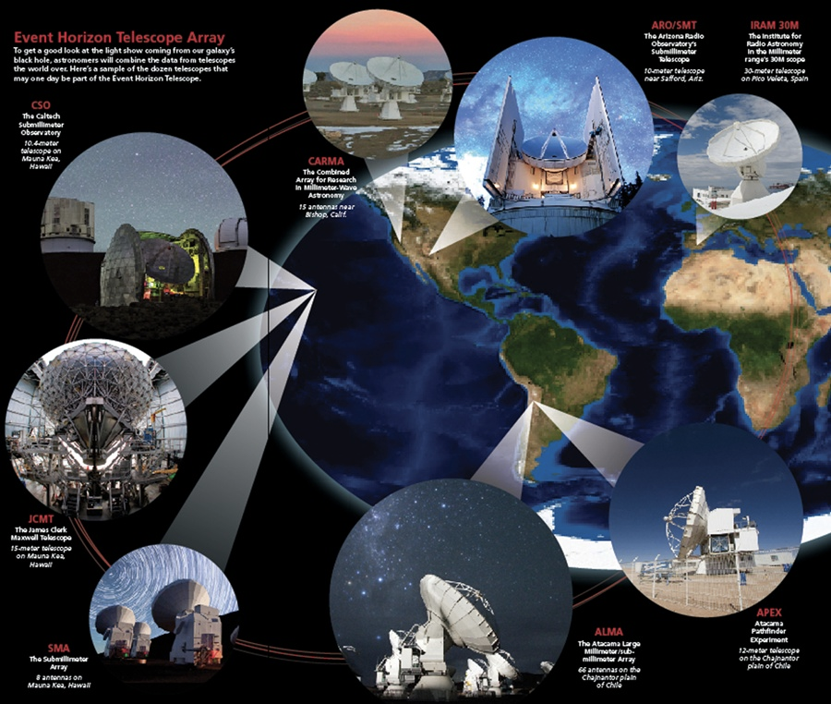

Slide 15
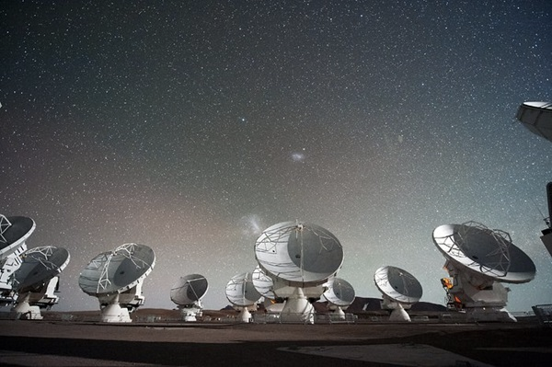
EHT : Each one is a collection of disk antennas

Slide 16
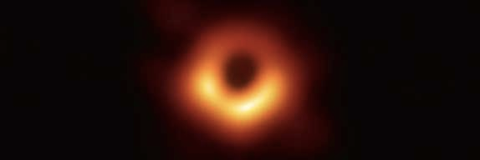
First ever image (shadow) of outside the Black Hole found in Messier 87 Galaxy
Image released by EHT (April 10, 2019)
Shows just outside the black hole, called Event Horizon

Slide 17
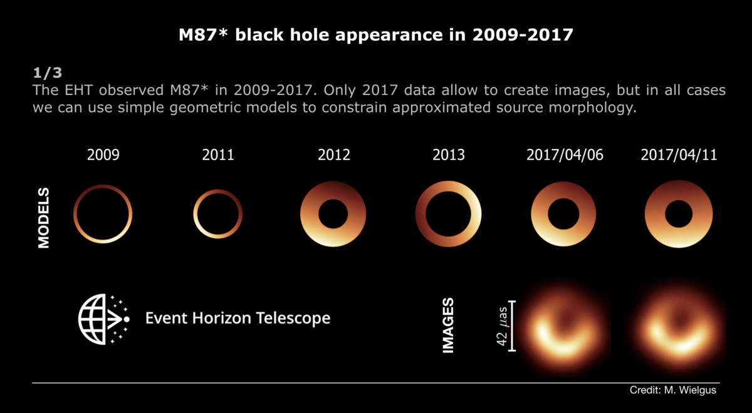
Black Hole at the centre of Messier 87 : Images taken over a few years

Slide 18
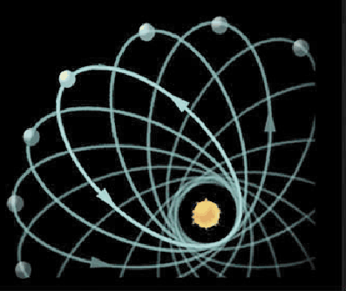

History and Mystery of Black Holes…
1915 : Einstein proposed General Theory of Relativity
Explained : Paths of planets around the sun are not elliptical

Slide 19
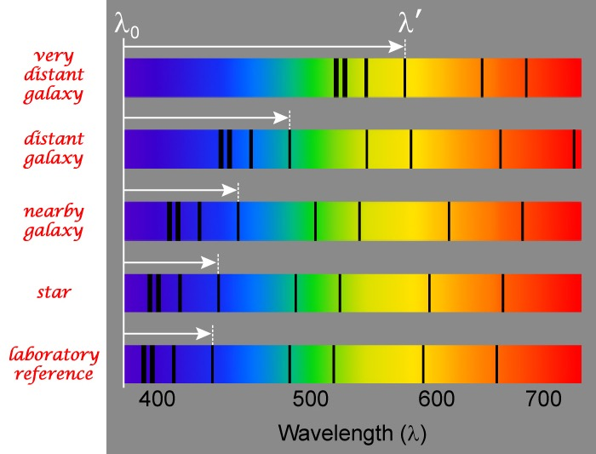
History and Mystery of Black Holes…
Predicted : Objects further away will look more red !
Found experimentally in 1925

Slide 20
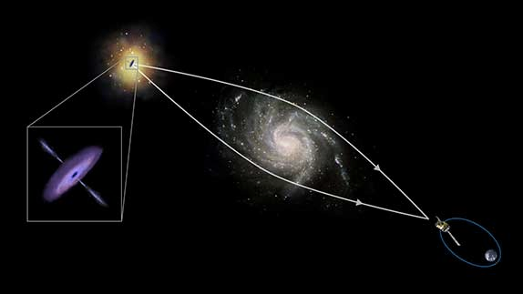
History and Mystery of Black Holes…
Predicted : Light ray can be bent by gravitation !
Stars, galaxies etc act as lenses
Stronger the gravitation, more is the amount of bending
Found experimentally in 1919

Slide 21
History and Mystery of Black Holes…
1916 : Karl Schwarzschild proposed there can be objects with huge mass and very tiny size
They have very strong gravitation
Hence can trap light and “eat up” everything, so cannot be “seen”
1926 : Eddington, Finkelstein and Kruskal explained mathematically why this can happen
1931 : Young Indian S. Chandrasekhar proved these objects should be at least 1.4 times heavier than the Sun
1939 : Tolman, Oppenheimer and Volkoff explained their existence from Gravitational Collapse
1958 : Victor Ambratsumian argued centre of galaxies must be made of huge mass: Active Galactic Nuclei (AGN)

Slide 22
History and Mystery of Black Holes…
1965 : Roger Penrose explained how Black holes are formed by proposing singularity theorem (Penrose Diagrams)
1967 : John Wheeler named these objects Black Holes
1967-71 : Werner Israel, Brandon Carter showed black holes have only mass, charge & spin. Wheeler/Bekenstein coined “No hair theorem (conjecture)”
1969 : Donald Lynden-Bell proposed every galaxy contains a supermassive black hole at its centre as AGN
1970 : Hawking and Penrose gave a more concrete singularity theorem
1974 : Hawking and Bekenstein showed Black hole radiation
1983 : S. Chandrasekhar was awarded Nobel prize for this
Experimental searches began…

Slide 23
Back to our Galaxy: Milky way

Slide 24
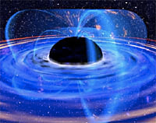
Black Hole at the centre of Galaxy :
Artist’s impression long back

Slide 25
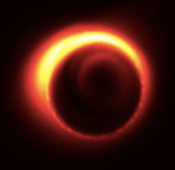
Sagittarius A* Black Hole at the centre of our Galaxy: Real image (shadow) in radio eye
Found by Event Horizon Telescope (April 10, 2019)
4 million times heavier than the Sun

Slide 26
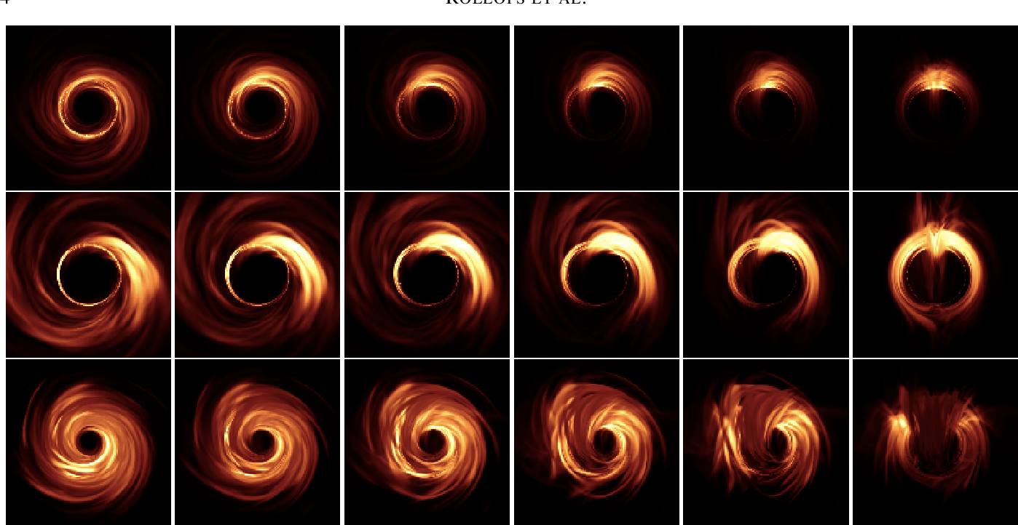
Sagittarius A* : Images taken over a few years

Slide 27
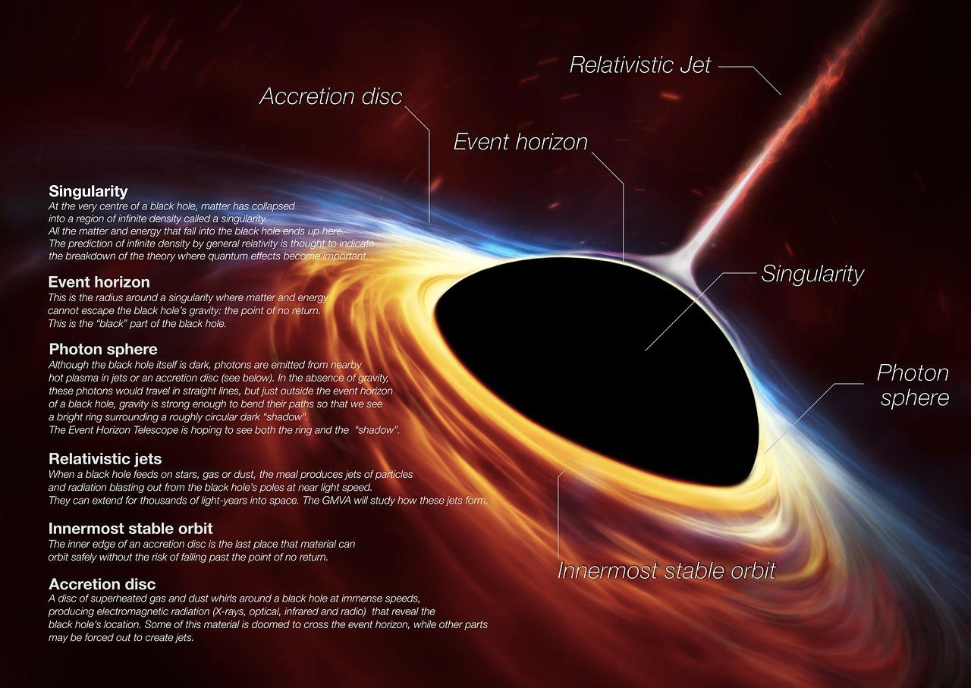
So, how does it all happen?

Slide 28
The Nobel Prize in Physics 2020
… the other half jointly to Reinhard Genzel and Andrea Ghez "for the discovery of a supermassive compact object at the centre of our galaxy."

Slide 29
How do we extract information using Telescopes? : A Scientist’s Perspectives
Collection of raw data from telescopes
Noise reduction/ cleaning using Statistical techniques
Extracting out scientific data
Analysis of scientific data using Statistics and Computer Programming
Estimation of error in the analysis
Scientifically drawing/mapping the image with high precision
Interpretation of data in terms of parameters
Explaining the data using Physics and Simulations

Slide 30
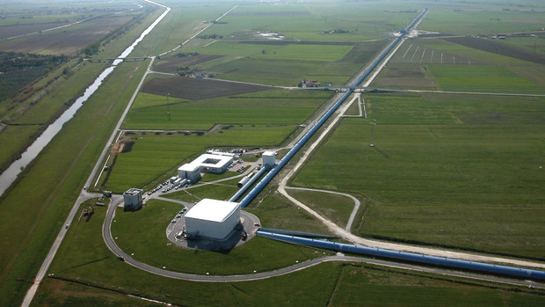
Did we find evidence of Black Holes earlier? : Gravitational Waves in LIGO

Slide 31
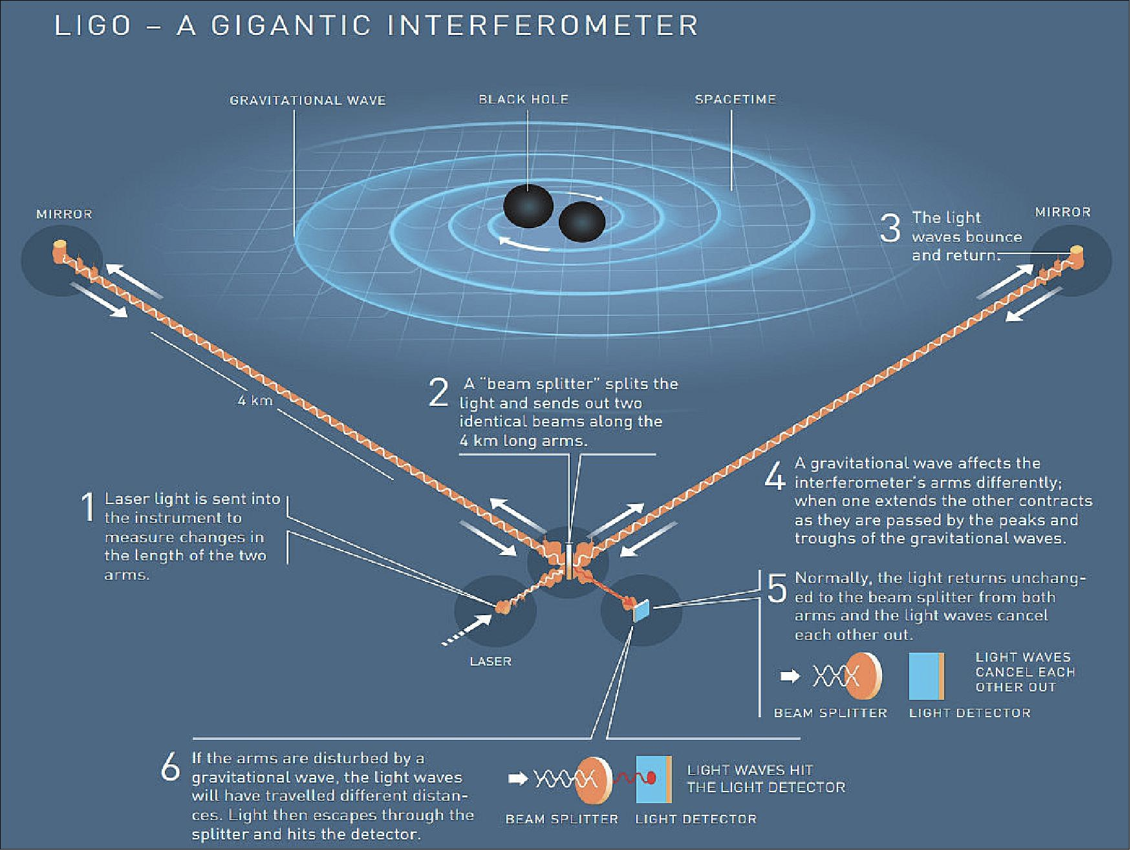

Slide 32
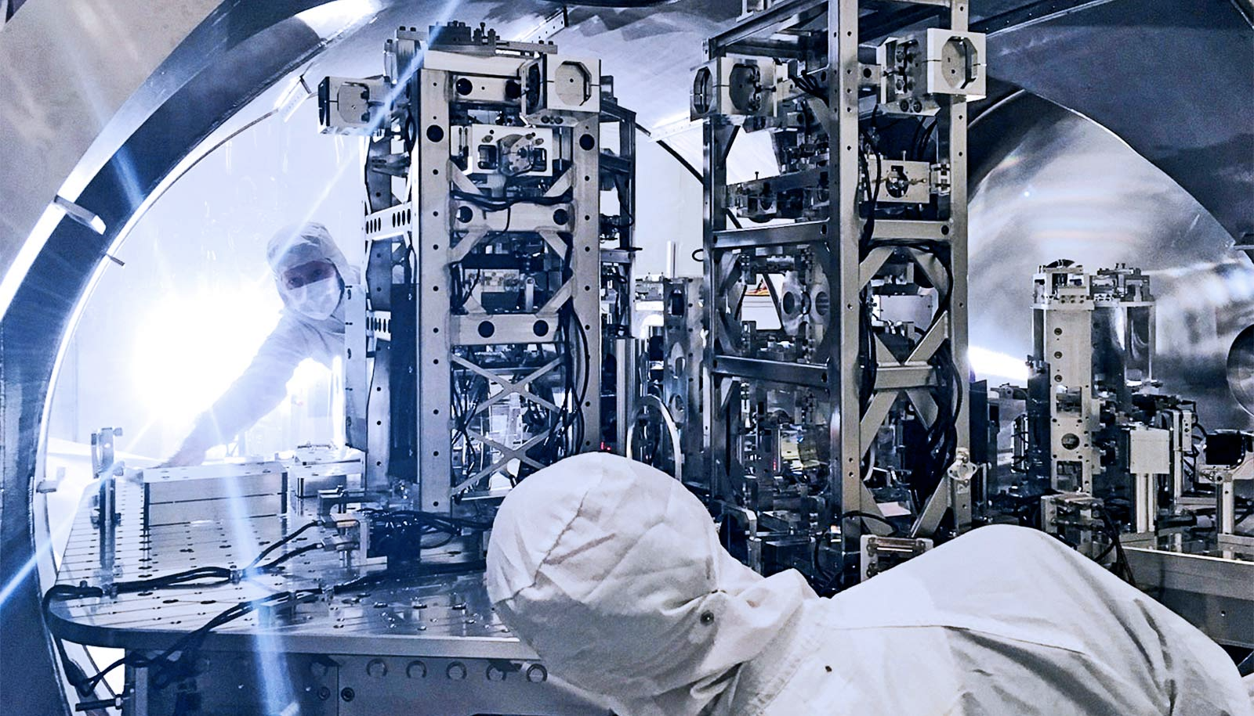

Slide 33
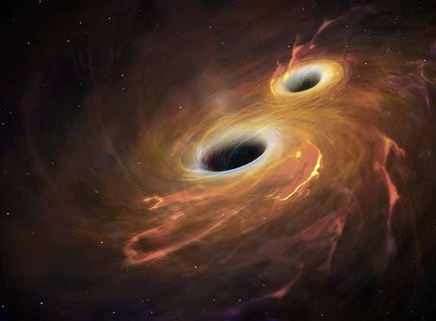
LIGO found Gravitational Waves from binary Black Hole merger (Sept 14, 2015)

Slide 34
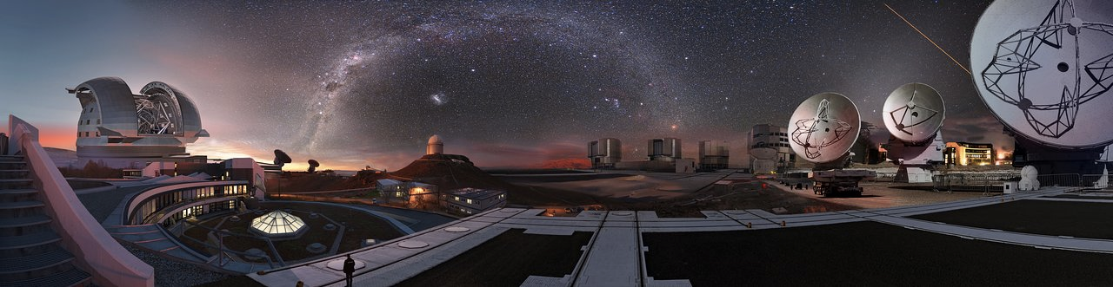
European Southern Observatory at Chile

Slide 35
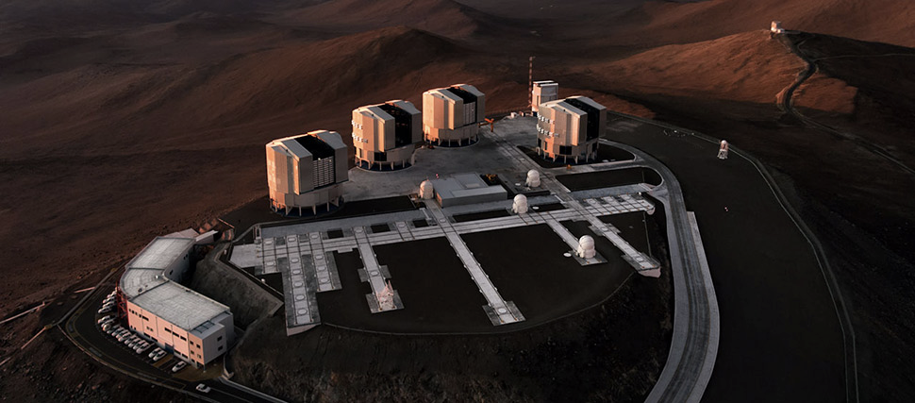
Very Large Telescope (VLT) of European Southern Observatory : Optical

Slide 36
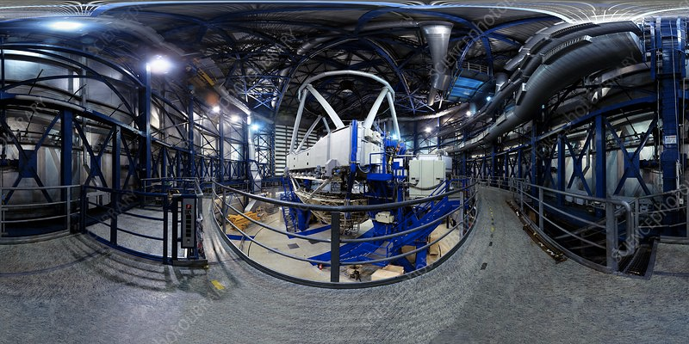

Slide 37
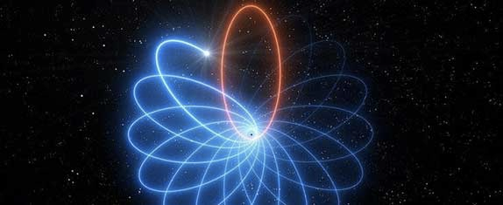
Stars dancing around Black Hole Sagittarius A*
in our Galaxy
Photo taken by VLT (April 16, 2020)
30 years of images combined
Proves Einstein’s General Relativity correct once again !

Slide 38
Back to the Nobel Prize in Physics 2020
…. one half awarded to Roger Penrose "for the discovery that black hole formation is a robust prediction of the general theory of relativity”….

Slide 39
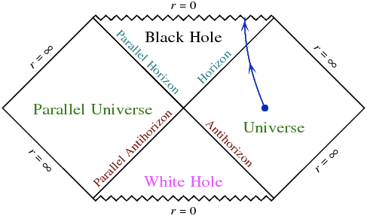
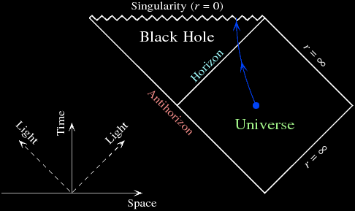
Penrose’s explanation for Black Hole formation

Slide 40
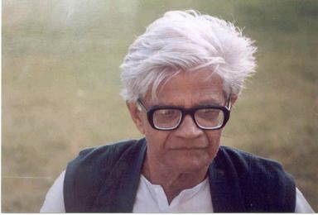
Amal Kumar Raychaudhuri… Raychaudhuri Equation… Penrose-Hawking singularity theorem…

Slide 41
Amal Kumar Raychaudhuri… Raychaudhuri Equation… Penrose-Hawking singularity theorem…
1942 : BSc, Presidency College
1944 : MSc, Calcutta University
1945 : Joined as a Research Scholar at IACS
1952 : Took up an experimental research job at IACS
Unhappy, started working on General Relativity on his own
1955 : Published paper explaining how the paths of objects will move apart and will meet at a point based on GR
This work got enormous praise from Wheeler, Jordon etc
1959 : Received PhD, Calcutta University
1961 : Joined Presidency College as a Physics Professor
1965 : Ellis and Hawking named “Raychaudhuri Equation”
Key ingredient in Penrose-Hawking singularity theorem and also in the explanation of expanding Universe

Slide 42
Black Holes:
Predicted 100 years back, discovered now !

Slide 43
Want to make it your career?
Be passionate
Be very passionate…..
Be very very passionate…………
BSc Physics/Mathematics with Computer Science
MSc Physics/Applied Mathematics/Astrophysics
MSc Specialization in Astrophysics/Cosmology
PhD & Post-doctorate in Astrophysics/Cosmology

Slide 44
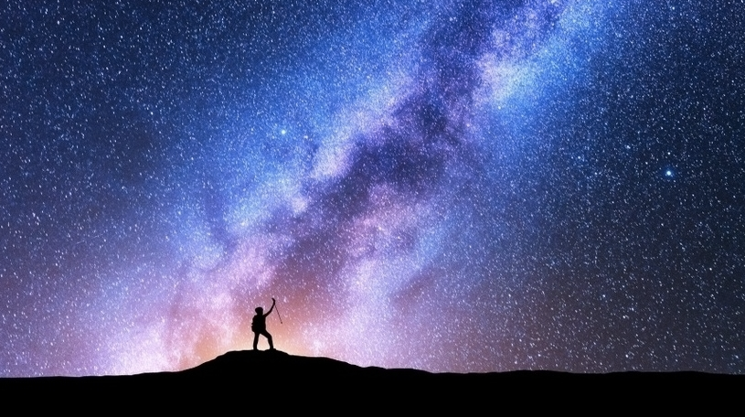
“There are more things in heaven and earth, Horatio,
Than are dreamt of in your Philosophy.”
- Shakespeare: Hamlet

