Slide 1
DARK, DARKER, DARKEST;
AND SOME LIGHT
অন্ধকারের উৎস হতে
Supratik Pal
Indian Statistical Institute, Kolkata

Slide 2
The purpose of doing Science is not just to help you brew your morning coffee!

Slide 3


Slide 4
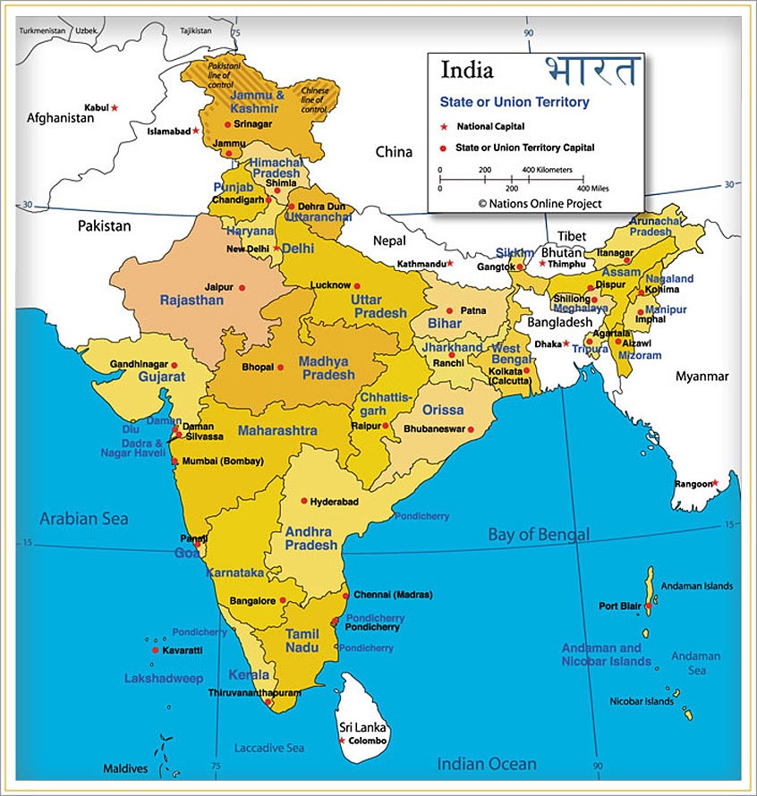

Slide 5


Slide 6
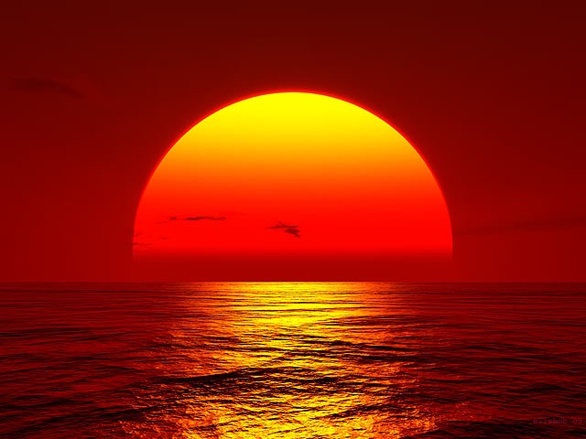
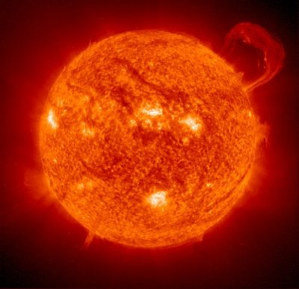

Slide 7
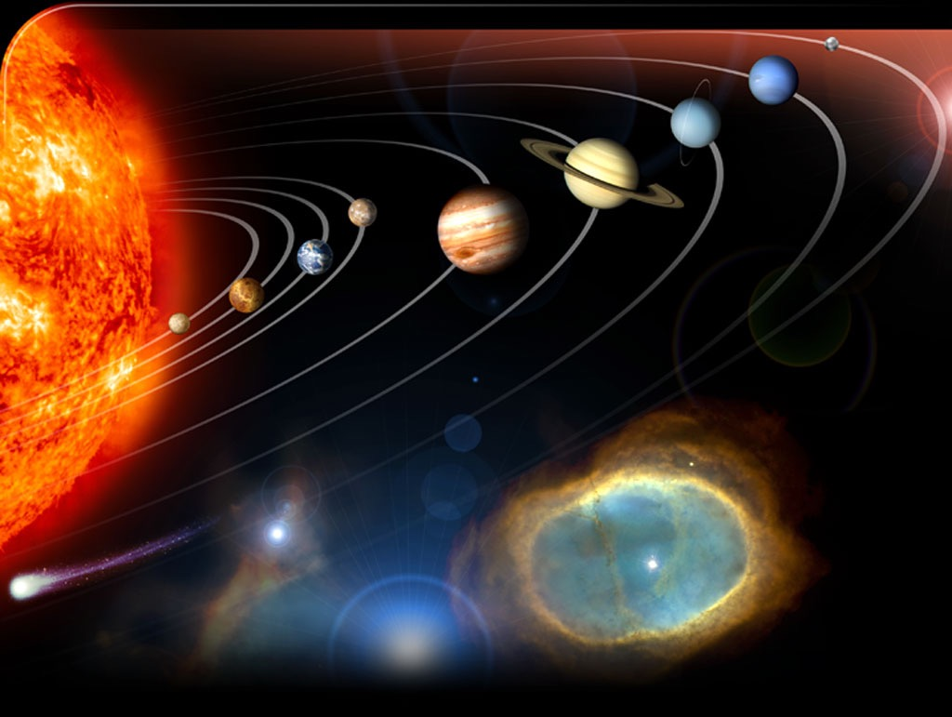

Slide 8
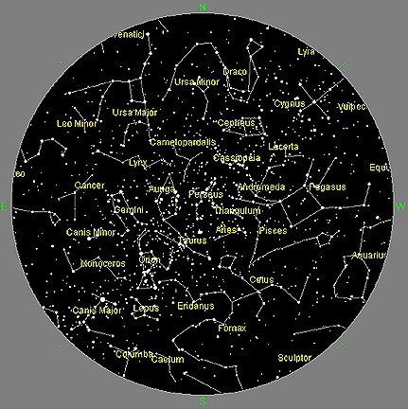
Night sky with naked eye

Slide 9
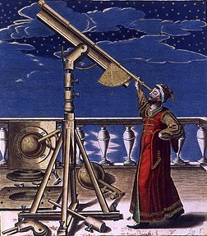
Beyond naked eye: Enter Telescopes

Slide 10
Dark…

Slide 11
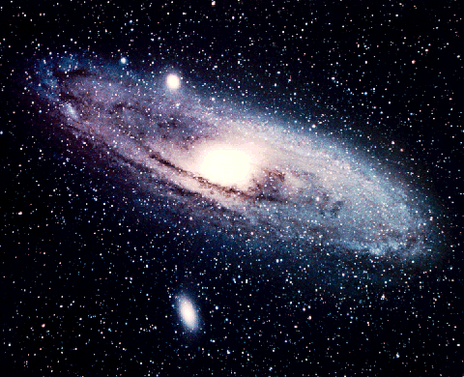
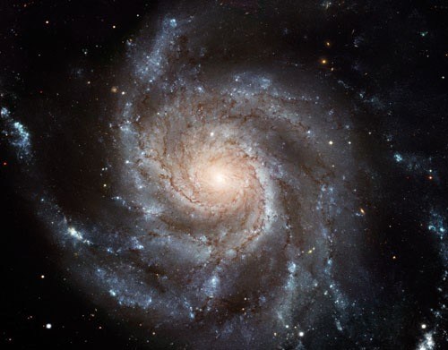
Our Galaxy
Milky Way

Slide 12
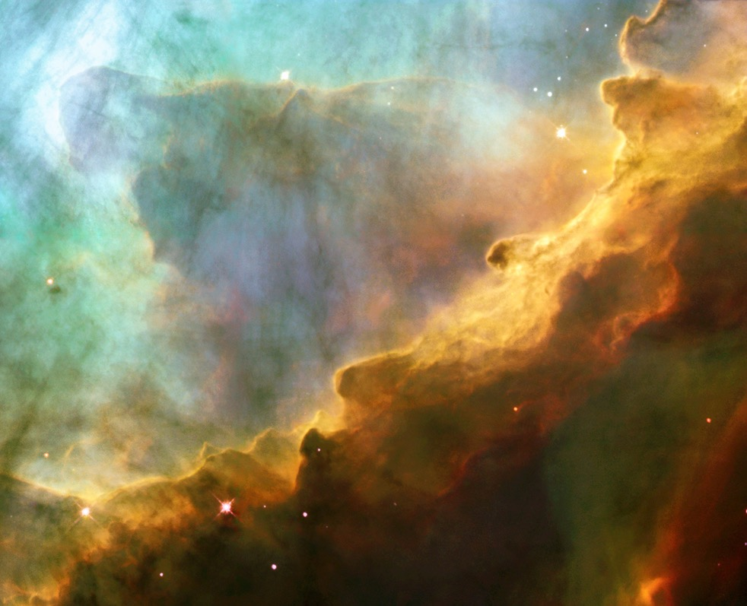
Cloud made of Hydrogen in the Galaxy

Slide 13
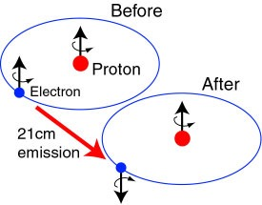

~80% of visible matter is Neutral Hydrogen
Neutral Hydrogen has singlet and triplet states
Spin flip (Hyperfine splitting)
Emits radiation with frequency 1420 MHz / wavelength 21 cm

Slide 14
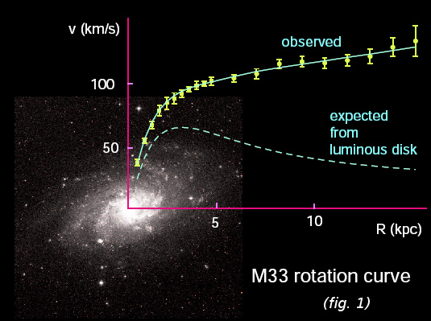
Measure rotational velocity

Slide 15
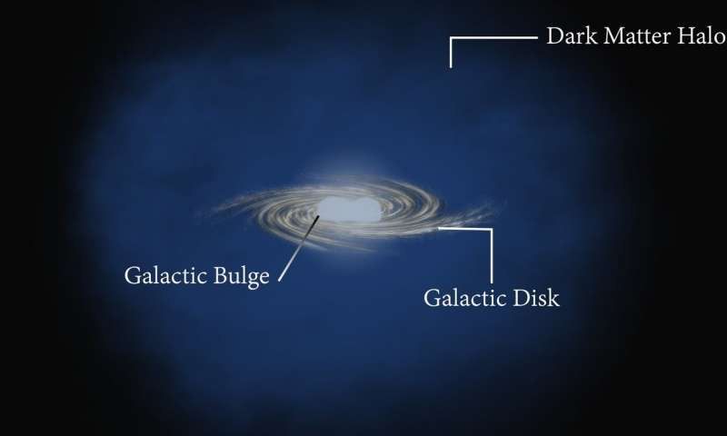
Even what we do not see also exists: Dark Matter!

Slide 16
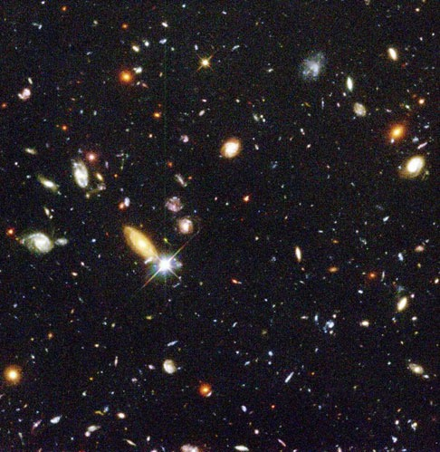
Our Galaxy is one among Millions: Clusters

Slide 17
How far are they?
Our Galaxy:
Milky way
Nearest Galaxy:
Andro-meda
2.5 million Light Years
= (300000 km/sec) X (2.5X1000000X365X24X60X60 sec)
= 20000000000000000000 kilo-meters !!!
Measure velocity dispersion, hence total mass of cluster
5 times mass of visible matter -> Dark Matter! (Zwicky, 1933)

Slide 18
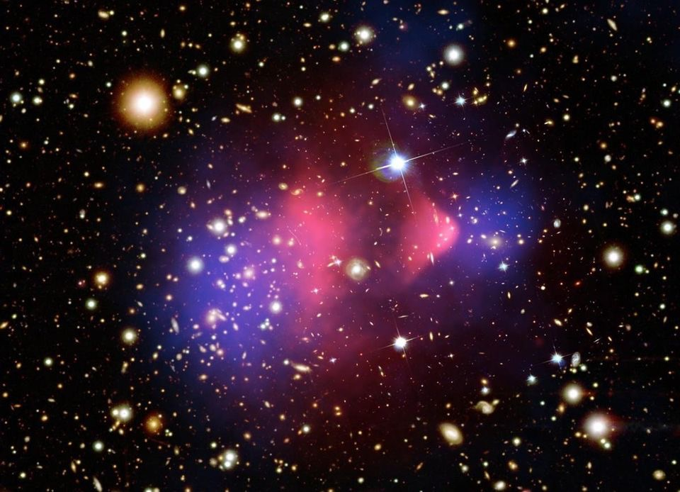
Collision in the sky: Bullet cluster

Slide 19
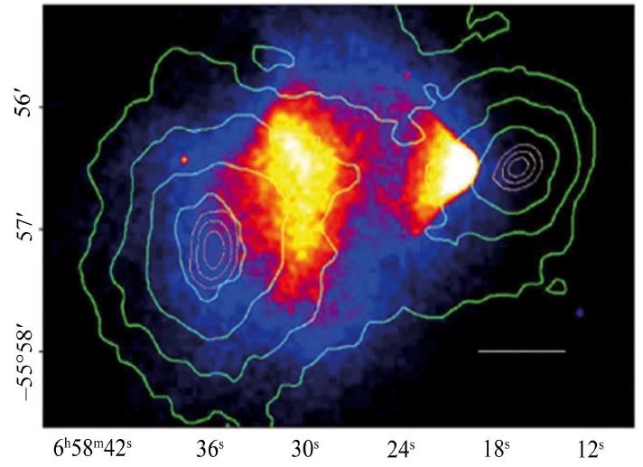
Dark matter and Luminous matter separate out!

Slide 20
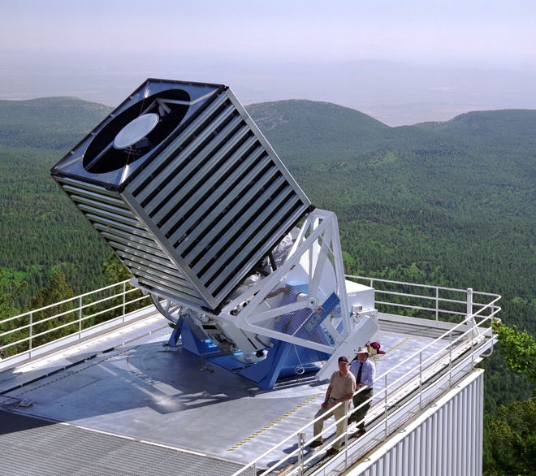
SDSS: Sloan Digital Sky Survey

Slide 21
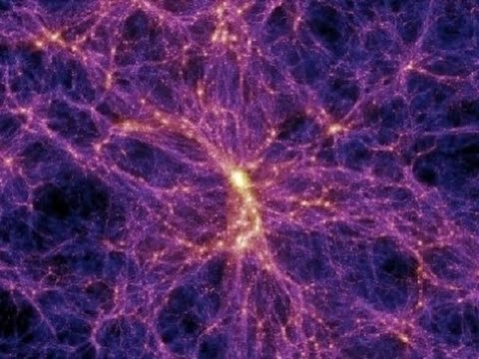
Large Scale Structure -> ~25% Dark Matter

Slide 22
Darker…

Slide 23
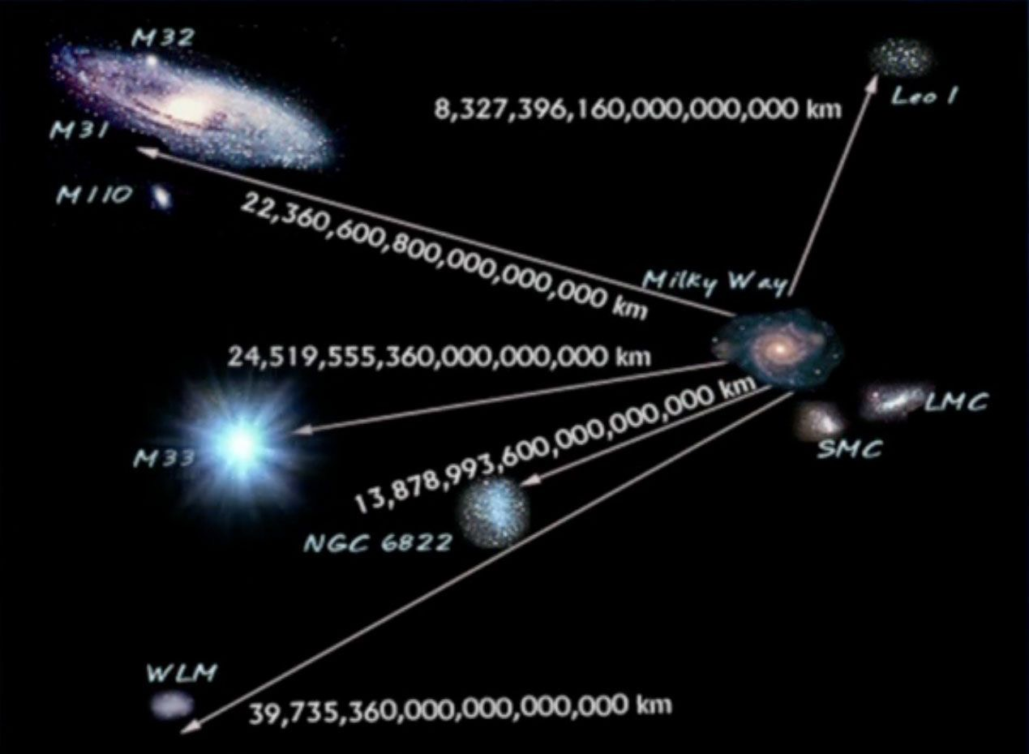
The grand old man of Observational Cosmology: Hubble (1929)

Slide 24
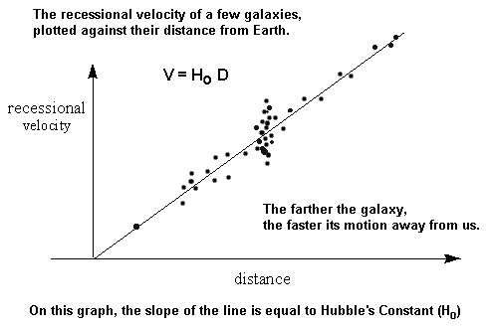
Farther the galaxy, greater is its velocity->
Galaxies are moving away from each other

Slide 25
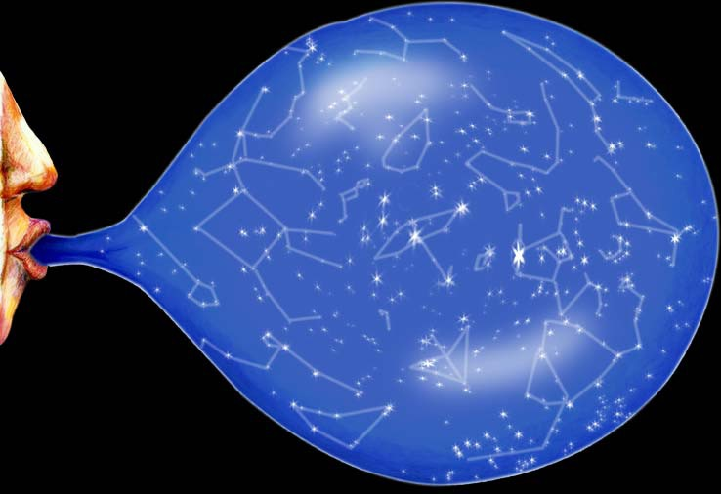
Our Universe is expanding!

Slide 26
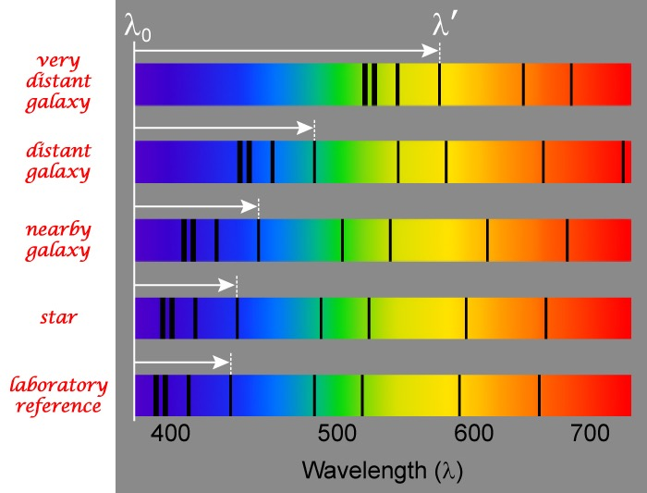
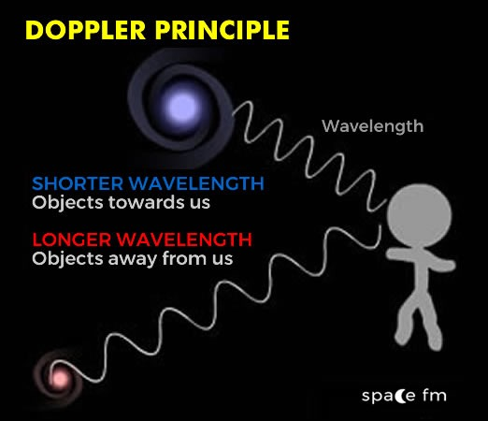
How do we measure? -> Redshift

Slide 27
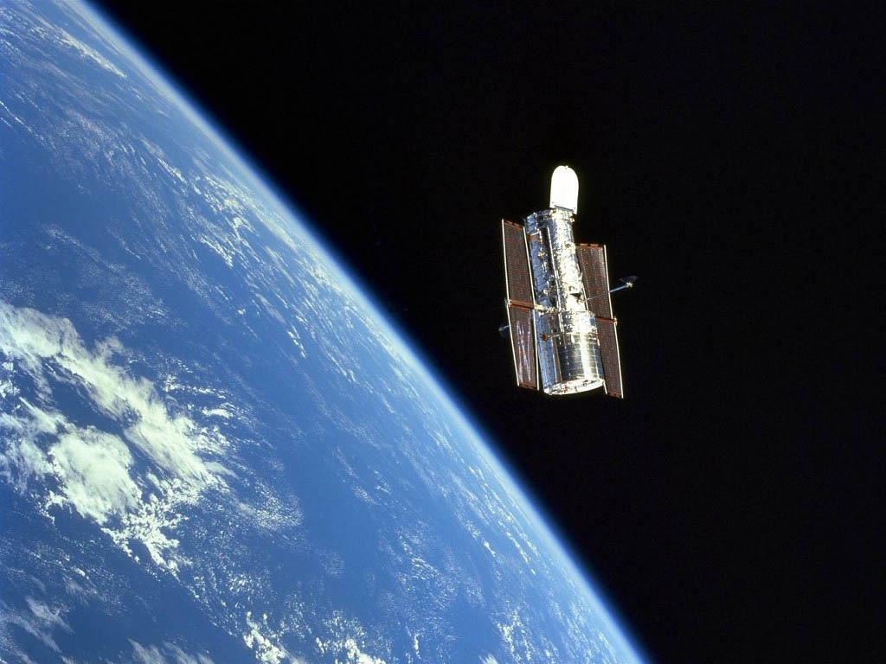
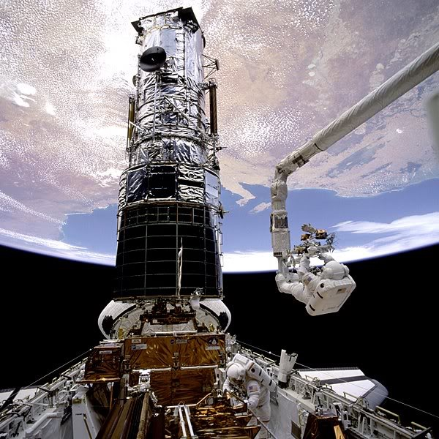
HST: Hubble Space Telescope

Slide 28
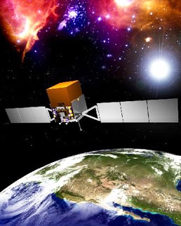
Enter Supernova Cosmology Project (1998)
W

Slide 29
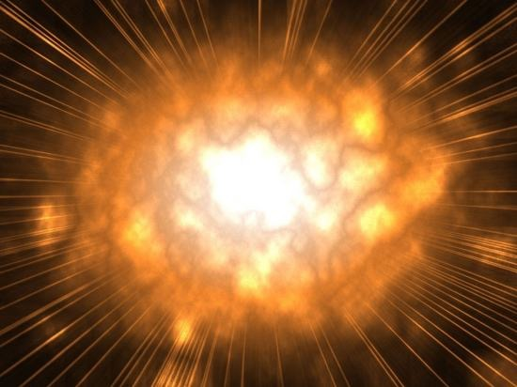
Death of a Star: Supernova Explosion

Slide 30
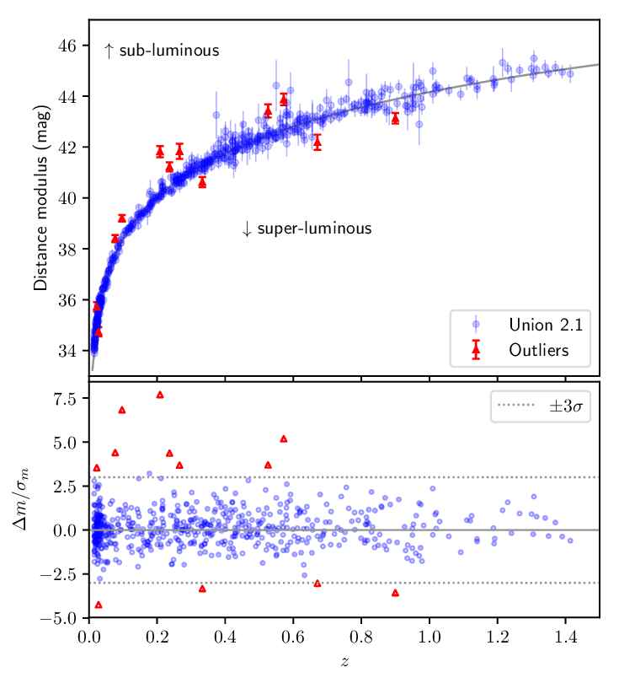
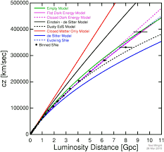
Supernovae Type Ia
(Redshift<1.5)

Slide 31
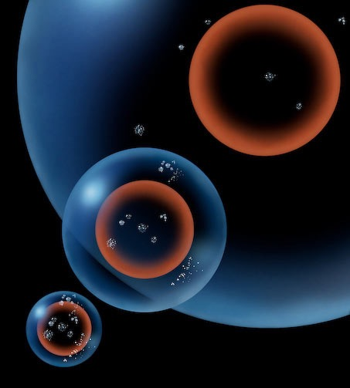
Universe is not only expanding but also accelerating!

Slide 32
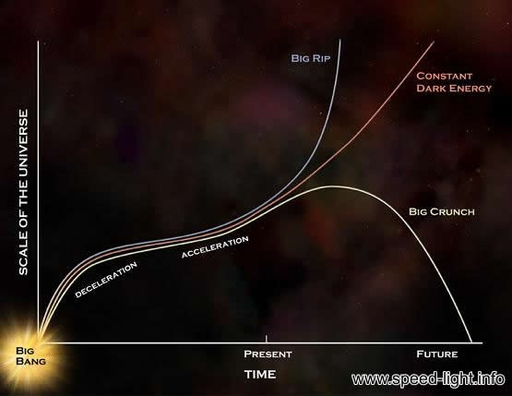
Require huge “anti-gravity” : Dark Energy!

Slide 33
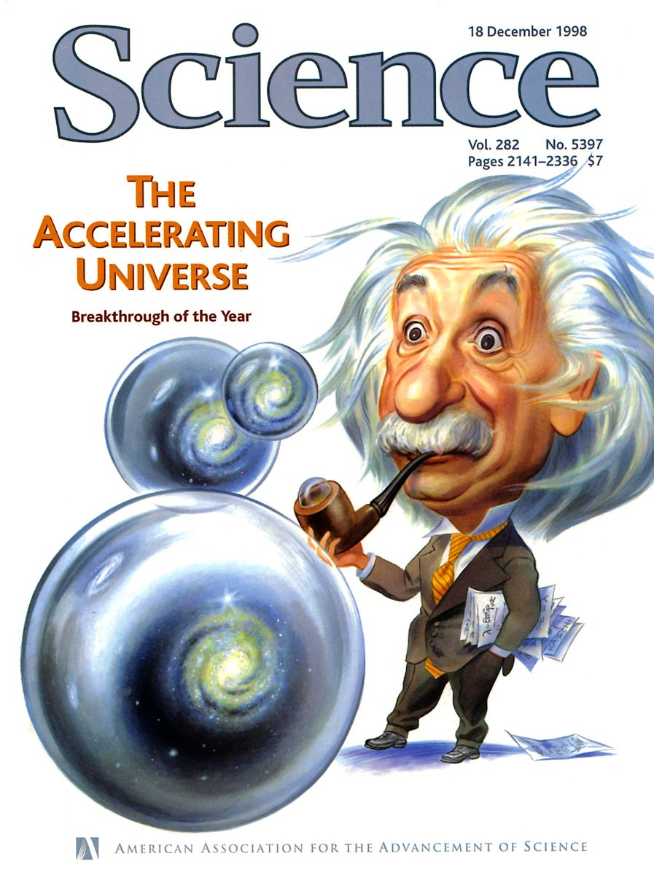

Slide 34
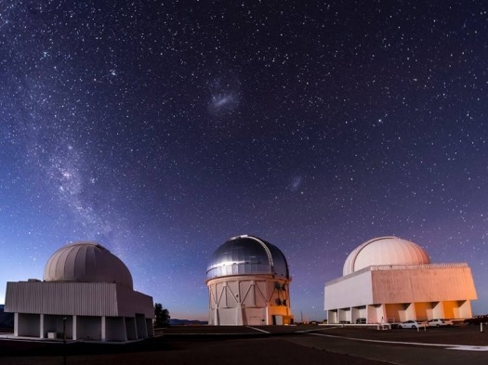
DES: Dark Energy Survey

Slide 35
Darkest…

Slide 36
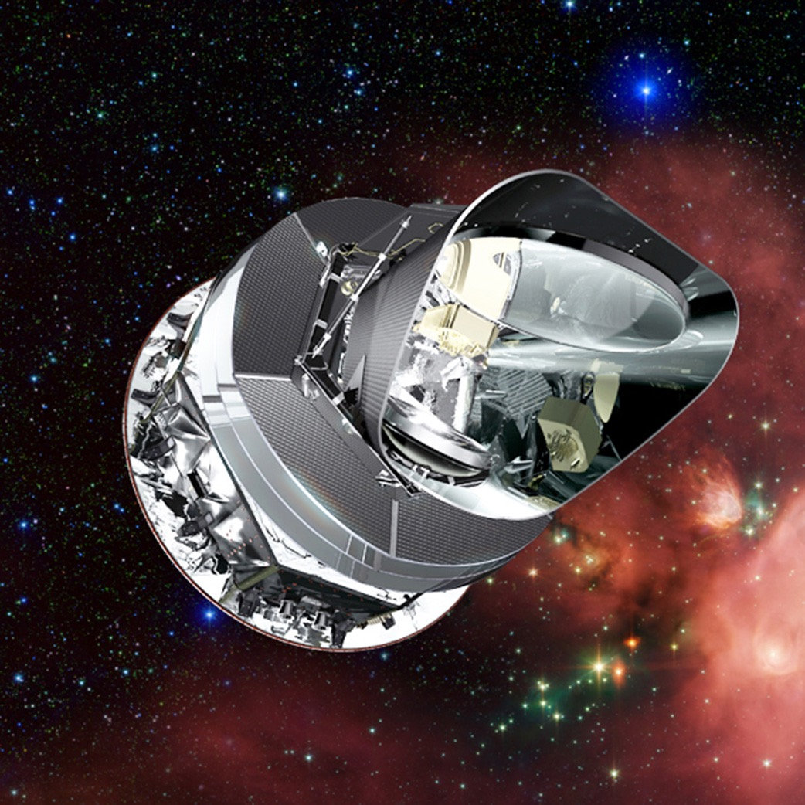
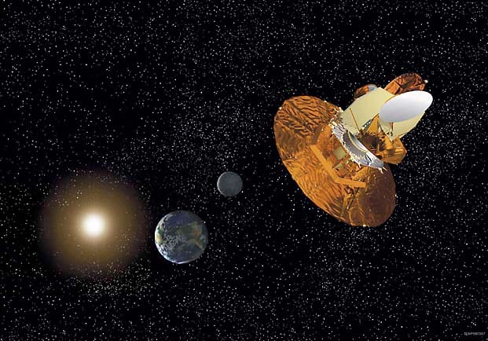
WMAP: Wilkinson Microwave Anisotropy Probe
and Planck (ESA)

Slide 37
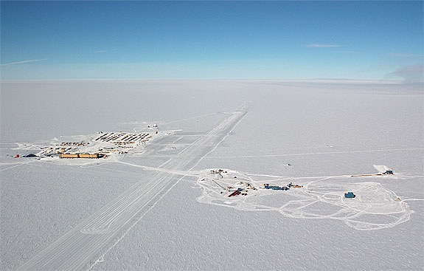
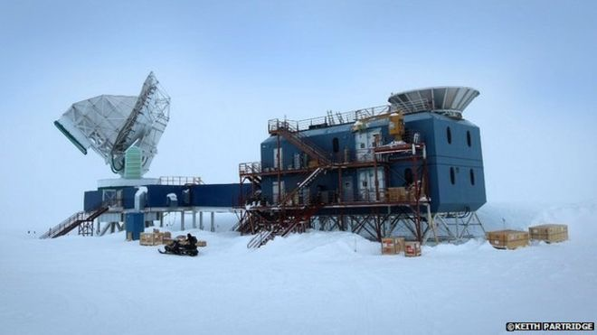
Under ground: South Pole Telescope

Slide 38
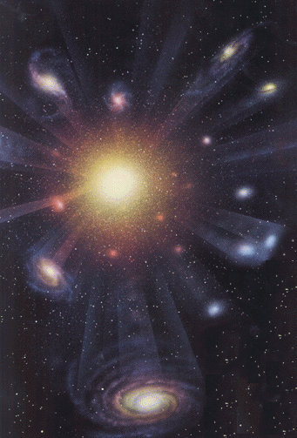
Happy Birthday to our Universe: 13800000000 Years Ago

Slide 39
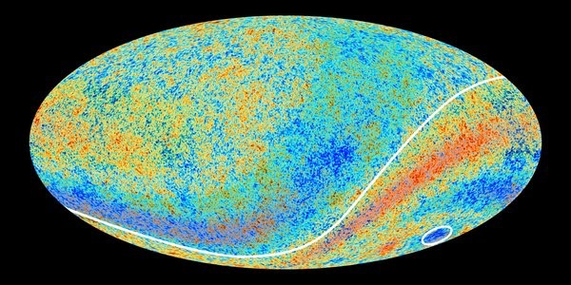
The First Sky: Cosmic Microwave Background
(Redshift=1100)

Slide 40
What do CMB observations tell us?
CMB Temperature is almost 2.725 Kelvin at all directions
Universe looked same everywhere at the beginning
Very tiny fluctuations in temperature of the order of 10 nano-Kelvin -- 200 micro-Kelvin
Everything in the universe originate from these tiny fluctuations

Slide 41
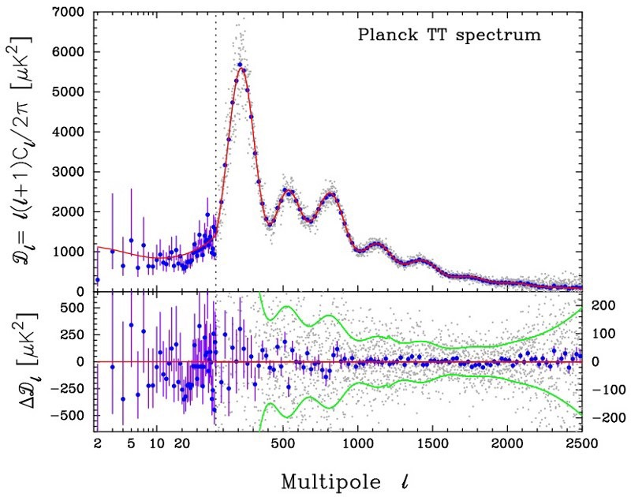
Height of first peak -> ~70% Dark Energy

Slide 42
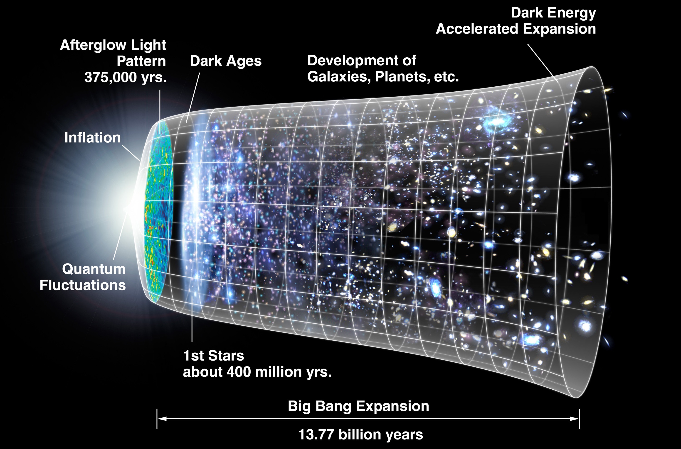
From CMB to today:
How did the Universe evolve?

Slide 43
SDSS: Sloan Digital Sky Survey

Slide 44
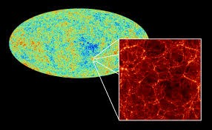
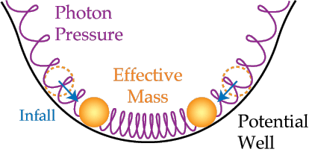
BOSS: Baryonic Acoustic Oscillation Spectroscopic Survey

Slide 45
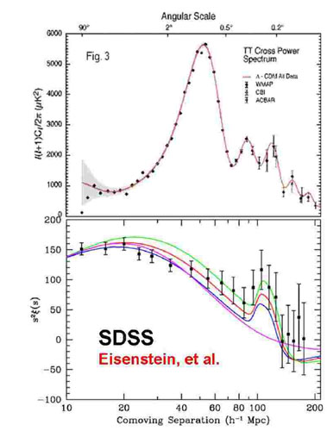
BAO data (Redshift<1) -> ~70% Dark Energy

Slide 46
HST: Hubble Space Telescope Revisited

Slide 47
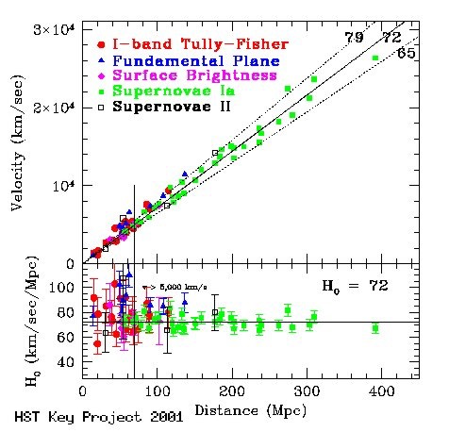
HST data -> ~70% Dark Energy

Slide 48
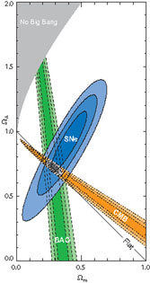
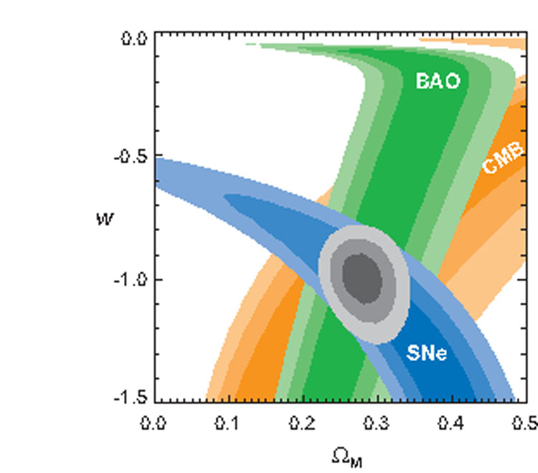
Together they stand…

Slide 49
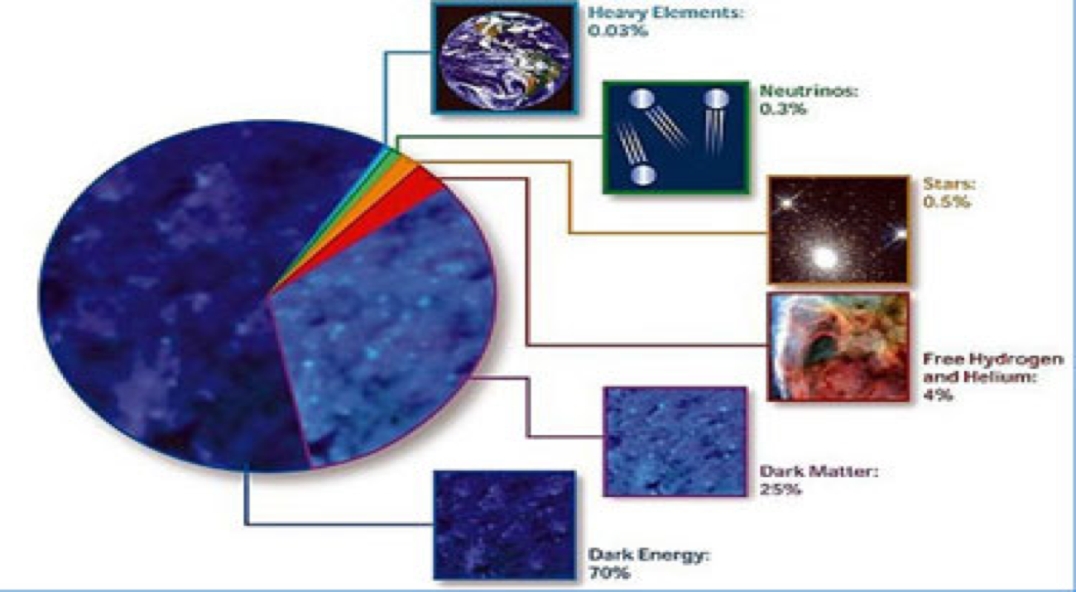
Cosmic Constituents: As of Now

Slide 50
So… What we know, what we don’t
Dark Matter must be there, ~25% of the Universe
Dark Energy must be there, ~70% of the Universe
We have not yet “seen” them directly
We do not know what they are made of
Mild tension among high redshift and low redshift datasets
We do not know much about intermediate redshift

Slide 51
Some Light…

Slide 52
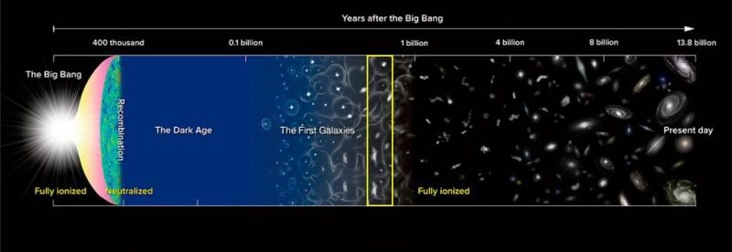
Clue: Probe intermediate redshift

Slide 53
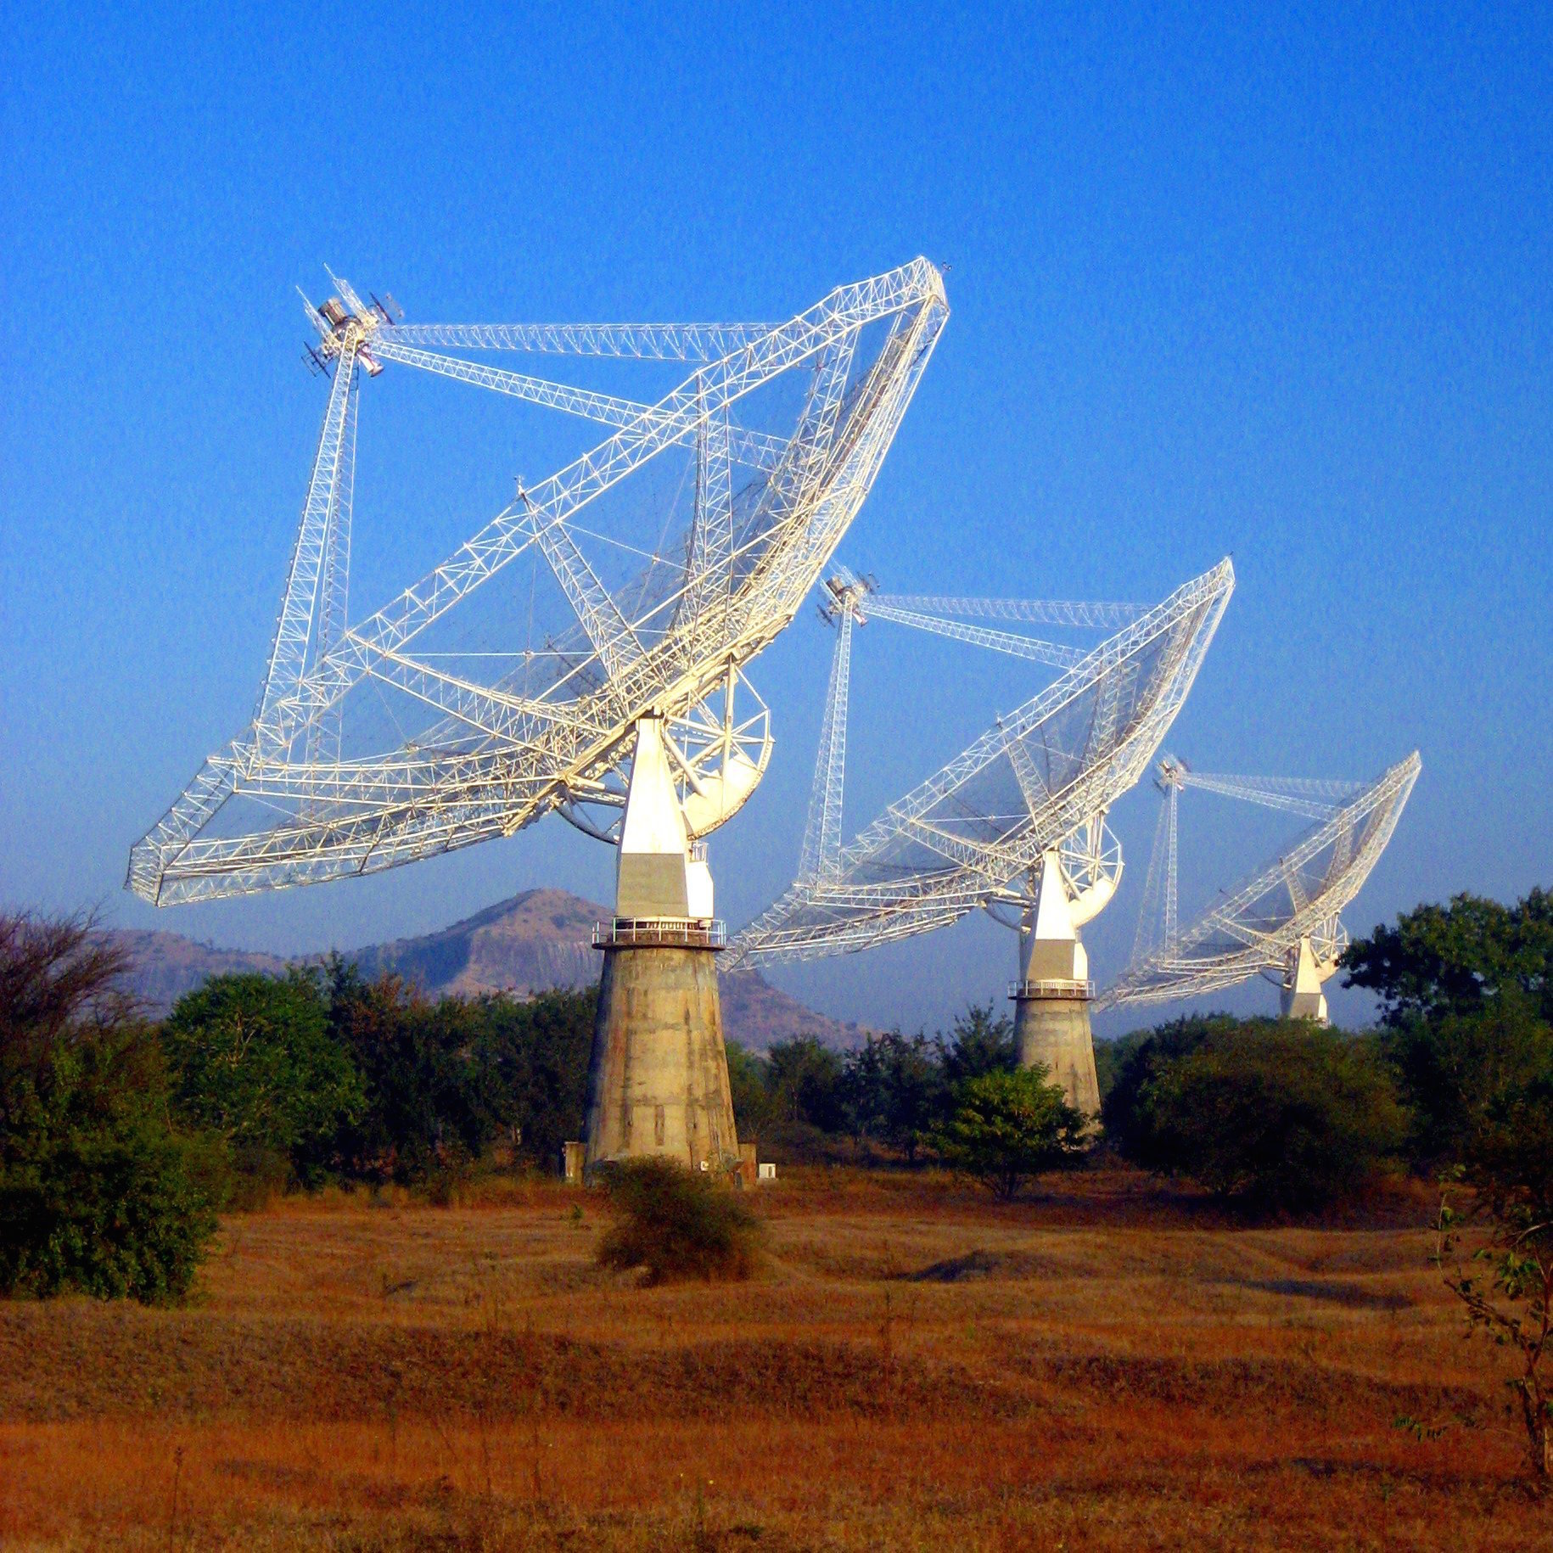
GMRT: Giant Meterwave Radio Telescope

Slide 54
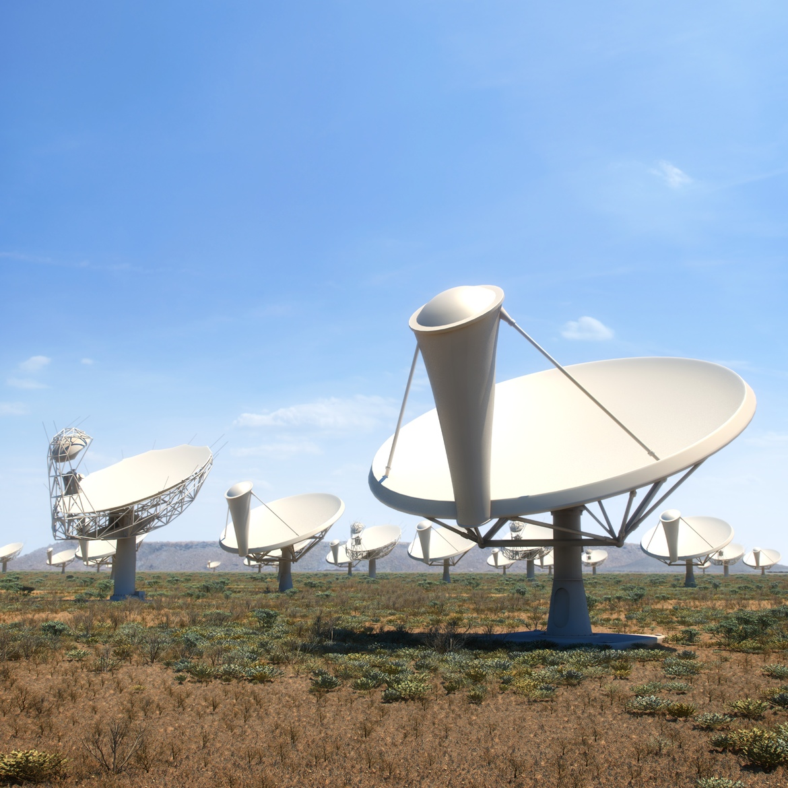

SKA: Square Kilometer Array in the making…
11 core members countries, including India
1

Slide 55
Interesting facts about SKA
SKA will use enough optical fibre to wrap twice around the earth.
The data collected by SKA in a single day would take nearly two million years to playback in an iPod.
The SKA central computer will have processing power of about one hundred million PCs.
The SKA will be so sensitive that it will be able to detect an airport radar on a planet tens of light years away.
The dishes of SKA will produce 10 times the global internet traffic.
The aperture arrays of SKA could produce more than 100 times the global internet traffic.

Slide 56
SKA and Dark Universe
How do they behave at intermediate redshift?
Is Dark Matter cold enough?
Is Dark Energy just a vacuum or a dynamical quantity?
Do they interact?
Does Dark Energy cluster?
Effect on Post-reionization era?
May answer to many such questions…

Slide 57

The point is not to pocket the truth
but to chase it…

Slide 58
Want to make it your career?
Passion
Some more passion…..
Yet more passion…………
BSc Physics/Mathematics with Computer Science
MSc Physics/Applied Mathematics/Astrophysics
MSc Specialization in Astrophysics/Cosmology
PhD & Post-doctorate in Astrophysics/Cosmology

Slide 59
This slide is neither dark nor blank
This is BLACK

