Slide 1
OUR UNIVERSE : AN EXPANDING MYSTERY
Supratik Pal
Indian Statistical Institute, Kolkata

Slide 2

Meeeeeee…..

Slide 3


Slide 4


Slide 5
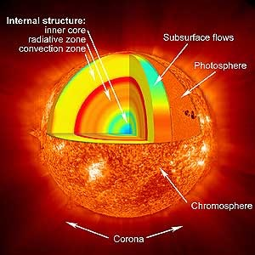

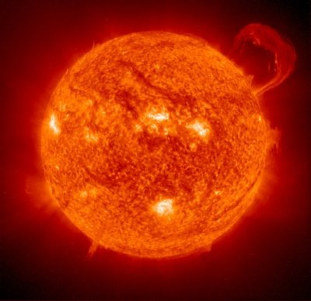

Slide 6
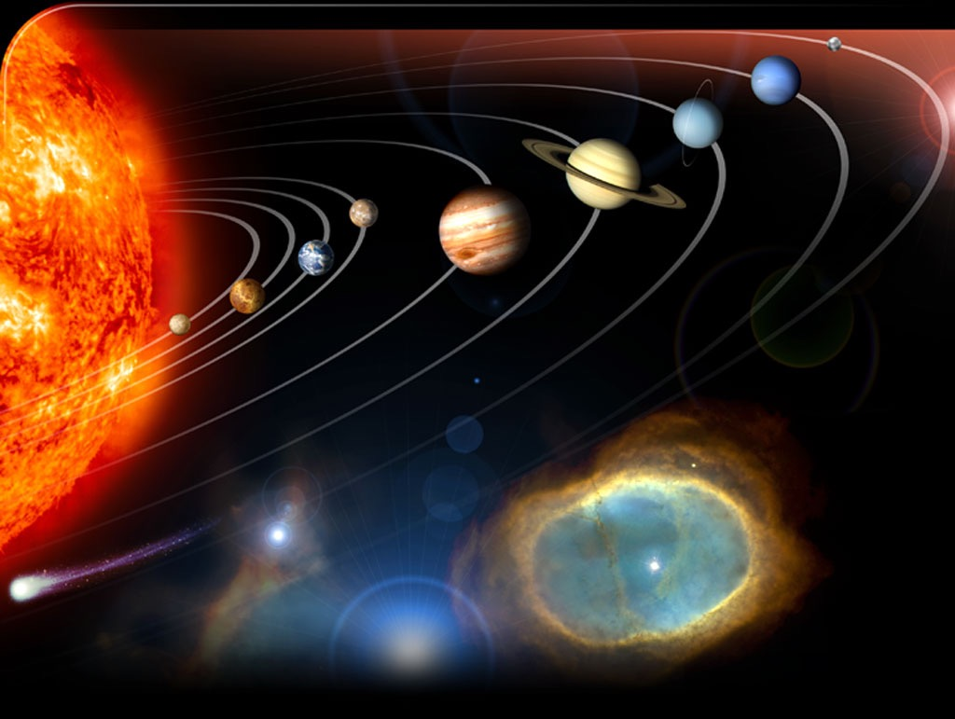

Slide 7
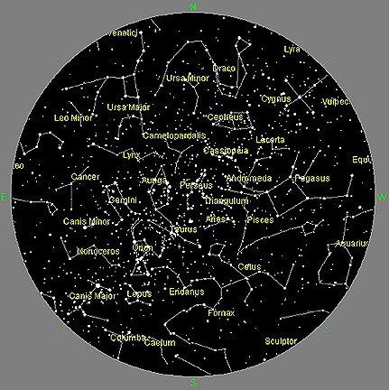
Night Sky
From New York

Slide 8
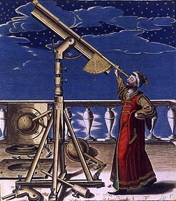

Beyond Naked Eye: Telescopes

Slide 9
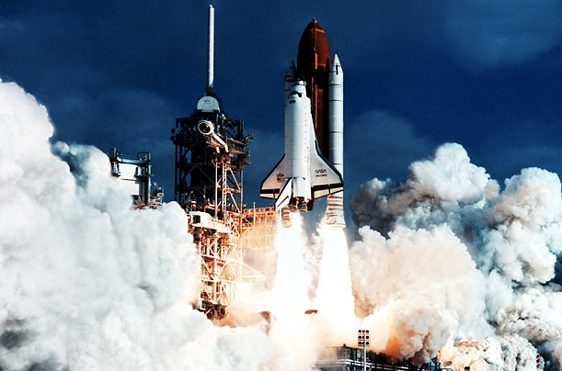

Slide 10
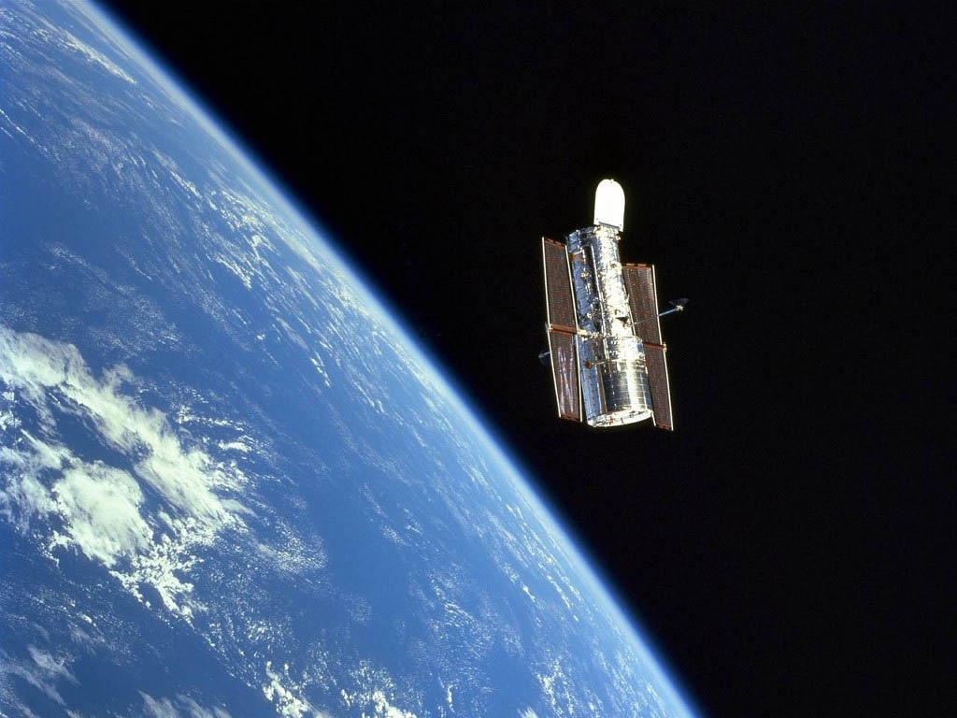
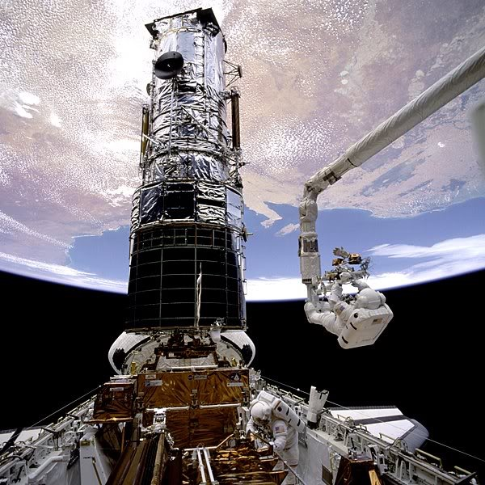
Eye in the Sky: Hubble Space Telescope

Slide 11
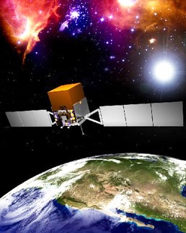
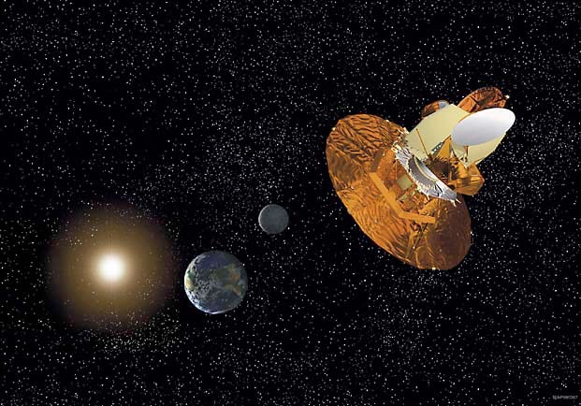
Supernova Probe
Wilkinson Microwave Anisotropy Probe

Slide 12
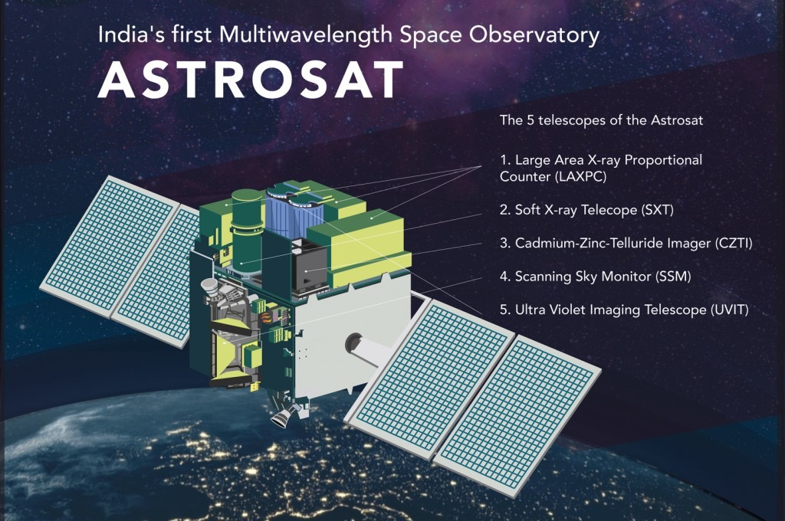
ASTROSAT: A purely Indian Initiative
Launched successfully on Sept 28, 2015

Slide 13
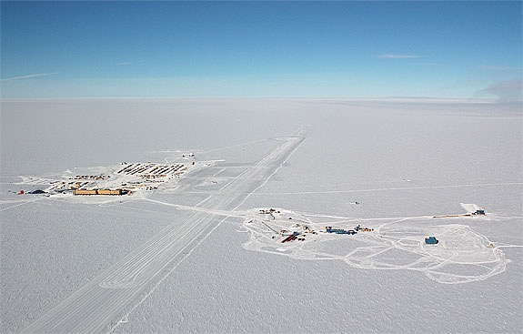
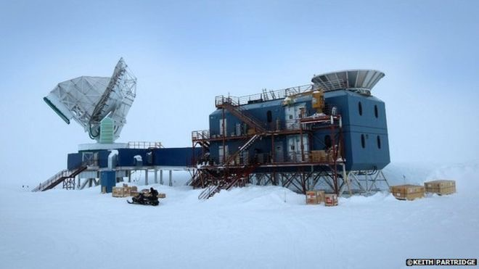
South Pole Telescope

Slide 14
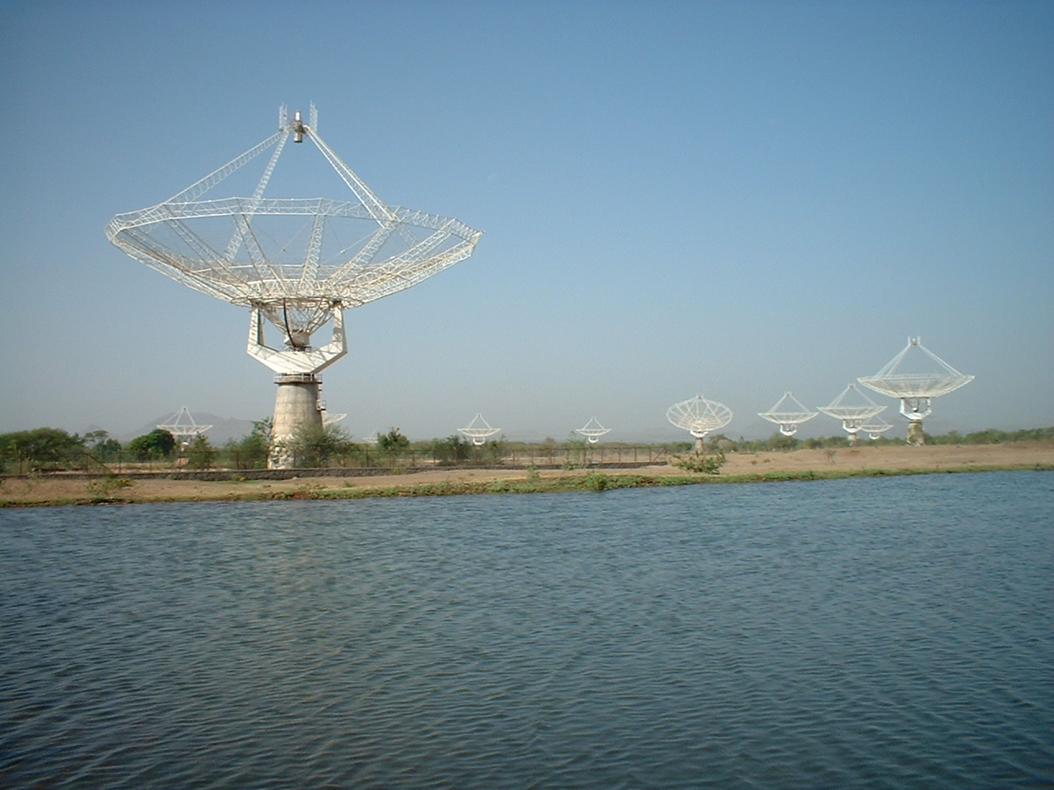
Giant Meterwave Radio Telescope: Indian initiative

Slide 15
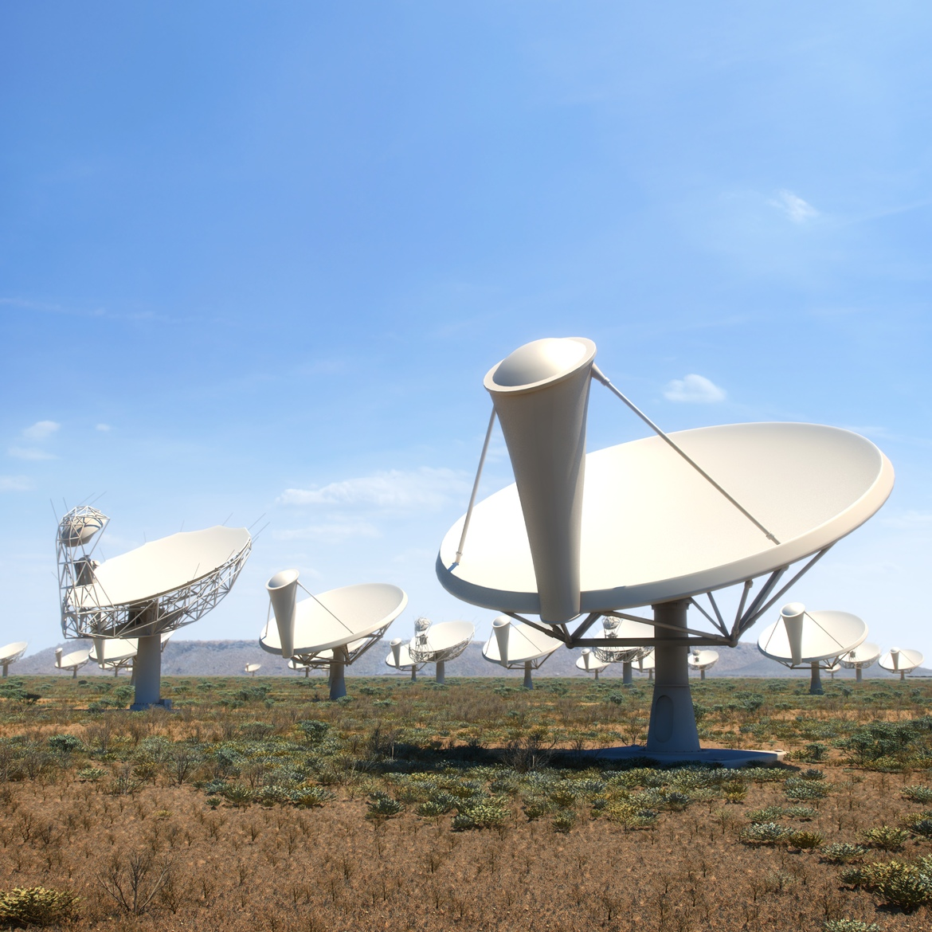
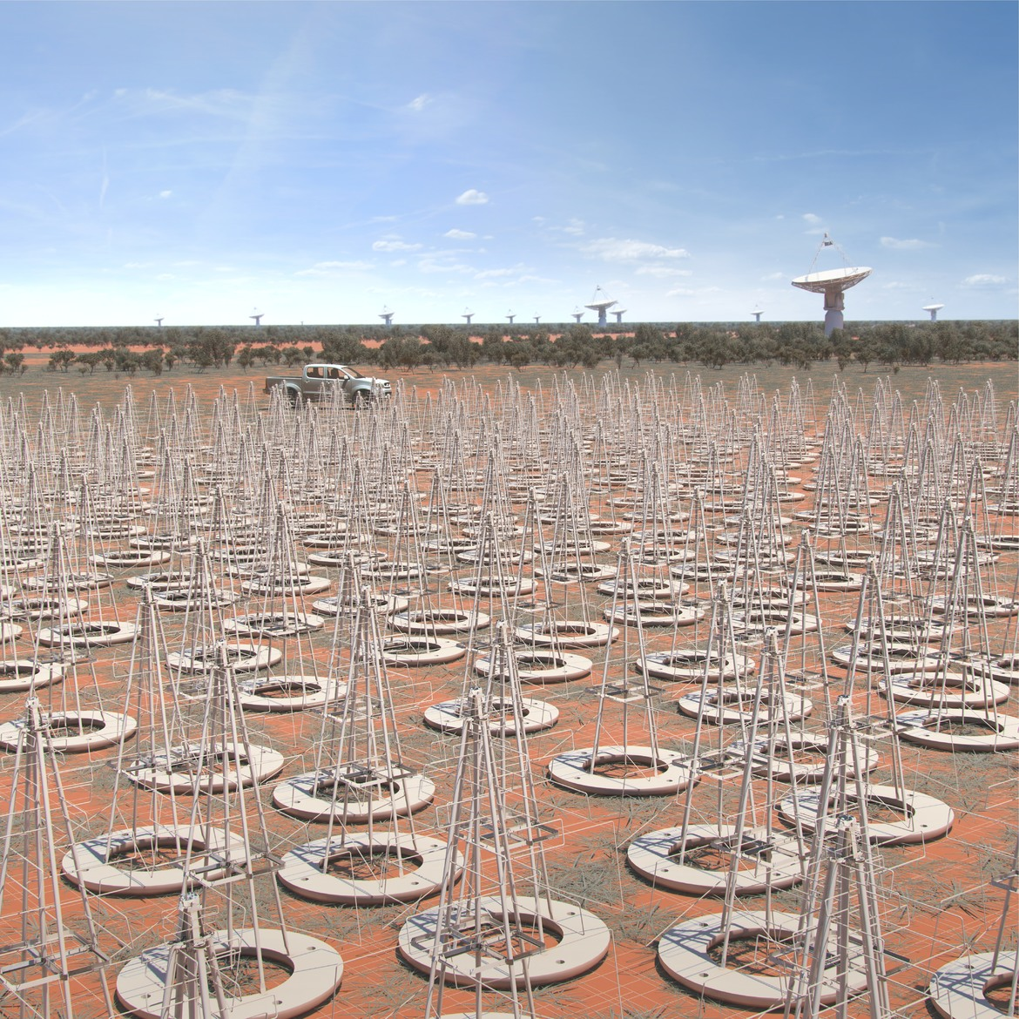
Square Kilometer Array in the making….
11 core members countries, including India
1

Slide 16
Interesting facts about SKA
SKA will use enough optical fibre to wrap twice around the earth.
The data collected by SKA in a single day would take nearly two million years to playback in an iPod.
The SKA central computer will have processing power of about one hundred million PCs.
The SKA will be so sensitive that it will be able to detect an airport radar on a planet tens of light years away.
The dishes of SKA will produce 10 times the global internet traffic.
The aperture arrays of SKA could produce more than 100 times the global internet traffic.

Slide 17
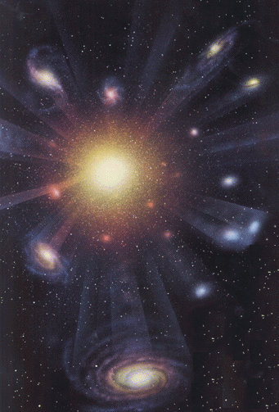
Happy Birthday to our Universe: 13800000000 Years Ago

Slide 18
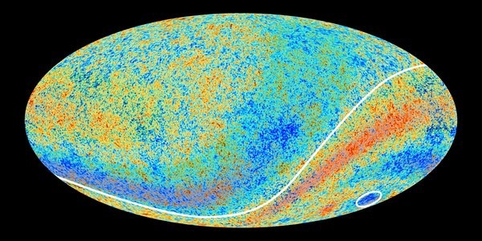
The First Sky

Slide 19
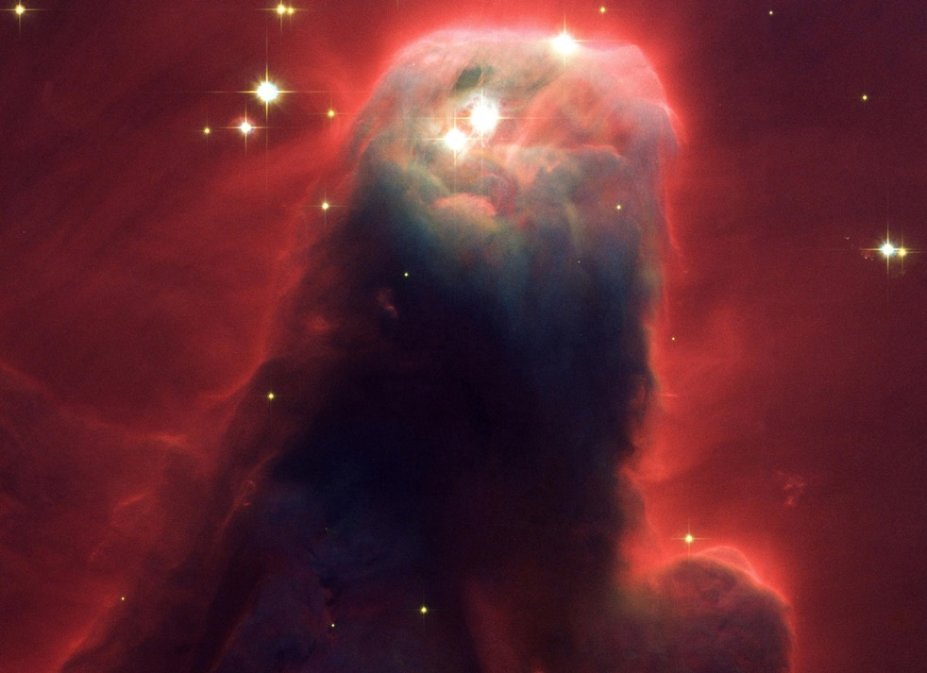
A Star is Born

Slide 20
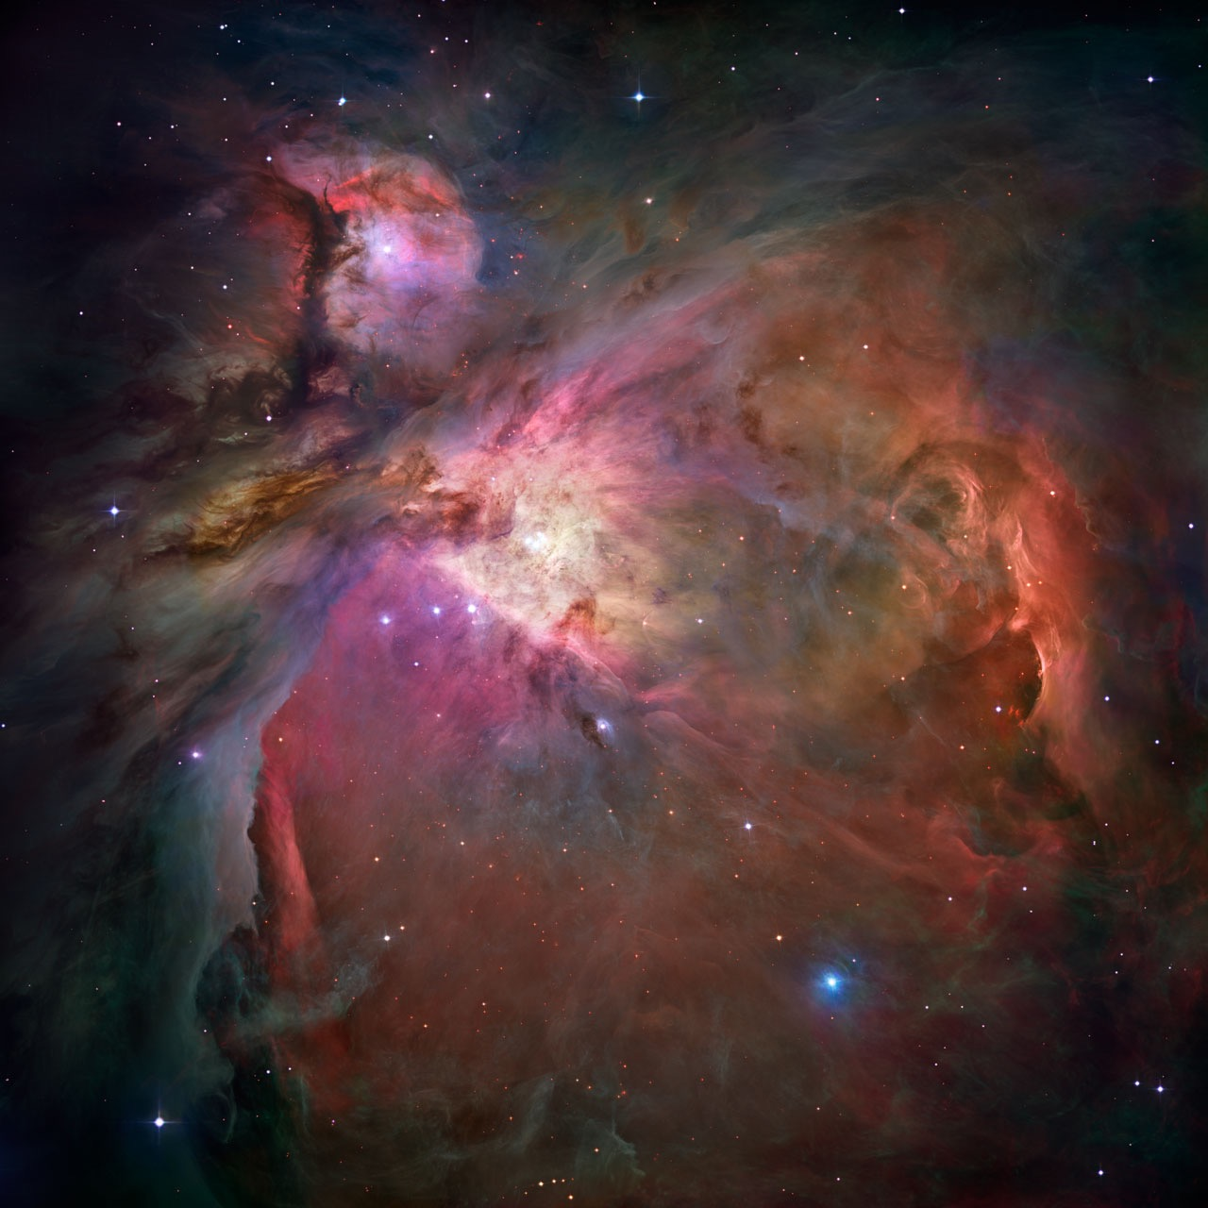
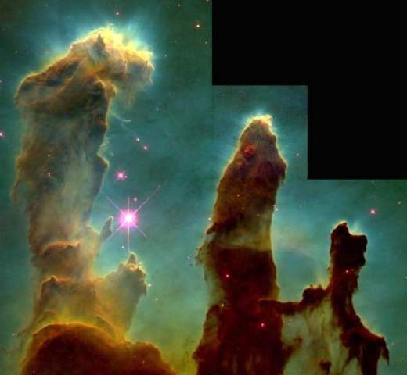
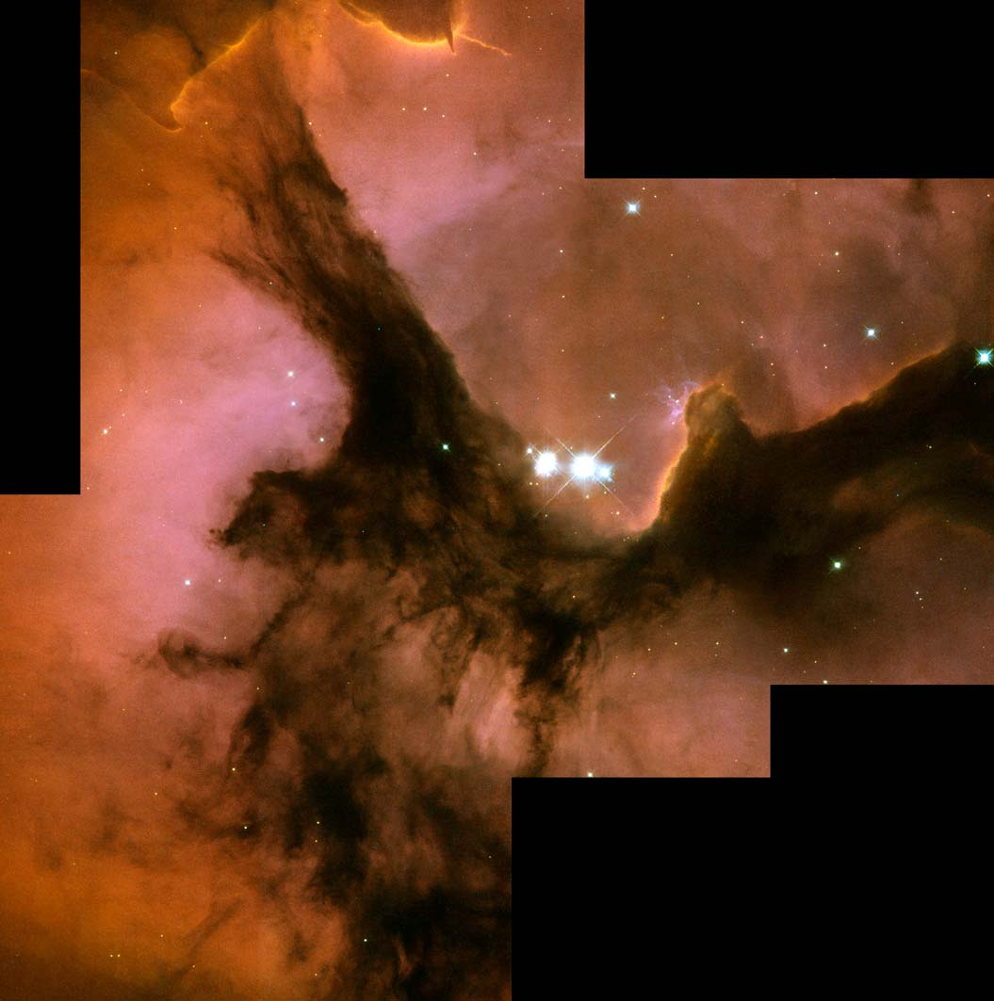
Brighter than Stars : Nebulae

Slide 21
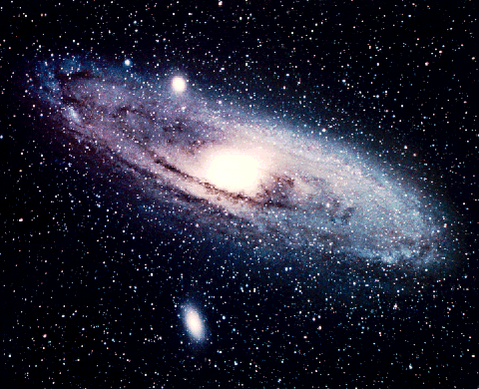
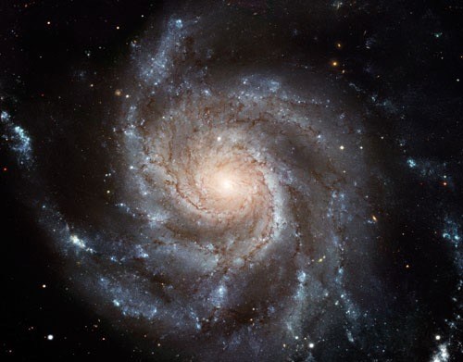
Our Galaxy
Milky Way

Slide 22
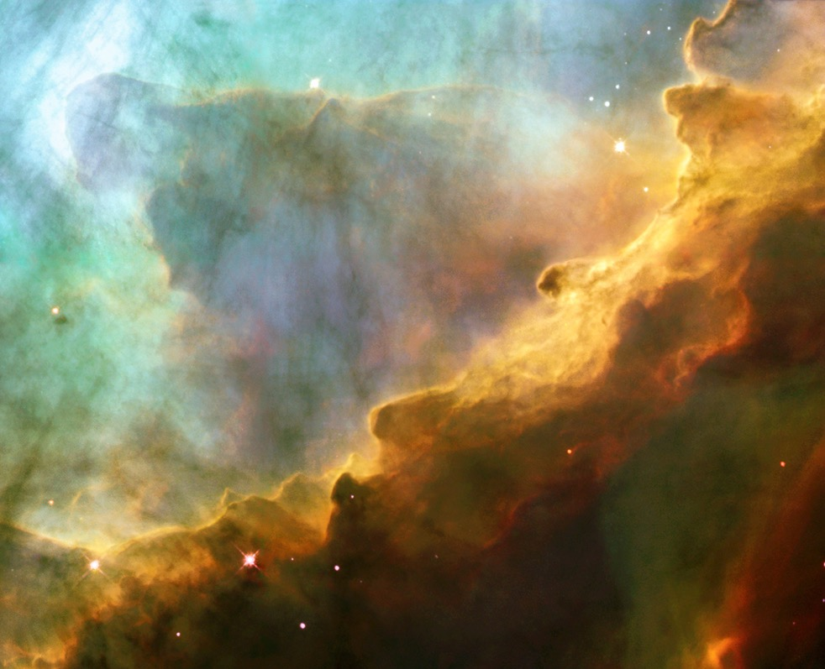
Cloud made of Hydrogen in our Galaxy

Slide 23
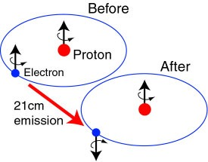
~80% of visible matter is Neutral Hydrogen
Neutral Hydrogen has singlet and triplet states
Spin flip (Hyperfine splitting)
Emits radiation with frequency 1420 MHz / wavelength 21 cm

Slide 24
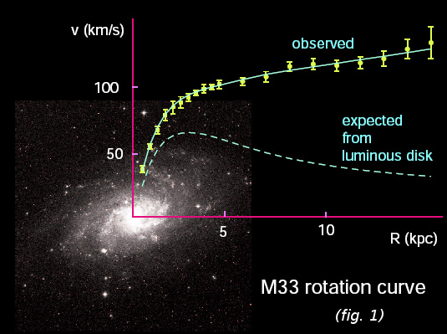
Even what we do not see also exists: Dark Matter

Slide 25
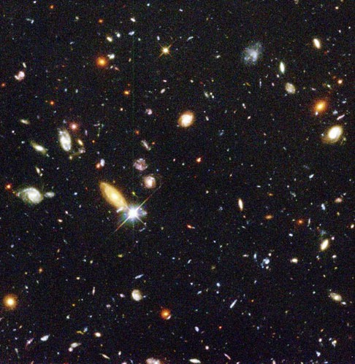
Our Galaxy is one among Millions

Slide 26
How far are They ?
Our Galaxy:
Milky way
Nearest Galaxy:
Andro-meda
2.5 million Light Years
= (300000 km/sec) X (2.5X1000000X365X24X60X60 sec)
= 20000000000000000000 kilo-meters !!!

Slide 27
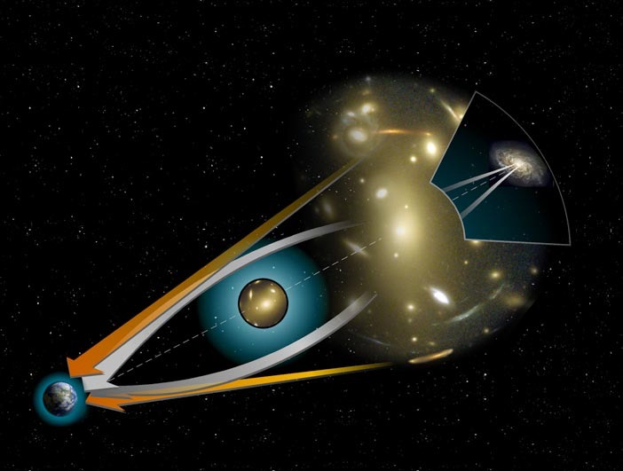
To See the Unseen: Lens in the Sky

Slide 28
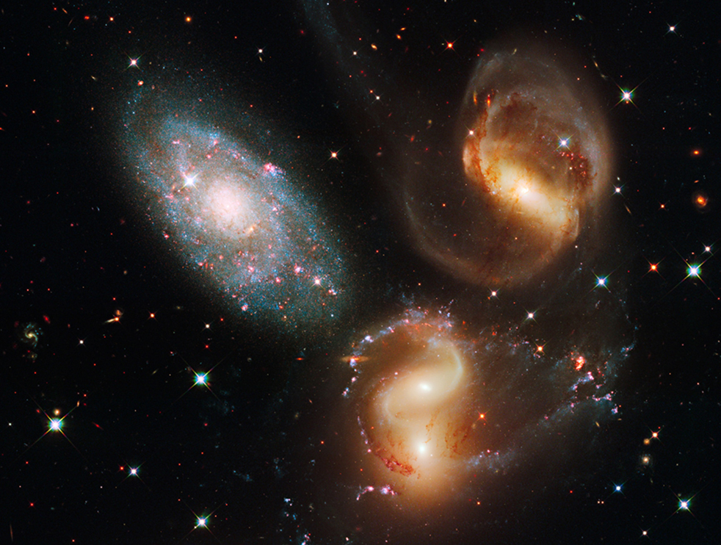
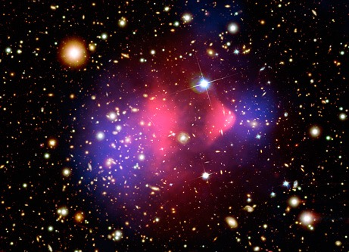
To See the Unseen: Collision in the Sky

Slide 29
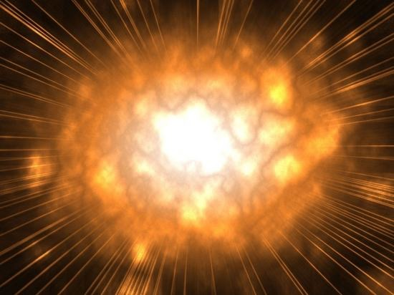
Death of a Star: Supernova Explosion

Slide 30
What do they tell us ?
Age of the Universe = 13800000000 Years
Size of our Universe = 13800000000 Light Years
= 100000000000000000000000 kilo-meters !!!
Why are they so important ?

Slide 31
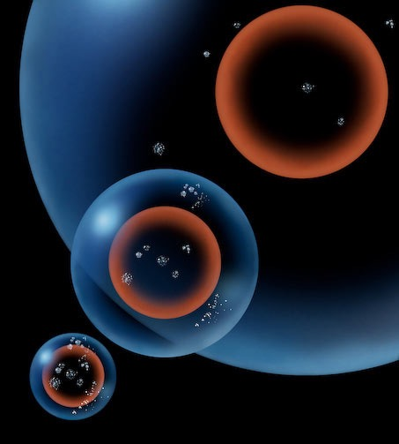
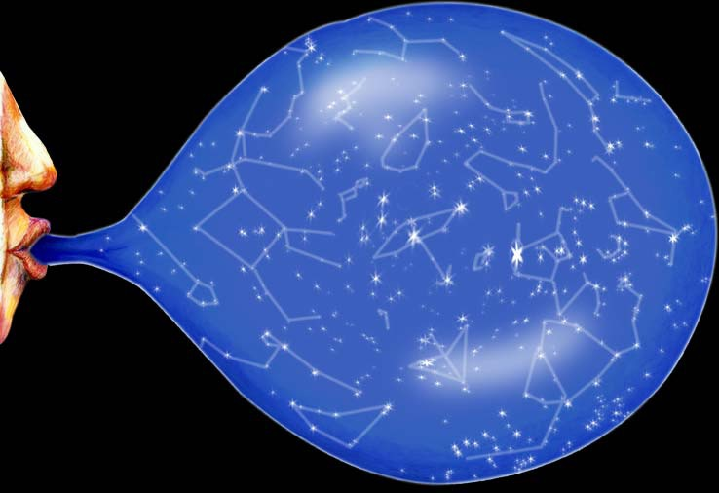
Universe is expanding at accelerated rate

Slide 32
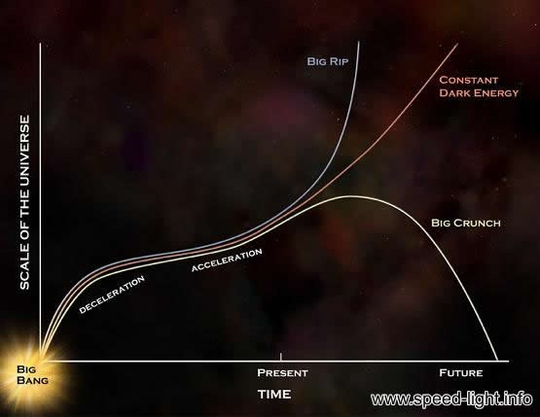
Huge Energy Still Unknown

Slide 33
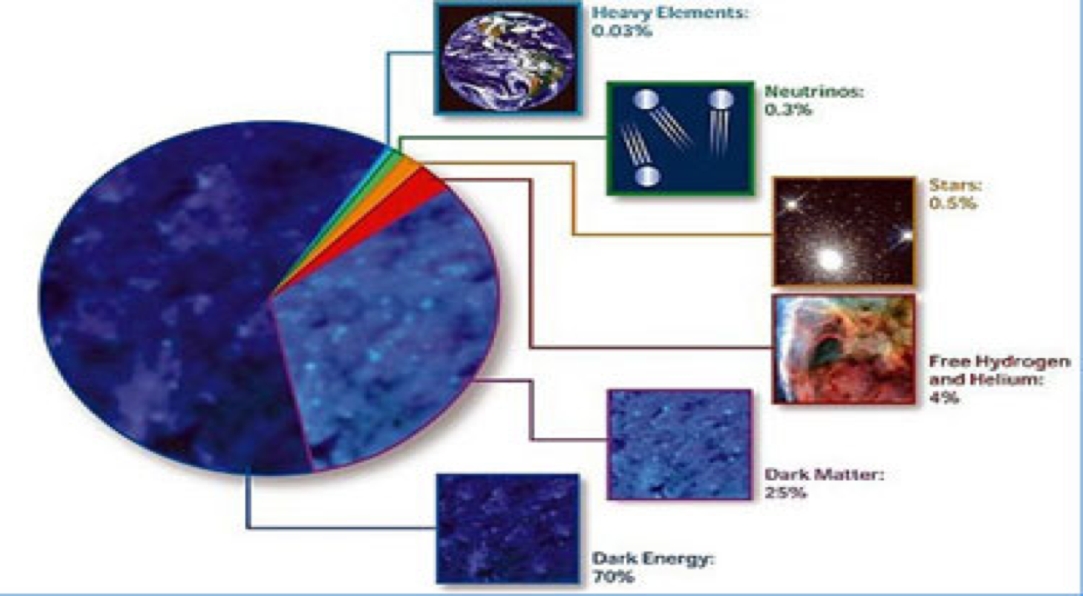
The Cosmic Constituents: As of Now

Slide 34
Scientific
Queries
What?
Why?
How?

Slide 35
And miles to go
Dark energy or cosmological constant?
What is dark energy?
Why is cosmological constant so small?
What is dark matter?
Who governs fast expansion at the beginning?
How were stars, galaxies etc formed?
Gravitational waves: yes or no?
How to match precise observational data?
How to discriminate a model from others?
Many more…..

Slide 36
Want to make it a career?
Basic level …..
Mathematical Methods
Classical Mechanics
Quantum Mechanics
Electrodynamics
Advanced level …..
General Relativity
Quantum Field Theory
Particle Physics
Computer Programming

Slide 37
