Slide 1
Obfuscation from Low Noise Multilinear Maps
Nico Döttling¹ Sanjam Garg² Divya Gupta³
Peihan Miao² Pratyay Mukherjee⁴
¹ Center of IT-Security, Privacy and Accountability, Saarbrücken, Germany
² University of California at Berkeley, USA
³ Microsoft Research India
⁴ Visa Research, USA

Slide 2
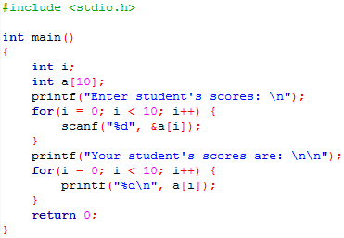
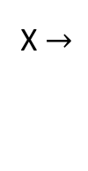


Program Obfuscation
Goal: make computer programs unintelligible while preserving their functionality
I want him to execute P but NOT learn how P works
O(P)
P
O(P)
X $→$
$→$Y
Alice
Bob
X $→$
$→$Y
………… ……………
Functionality: O(P) and P has same I/O behavior (Bob OK)
Unintelligibility: O(P) does NOT reveal “anything else about P” (Alice OK)
*Note: overhead = |O(P)|/|P| should be small (poly)
Notes:
Let’s start with the notion of program obfuscation. Intuitively speaking, the goal of program obfuscation is to make computer programs unintelligible while preserving their functionalities.
For example, Alice has a program P with certain functionality. She wants to let Bob execute the program without learning how the program is written.
We want two guarantees for the obfuscated program: First, it should have the same functionality as the original program; Second, we don’t want Bob to learn anything about the program besides its input/output behavior.
In addition, we want the obfuscation overhead to be small (typically polynomial in the security parameter).

Slide 3

Formalization: Indistinguishability Obfuscation
First formalized in [BGIRSVY’01]
  Most natural definition - Virtual Black Box (VBB) – Impossible!
  A natural weakening of VBB: avoids the impossibility.
  IO is the best possible definition [GR’07]
IO
O is IO if for any functionally equivalent P₁ and P₂; for any Adv
$$≈$$
Can still have useful applications!
Notes:
The notion of program obfuscation was first formalized by Barak et al in 2001.
Unfortunately the most natural definition, Virtual Black Box (VBB) obfuscation, where Bob is only given black-box access to the obfuscated program, is proven to be impossible.
However, in the same work the authors proposed a weaker definition known as indistinguishability obfuscation (IO). The weaker definition considers two programs P1 and P2 that are functionally equivalent. Now we call the obfuscation algorithm O as IO if for any such pair of functionally equivalent programs the following two experiments are computationally indistinguishable to Bob. In one experiment Alice sends obfuscation of P1 and in the other she sends obfuscation of P2.
This weaker definition is not as natural as VBB obfuscation. In fact it is not clear what information it can hide which seems necessary for crypto. However, later in 2007 Goldwasser and Rothblum proved that this definition is the best possible definition. In other words, if P is a program such that its implementation always outputs some additional information than the VBB implementation of P, then IO does NOT leak any more information.
More importantly, a lot of research in the past few years showed that IO is actually sufficient for most applications in crypto.

Slide 4

Obfuscation implies….
Obfustopia
Paradise
Notes:
With obfuscation we can create a Crypto paradise, sometimes also called as Obfustopia. Let’s take a closer look into obfustopia….

Slide 5
Crypto from Obfuscation
Obfustopia
Deniable Encryption
[SW’14]
Functional Encryption [GGHRSW’13]
Round Optimal MPC
[GGHR’14]
Multi-party
Non-interactive Key-exchange
[BZ’14]
IO
Trapdoor Permutations [BPW’16]
Software Watermarking
[CHNVW’16]
Notes:
From IO we can construct lots of crypto primitives. In fact the outreach of IO is so vast that people sometimes say that “Obfuscation is Crypto-complete”. That is, if we can construct Obfuscation, then we are DONE in Crypto. It is not entirely accurate but to some extent it shows how powerful IO is.

Slide 6
Candidate constructions of IO
[GGHRSW’13]: First Candidate Construction of IO from
assumptions on Multilinear Maps ([GGH’13])
Subsequently more IO candidates from Multilinear Maps
[BGKPS’14, BR’14, PST’14, AGIS’14, Zim’15, AB’15, GLSW’15, BMSZ’16, Lin’16, BD’16, GMMSSZ’16…]
Security of assumptions on MMaps ([GGH’13, CLT’13, GGH’15, CLT’15]) are poorly understood!
Vulnerabilities on MMaps: [HJ’15, CHLRS’15, CGHLMMRST’15, MSZ’16…]
Notes:
The first candidate construction of IO is given by Garg et al in 2013, based on new candidate constructions of multilinear maps. Since then a lot of IO candidates are constructed based on multilinear maps.
However, the security of mmaps is poorly understood. In particular, there are various attacks found on the existing constructions of mmaps.

Slide 7
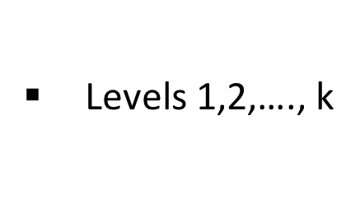
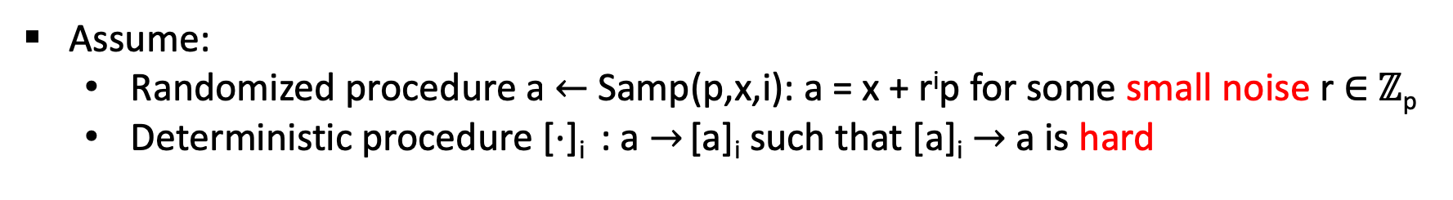
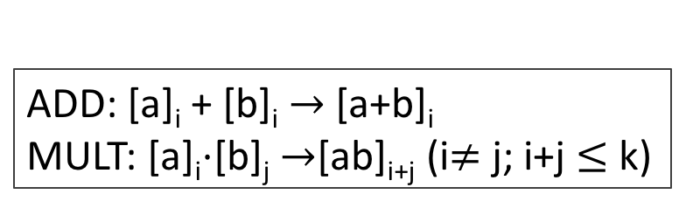
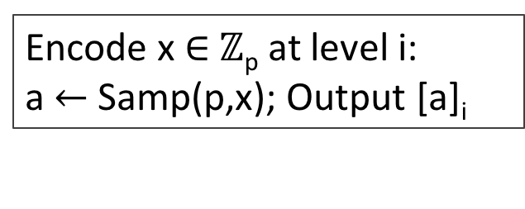
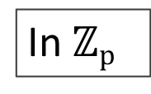
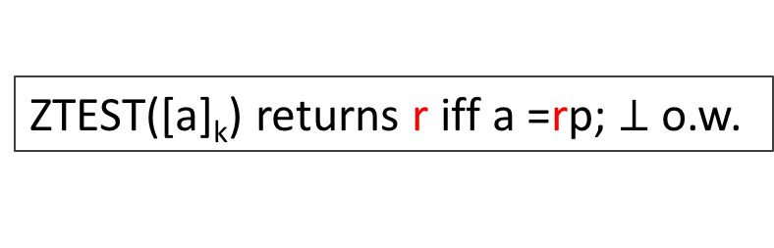
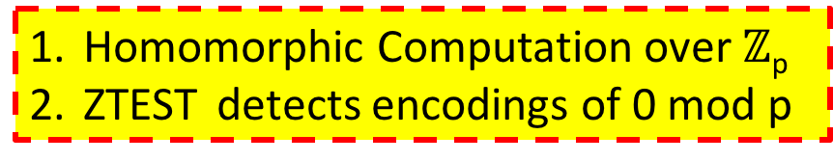
Multilinear Maps (Abstractly)
In $ℤp$
Large secret prime p
Levels 1,2,…., k
Noise ∝ exp(i)
Assume:
  Randomized procedure a$←$Samp(p,x,i): a = x + r^{i}p for some small noise r $∈$ $ℤ$_{p}
  Deterministic procedure [$⋅$]_{i} : a $→$ [a]_{i} such that [a]_{i} $→$ a is hard
Noise growth ∝ exp(# multiplications)
Private Encoding
Multi-linear ops
Encode x $∈$ $ℤ$_{p} at level i:
a$←$Samp(p,x); Output [a]_{i}
ADD: [a]_{i} + [b]_{i} $→$[a+b]_{i}
MULT: [a]_{i}$⋅$[b]_{j} $→$[ab]_{i+j} (i$≠$ j; i+j $≤$ k)
Zero-test
Homomorphic Computation over $ℤ$_{p}
ZTEST detects encodings of 0 mod p
ZTEST([a]_{k}) returns r iff a =rp; $⊥$o.w.
Noise ∝ exp(k)
Weak MMAP Model [MSZ’16]
Notes:
Let me now briefly talk about Multilinear maps. I will be giving a oversimplified description over $ℤp$ which is enough for communicating the overview.
Let's assume there are k levels in total.
Now let's assume we have a randomized procedure that, given some integer x in Z_p as input chooses a random noise r in Z_p and outputs a that is equal to x + p . r^i for a small noise r
Also assume that we have access to a deterministic procedure which encodes any integer a at level i to produce an encoding such that from that encoding it is hard to find out the input -- that's the basic guarantee.
Now the encoding algorithm encodes elements in Z_p at some level i just sampling some a that is equal to x mod p and then output the encoding of a at level i. Note that it is a private procedure.
It allows homomorphic operations guided by the levels. Addition is allowed in the same level and multiplication in different levels until it hits the ceiling at level k.
Until now the scheme has nothing special apart from a graded homomorphic encryption. What makes it so interesting is the Zero-test procedure . This procedure checks an encoding at the top-level and checks if it is an encoding of 0 mod p, in other words if it is a multiple of p. In the ideal model it just returns an yes/no answer.
So an ideal model mmap allows one to do homomorphic computation over Z_p and tests if an element at top level is 0 mod p.
However, in approximate mMAP such ZTEST reveals not only yes/no but some concrete information (the noise in this case) and that is found to be problematic.
To address this we will be working in weak MMAP model in that the Ztest returns the multiplicative factor in case the element is indeed 0 and just signals a flag otherwise. This is one of our main contribution.
Now, let’s looking into the factors the noise is dependent on.
First, note that noise is exponentially dependent on the level, that is i, it is encoded fresh.
Second, each multiplication accumulates more noise and consequently it grows exponentially with multiplicative depth, eventually becoming proportional to exp(k) at the top level.

Slide 8
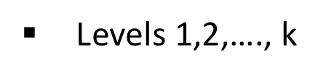
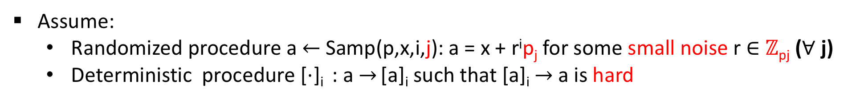
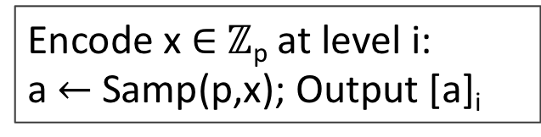
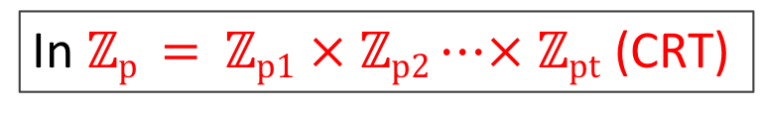
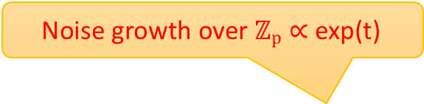
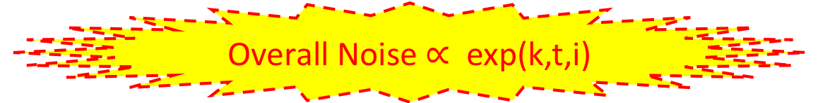
Composite Order MMaps (Abstractly)
Large secret primes p₁,….p_{t}
Levels 1,2,…., k
In $ℤp = ℤp1$ × $ℤp2⋯× ℤpt$ (CRT)
Noise ∝ exp(i)
Assume:
  Randomized procedure a$←$Samp(p,x,i,j): a = x + r^{i}p_{j} for some small noise r $∈$ $ℤ$_{pj} ($∀$ j)
  Deterministic procedure [$⋅$]_{i} : a $→$ [a]_{i} such that [a]_{i} $→$ a is hard
Noise growth ∝ exp(# multiplications)
Noise growth over $ℤp∝$ exp(t)
Private Encoding
Multi-linear ops
Overall Noise $∝$ exp(k,t,i)
Encode x $∈$ $ℤ$_{p} at level i:
a$←$Samp(p,x); Output [a]_{i}
ADD: [a]_{i} + [b]_{i} $→$[a+b]_{i}
MULT: [a]_{i}$⋅$[b]_{j} $→$[ab]_{i+j} (i$≠$ j; i+j $≤$ k)
Zero-test
Homomorphic Computation over $ℤ$_{p}
ZTEST detects encodings of 0 mod p
ZTEST([a]_{k}) returns r iff a =rp; $⊥$o.w.
Noise ∝ exp(k)
Weak MMAP Model [MSZ’16]
Notes:
Now, for the composite MMAP setting, where we work over the CRT representation of t primes instead of one prime, the noise also depends exponentially on the number of prime factors.
So overall the noise depends on 3 things exponentially, the multiplicative depth, the level of the fresh encoding, and the number of primes factors of the modulus.

Slide 9
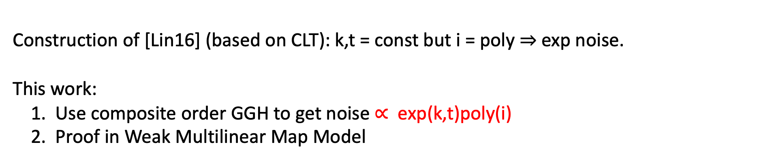

Our contribution
Overall Noise $∝$ exp(k,t,i)
MMaps-based IO constructions [GGHRSW’13, BGKPS’14, BR’14, PST’14, AGIS’14, Zim’15, AB’15, GLSW’15, BMSZ’16, Lin’16,…]:
Map program to a sequence of encodings.
Output of program on an input is 0 ⇔ output of a corresponding input dependent polynomial on the encoded values yields 0.
Construction of [Lin16] (based on CLT): k,t = const but i = poly $⇒$ exp noise.
This work:
1. Use composite order GGH to get noise $∝$ exp(k,t)poly(i)
2. Proof in Weak Multilinear Map Model
Notes:
MMAP-based IO essentially maps a Boolean circuit to a sequence of encodings and output an encoding of 0 in the top level if and only if the program evaluates to 0.
In Eurocrypt 2016 Lin shows that using composite order CLT map it is possible to build IO for which the multiplicative depth, as well as the number of prime factors are constant. However, due to some technical reason in CLT map one must use polynomial levels for fresh encoding which makes the overall noise to be exponential in the security parameter.
In this work we consider the two major vulnerabilities in mmap-based IO constructions as we discussed so far. The first vulnerability is the exponential noise in mmaps and the second is to prove security in the weak multilinear map model.
We use a new variant of composite order GGH map instead to get the noise proportional to poly(i) and then use Lin’s idea to get overall IO based on noise that is polynomial. As a result we can have a IO with polynomial modulus q as the the modulus must be greater than the max noise for correctness. It increases the efficiency, moreover gave more security asymptotically as attacks like overstretched NTRU attack only works for superpoly q.
As mentioned earlier, as our second contribution we resort to weak MMAP model that gave stronger security by capturing annhilation attacks – found to be destructive for many constructions proven secure in so-called IDEAL MMAP model.

Slide 10


Starting Point: [Lin16] Construction
IO for $C_{seed}$ that only has polynomial noise and is secure in weak multilinear map model
IO for specific constant-degree circuits $C_{seed}$
IO for P/poly
Bootstrapping
Notes:
Our starting point is Lin’s IO construction.
At a high level it has two major steps. First, it provides a bootstrapping technique that in order to construct IO for all circuits, it only requires iO for specific constant-degree circuits. We call it seed class.
And then it gives a candidate iO construction for this seed class. The second step only needs constant-degree computation.
In our work, we build on the bootstrapping technique and try to build the IO for the seed class such that it only has polynomial noise and is secure in the weak multilinear map model.

Slide 11
Overview
Composite order GGH multilinear maps
Reducing noise in GGH
Strengthen security via self-fortification [GMMSSZ’16]
Notes:
Here is an overview of our techniques.
First, we review the composite-order extension of the GGH multilinear map candidate.
Second, we propose modifications of composite-order GGH multilinear maps such that all fresh encodings that are needed in our construction can be provided with only polynomial noise.
Finally, we strengthen the security of Lin’s iO construction via the self-fortification techniques, similar to the work of Garg et al. As a result we can prove that our construction is secure in the weak multilinear map model.

Slide 12
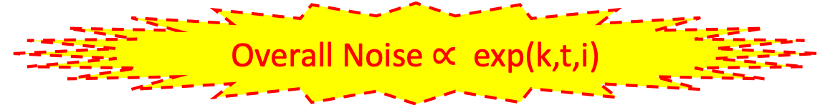
RECALL: Composite Order MMaps (Abstractly)
Large secret primes p₁,….p_{t}
Levels 1,2,…., k
In $ℤp = ℤp1$ × $ℤp2⋯× ℤpt$ (CRT)
Noise ∝ exp(i)
Assume:
  Randomized procedure a$←$Samp(p,x,i,j): a = x + r^{i}p_{j} for some small noise r $∈$ $ℤ$_{pj} ($∀$ j)
  Deterministic procedure [$⋅$]_{i} : a $→$ [a]_{i} such that [a]_{i} $→$ a is hard
Noise growth ∝ exp(# multiplications)
Noise growth over $ℤp∝$ exp(t)
Private Encoding
Multi-linear ops
Overall Noise $∝$ exp(k,t,i)
Encode x $∈$ $ℤ$_{p} at level i:
a$←$Samp(p,x); Output [a]_{i}
ADD: [a]_{i} + [b]_{i} $→$[a+b]_{i}
MULT: [a]_{i}$⋅$[b]_{j} $→$[ab]_{i+j} (i$≠$ j; i+j $≤$ k)
Zero-test
Homomorphic Computation over $ℤ$_{p}
ZTEST detects encodings of 0 mod p
ZTEST([a]_{k}) returns r iff a =rp; $⊥$o.w.
Noise ∝ exp(k)
Weak MMAP Model [MSZ’16]
Notes:
Recall the composite order mmap, the overall the noise depends on 3 things exponentially, the multiplicative depth k, the level of the fresh encoding i, and the number of primes factors of the modulus t.

Slide 13
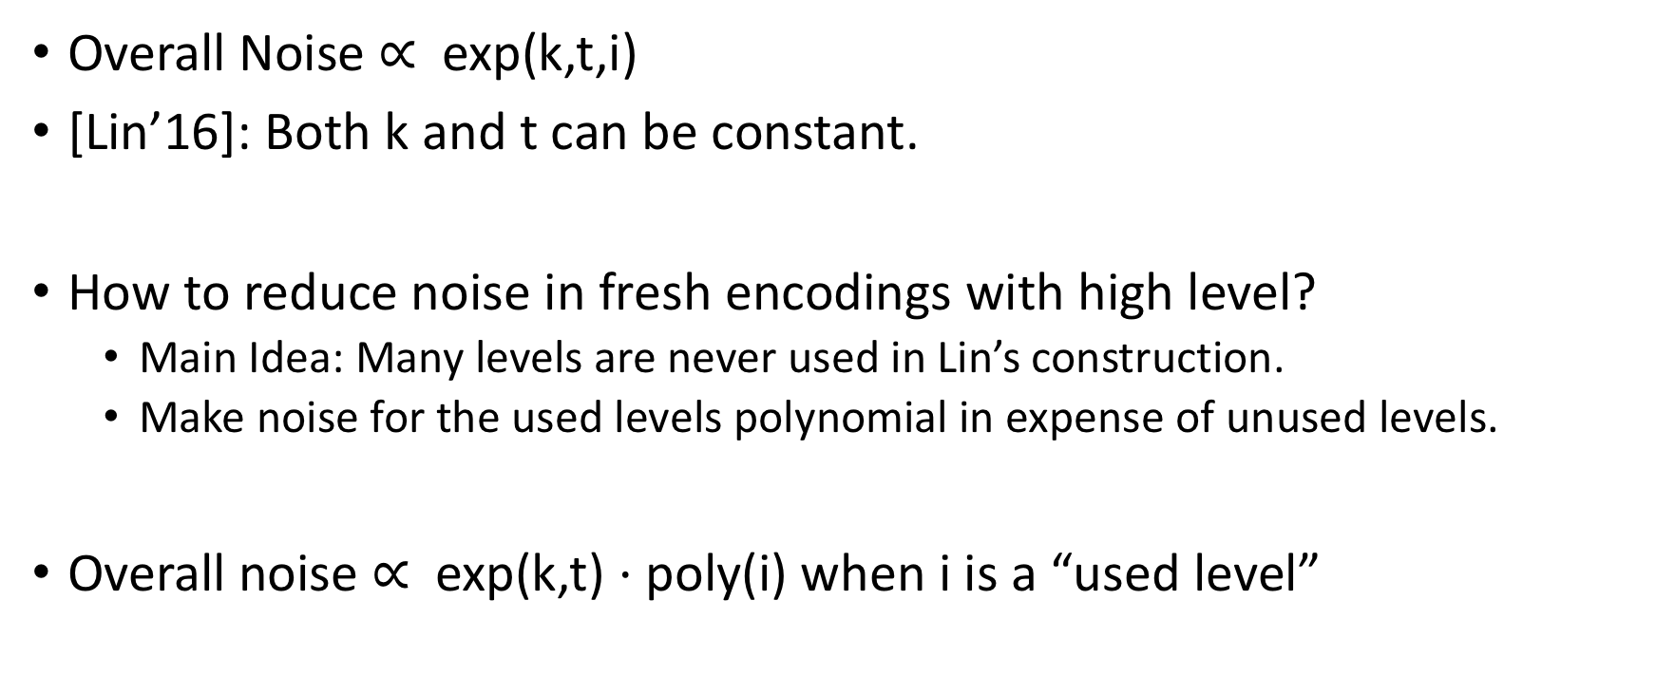
Reducing noise in composite order GGH
Overall Noise $∝$ exp(k,t,i)
[Lin’16]: Both k and t can be constant.
How to reduce noise in fresh encodings with high level?
  Main Idea: Many levels are never used in Lin’s construction.
  Make noise for the used levels polynomial in expense of unused levels.
Overall noise $∝$ exp(k,t) $⋅$ poly(i) when i is a “used level”
Notes:
Using Lin’s techniques, both k and t can be constant. So the question becomes how to reduce the noise in fresh encodings with high level.
Our technique is tailored to our specific IO construction which is a variant of Lin’s construction. At a high level, we first observe that in our obfuscation construction many levels are never used. Then we modify our sampling procedure to make noise for the used levels polynomial, while increasing noise for unused levels without affecting the overall noise required for the basic security of the encoding.
Therefore the accumulated noise at the top level becomes exponential in k and t and polynomial in the level of the fresh encoding i. Because k and t are constants, the overall noise is polynomial.

Slide 14
Strengthen security via self-fortification [GMMSSZ’16]
C
x
Universal Circuit U
(C(x) mod g₁, 0 mod g₂, …, 0 mod g_{t})
Notes:
Finally, to prove security of our IO construction in the weak multilinear map model, we make another modification to Lin's IO construction for the seed class circuits using a self-fortification technique similar to the work of Garg et al.
At a high level, consider a universal circuit U that takes as input the circuit C and input x and outputs C(x). When initiated with composite-order multilinear maps, a correct evaluation will give an encoding of this at the highest level. Then zero-testing will reveal the output.

Slide 15
Strengthen security via self-fortification [GMMSSZ’16]
C
x
Universal Circuit U
Blinding factor in Zero-Test
(C(x) mod g₁, 0 mod g₂, …, 0 mod g_{t}, C_{PRF}(x) · g_{t+1} mod g_{t+1})
Notes:
Our idea is to add an extra slot, say the last slot, for PRF computation such that a correct computation produces an encoding of this at the top level.
Notice that the computation is not affected by the PRF output since the value in the last slot is still 0 mod g_{t+1}. However, we can show that a successful zero-test returns a ring element that has a PRF value as a blinding factor. Therefore it is secure against the annihilation attacks and we can prove security in the weak multilinear map model.

Slide 16
Summarize
Composite order GGH multilinear maps
Reducing noise in GGH
Strengthen security via self-fortification [GMMSSZ’16]
We give a candidate IO construction with polynomial noise and is proven secure in the weak multilinear map model.
Notes:
To summarize, we first review the composite-order extension of the GGH multilinear map candidate. Then we propose modifications such that all fresh encodings needed in our construction can be provided with only polynomial noise. Finally we strengthen the security of Lin’s IO construction via the self-fortification techniques.
Combined with Lin’s bootstrapping techniques, we obtain a candidate IO construction with polynomial noise and is proven secure in the weak multilinear map model.

