Slide 1
More Efficient Lattice PRFs from Keyed Pseudorandom Synthesizers
Indocrypt 2018
December 11, 2018
Hart Montgomery
Fujitsu Laboratories of America, Inc.
Software Quality and Security Lab

Slide 2

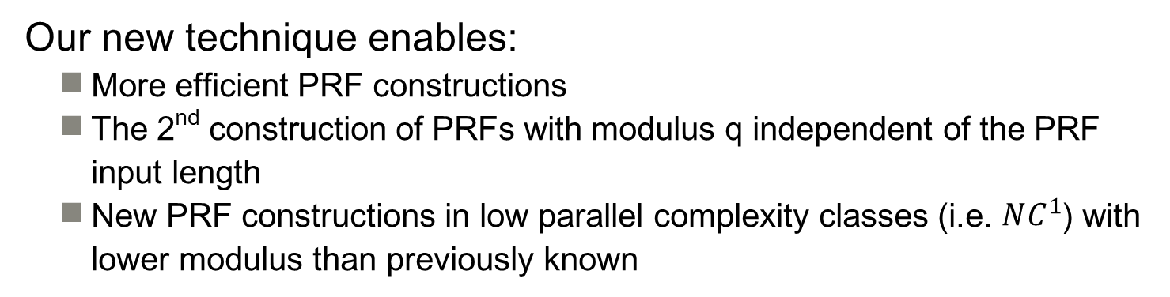
TL;DR for Today
A technique that allows us to “synthesize” basic lattice-based PRF constructions
[BPR12]
[BLMR13]
[BP14]
Our new technique enables:
More efficient PRF constructions
The 2nd construction of PRFs with modulus q independent of the PRF input length
New PRF constructions in low parallel complexity classes (i.e. $NC^{1}$) with lower modulus than previously known

Slide 3

Talk Outline
Background
PRFs and Lattices
Why study lattice PRFs?
Pseudorandom Synthesizers
Our Techniques
Recalling LWR and [BLMR13]
Synthesizing [BLMR13]
Results and Comparison
Future Work

Slide 4

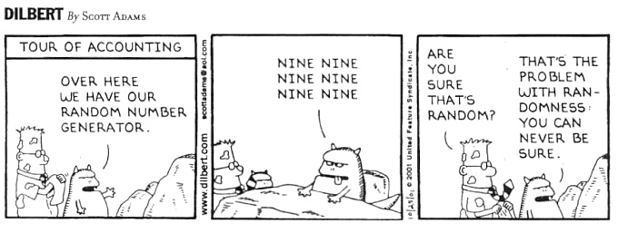
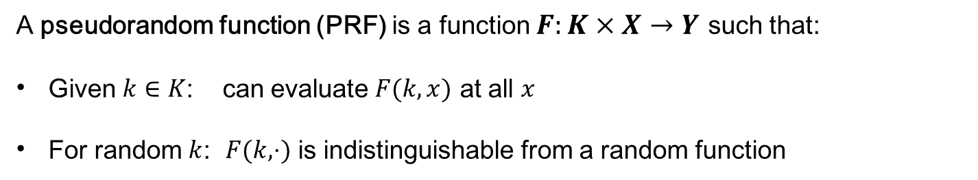
Pseudorandom Functions
A pseudorandom function (PRF) is a function $F:K×X→Y$ such that:
Given $k∈K$: can evaluate $F(k, x)$ at all $x$
For random $k$: $F(k, ⋅)$ is indistinguishable from a random function

Slide 5

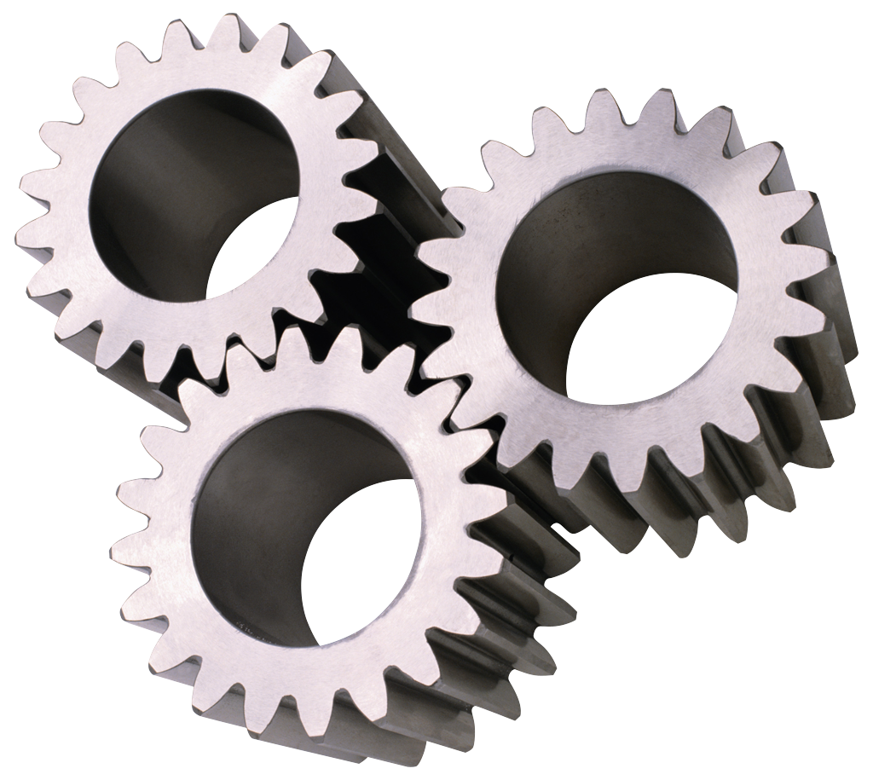

Pseudorandom Functions
PRF
x ∈ {0,1}^{ℓ}
k ^{R} K
PRF(k, x)
Random
x ∈ {0,1}^{ℓ}
x₁
x₂
x₃
x₄
r(x₁)
r(x₂)
r(x₃) r(x₄)
rand(x)
Notes:
PRF security: game between an adversary and a challenger, where the challenger is given adaptive oracle access to either a real PRF or a random function.

Slide 6

PRFs are Everywhere!
Cryptography:
Encryption, user authentication, message integrity, signatures, key derivation, and much more
Outside cryptography:
Learning theory, defending against DOS attacks, etc.
Practical PRFs, like AES or DES, are very efficient but rely on online, interactive security assumptions
Theoretical PRFs tend to be less efficient, but have mathematical structure and can be reduced to offline, noninteractive assumptions (like factoring, LWE, or the Decisional Diffie-Hellman problem)

Slide 7

Why Study (Lattice) PRFs?
In an ideal world we would have block ciphers based on offline, non-interactive standard assumptions
To do this, we can both improve our understanding of current block ciphers or try to build more efficient PRFs with security proofs
Implications for complexity theory
The existence of fast, low-depth PRFs has interesting implications for complexity and learning theory
Here we focus on low-depth PRFs, which are (generally) faster to compute in practice due to parallelization and offer more interesting complexity implications.

Slide 8
Why Study (Lattice) PRFs?
In an ideal world we would have block ciphers based on offline, non-interactive standard assumptions
To do this, we can both improve our understanding of current block ciphers or try to build more efficient PRFs with security proofs
Implications for complexity theory
The existence of fast, low-depth PRFs has interesting implications for complexity and learning theory
Here we focus on low-depth PRFs, which are (generally) faster to compute in practice due to parallelization and offer more interesting complexity implications.
If I can convince you of anything—
Hopefully you will leave today believing that PRFs are an important and interesting topic to study in cryptography!

Slide 9

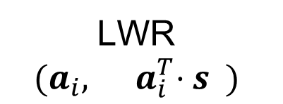
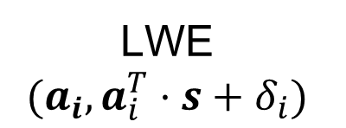


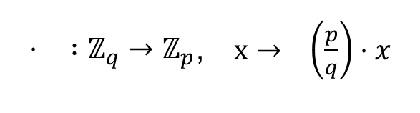

Lattice Background and Notation
m: “big” lattice dimension
n: “little” lattice dimension
q: modulus (we compute mod
q unless stated otherwise)
p: “rounding parameter”
v: vector
M: matrix
$⋅ :ℤ_{q}→ℤ_{p}$, $x→ \left(\frac{p}{q}\right)⋅x$
$$p$$
“round to the nearest integer multiple of $\frac{q}{p}$, then divide by $\frac{q}{p}$”
Fixed key $s←ℤ_{q}^{n}$
Fresh samples $a_{i}←ℤ_{q}^{n}$
Fresh noise $δ_{i}←Ψ$
LWE
$$(a_{i}, a_{i}^{T}⋅s+δ_{i})$$
LWR
$$(a_{i}, { a}_{i}^{T}⋅s )$$
$$p$$
*we can also have different distributions of the key $s$ and samples $a_{i}$

Slide 10
Lattice Background and Notation
m: “big” lattice dimension
n: “little” lattice dimension
q: modulus (we compute mod
q unless stated otherwise)
p: “rounding parameter”
v: vector
M: matrix
$⋅ :ℤ_{q}→ℤ_{p}$, $x→ \left(\frac{p}{q}\right)⋅x$
Slight* simplification:
Hardness of the lattice problems reduced from are proportional to the modulus q
Smaller LWE modulus q → harder LWE
$$p$$
“round to the nearest integer multiple of $\frac{q}{p}$, then divide by $\frac{q}{p}$”
Fixed key $s←ℤ_{q}^{n}$
Fresh samples $a_{i}←ℤ_{q}^{n}$
Fresh noise $δ_{i}←Ψ$
LWE
$$(a_{i}, a_{i}^{T}⋅s+δ_{i})$$
LWR
$$(a_{i}, { a}_{i}^{T}⋅s )$$
$$p$$
*we can also have different distributions of the key $s$ and samples $a_{i}$

Slide 11
Existing Lattice-based PRFs
Generic constructions like [GGM84] give highly sequential PRF constructions
[BPR12]: defined LWR for the 1st time, 1st lattice-based parallel PRF
[BLMR13]: 1st key homomorphic PRF in standard model
[BP14]: improves [BPR12] and [BLMR13] using “tree” construction
[Ban15]: example of an efficient synthesizer construction
[DS15]: on-the-fly adaptation, can be used with lattice PRFs
[JKP18]: recent concurrent work (Asiacrypt ‘18), improve approach of [DS15]

Slide 12


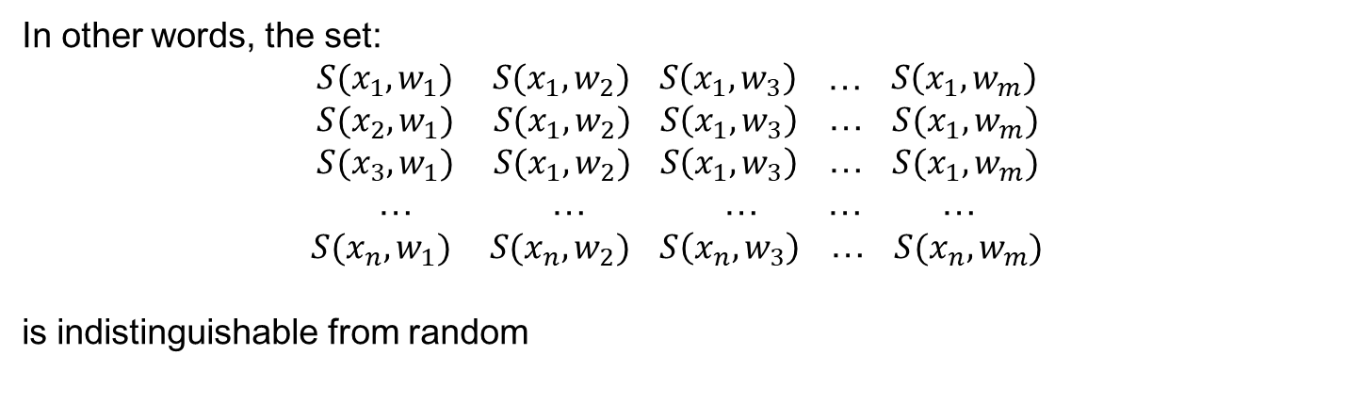
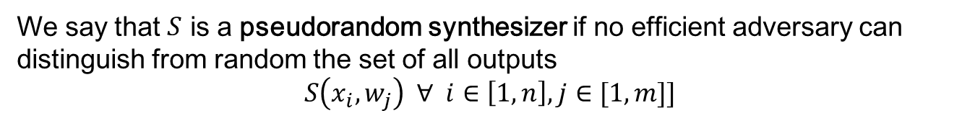
Pseudorandom Synthesizers [NR95]
Consider a function $S≔X×W→Y$
Let $x_{i}←X$ for $i∈\left[1, n\right]$ and $w_{j}←W$ for $j∈[1, m]$ for some (polynomially-sized) $n,m$
We say that $S$ is a pseudorandom synthesizer if no efficient adversary can distinguish from random the set of all outputs
$$S\left(x_{i}, w_{j}\right) ∀ i∈\left[1,n\right], j∈[1, m]]$$
In other words, the set:
$S(x_{1},w_{1})$ $S(x_{1},w_{2})$ $S\left(x_{1}, w_{3}\right)$ … $S\left(x_{1}, w_{m}\right)$
$S(x_{2},w_{1})$ $S(x_{1},w_{2})$ $S\left(x_{1}, w_{3}\right)$ … $S(x_{1}, w_{m})$
$S(x_{3},w_{1})$ $S(x_{1},w_{2})$ $S\left(x_{1}, w_{3}\right)$ … $S(x_{1}, w_{m})$
… … … … …
$S(x_{n},w_{1})$ $S(x_{n},w_{2})$ $S\left(x_{n}, w_{3}\right)$ … $S(x_{n}, w_{m})$
is indistinguishable from random

Slide 13














Synthesizer PRF Construction
$$K_{1,0}$$
$$K_{2,0}$$
$$K_{3,0}$$
$$S≔K×K→K$$
$$K_{4,0}$$
Pick keys based on input bit string x
$$K_{1,1}$$
$$K_{2,1}$$
$$K_{3,1}$$
$$K_{4,1}$$
S( , ) S ( , )
$$K_{1,x_{1}}$$
$$K_{2,x_{2}}$$
$$K_{3,x_{3}}$$
$$K_{4,x_{4}}$$
Synthesize!
S( , )
$$Output$$

Slide 14

Synthesizer PRF Construction
$$K_{1,0}$$
$$K_{2,0}$$
$$K_{3,0}$$
$$S≔K×K→K$$
$$K_{4,0}$$
Pick keys based on input bit string x
Key Fact:
Parallel Construction! For input length $ℓ$, we only need a $\log{ℓ}$ depth tree of synthesizers.
$$K_{1,1}$$
$$K_{2,1}$$
$$K_{3,1}$$
$$K_{4,1}$$
S( , ) S ( , )
$$K_{1,x_{1}}$$
$$K_{2,x_{2}}$$
$$K_{3,x_{3}}$$
$$K_{4,x_{4}}$$
Synthesize!
S( , )
$$Output$$

Slide 15
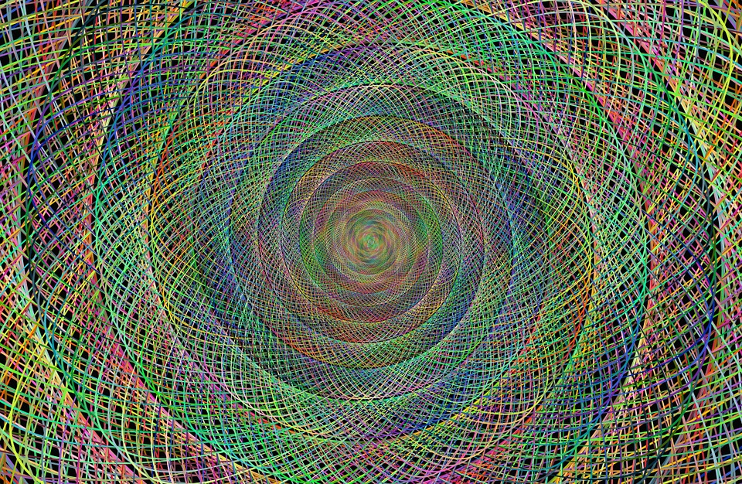





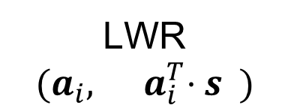
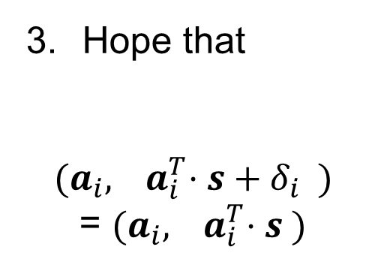
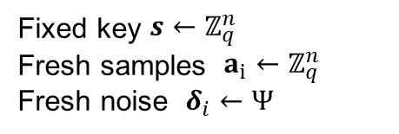

Original LWR: [BPR12]
Fixed key $s←ℤ_{q}^{n}$
Fresh samples $a_{i}←ℤ_{q}^{n}$
Fresh noise $δ_{i}←Ψ$
LWR
$$(a_{i}, { a}_{i}^{T}⋅s )$$
$$p$$
Security Proof Idea:
Hope that
$$(a_{i}, { a}_{i}^{T}⋅s+δ_{i} )$$
= $(a_{i}, { a}_{i}^{T}⋅s )$
Start with an LWE sample
$$(a_{i}, a_{i}^{T}⋅s+δ_{i})$$
Round the second term
$$(a_{i}, { a}_{i}^{T}⋅s+δ_{i} )$$
$$p$$
$$p$$
$$p$$

Slide 16

Original LWR: [BPR12]
Fixed key $s←ℤ_{q}^{n}$
Fresh samples $a_{i}←ℤ_{q}^{n}$
Fresh noise $δ_{i}←Ψ$
LWR
$$(a_{i}, { a}_{i}^{T}⋅s )$$
This (potential) one-bit rounding error is the reason we don’t get easy PRFs!
$$p$$
Security Proof Idea:
Set q/p super –poly large so
$$(a_{i}, { a}_{i}^{T}⋅s+δ_{i} )$$
= $(a_{i}, { a}_{i}^{T}⋅s )$
with high probability
Remember: we want small modulus!
Gives us better parameters and hardness.
Start with an LWE sample
$$(a_{i}, a_{i}^{T}⋅s+δ_{i})$$
Round the second term
$$(a_{i}, { a}_{i}^{T}⋅s+δ_{i} )$$
$$p$$
$$p$$
$$p$$

Slide 17
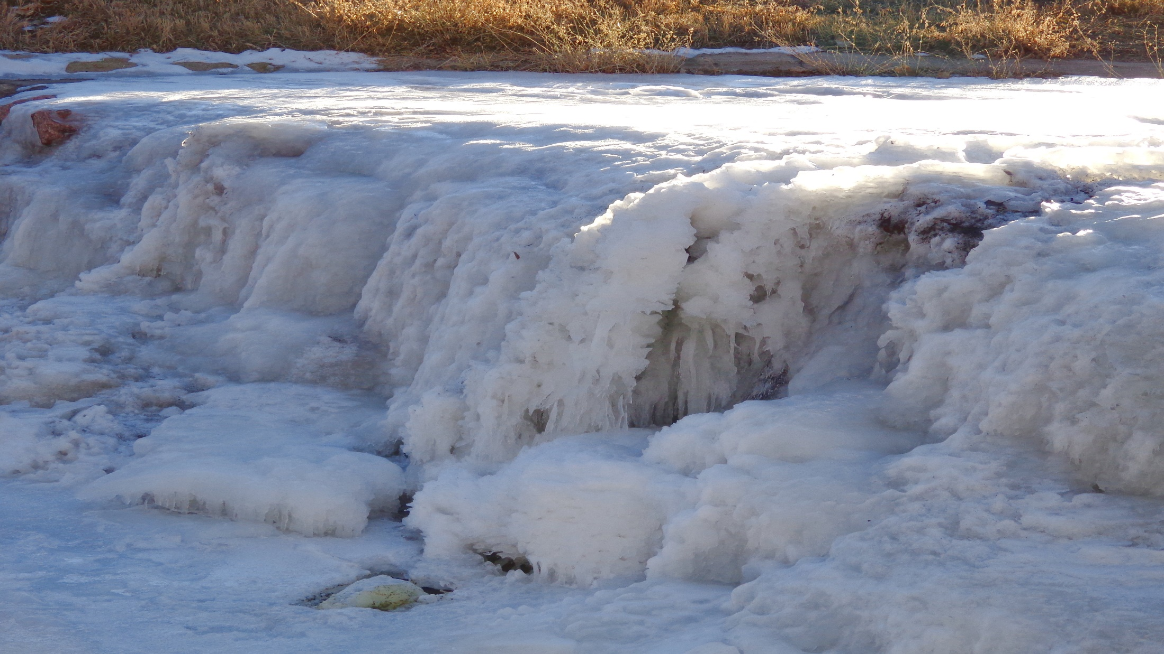
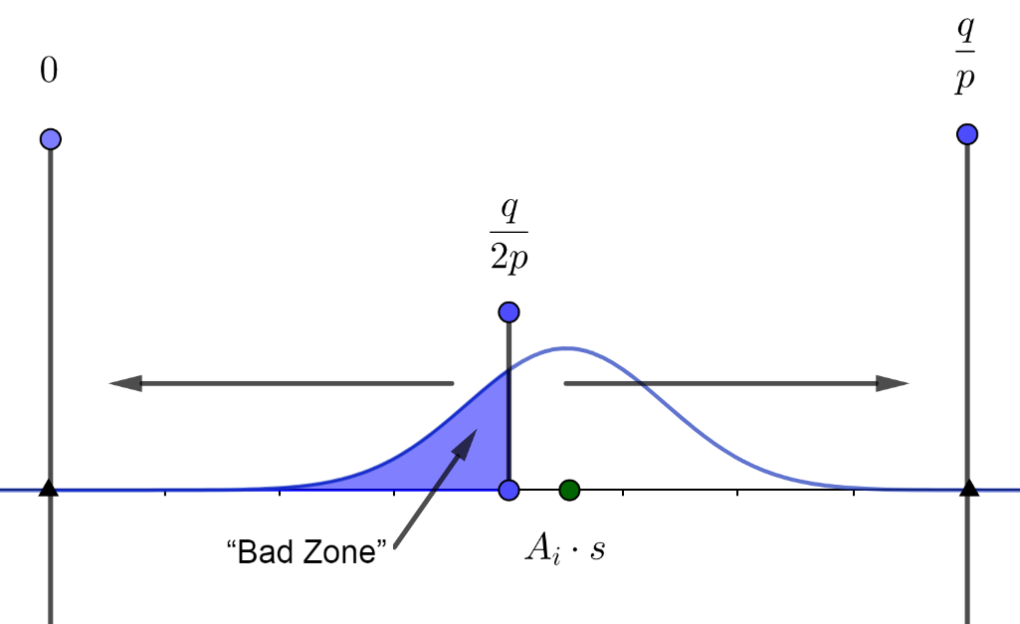

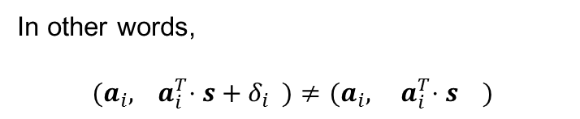
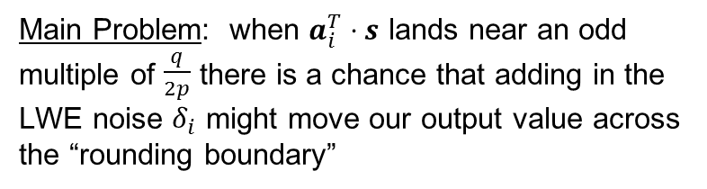

More Precise Rounding Explanation
Main Problem: when $a_{i}^{T}⋅s$ lands near an odd multiple of $\frac{q}{2p}$ there is a chance that adding in the LWE noise $δ_{i}$ might move our output value across the “rounding boundary”
In other words,
$$(a_{i}, { a}_{i}^{T}⋅s+δ_{i} )≠(a_{i}, { a}_{i}^{T}⋅s )$$
$$p$$
$$p$$
If $\frac{q}{p⋅|\left|noise\right||}$ is superpolynomially large, then we are exponentially unlikely to have this happen

Slide 18


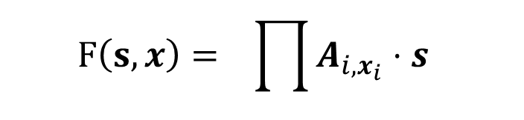
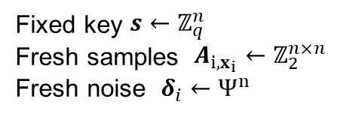
Original [BLMR13] PRF
Fixed key $s←ℤ_{q}^{n}$
Fresh samples $A_{i,x_{i}}←ℤ_{2}^{n×n}$
Fresh noise $δ_{i}←Ψ^{n}$
$$ℓ$$
$$F\left(s, x\right)= \prod{A_{i,x_{i}}⋅s }$$
$$p$$
$$i=1$$
F is also key homomorphic—but we won’t focus on or use that property today

Slide 19

[BLMR13] PRF Security Proof
Security Proof Idea (Part 1) (4 bit input) :
$$A_{1,x_{1}}\left(A_{2,x_{2}}\left(A_{3,x_{3}}\left(A_{4,x_{4}}⋅s+δ_{x_{4}}\right)+δ_{x_{34}}\right)+δ_{x_{234}}\right)+δ_{x_{1234}}$$
LWE
$$A_{1,x_{1}}\left(A_{2,x_{2}}\left(A_{3,x_{3}}⋅s_{4}+δ_{x_{34}}\right)+δ_{x_{234}}\right)+δ_{x_{1234}}$$
LWE
$$A_{1,x_{1}}\left(A_{2,x_{2}}⋅s_{34}+δ_{x_{234}}\right)+δ_{x_{1234}}$$
LWE
$$δ_{x_{ij}}≔$$
A noise term depending on only the $i$th and $j$th bits of x
(i.e. changing $x_{1}$ will not change $δ_{x_{234}}$ but will change $δ_{x_{1234}})$
$$A_{1,x_{1}}⋅s_{234}+δ_{x_{1234}}$$
LWE
$$s_{1234}$$

Slide 20
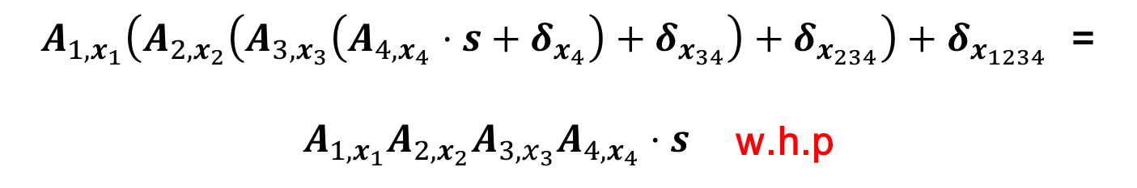
[BLMR13] PRF Security Proof
Security Proof Idea (Part 2) (4 bit input) :
$A_{1,x_{1}}\left(A_{2,x_{2}}\left(A_{3,x_{3}}\left(A_{4,x_{4}}⋅s+δ_{x_{4}}\right)+δ_{x_{34}}\right)+δ_{x_{234}}\right)+δ_{x_{1234}}$ =
$A_{1,x_{1}}A_{2,x_{2}}A_{3,x_{3}}A_{4,x_{4}}⋅s$ w.h.p
$$p$$
$$p$$
$$δ_{x_{ij}}≔$$
A noise term depending on only the $i$th and $j$th bits of x
(i.e. changing $x_{1}$ will not change $δ_{x_{234}}$ but will change $δ_{x_{1234}})$
A standard hybrid argument completes the proof.

Slide 21
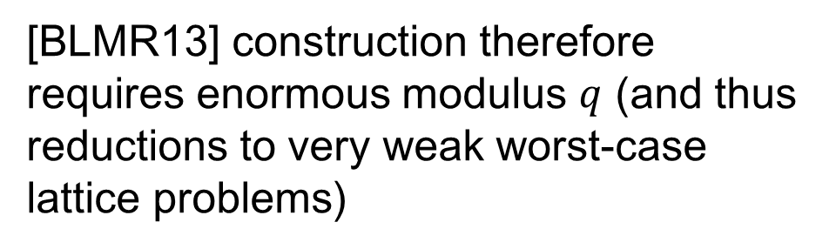
[BLMR13] PRF Security Proof
Problem: Noise is enormous (4 bit input)
Effective Noise = $A_{2,x_{2}}A_{3,x_{3}}A_{4,x_{4}}⋅δ_{x_{4}}$
Noise growth is exponential in the input bits!
[BLMR13] construction therefore requires enormous modulus $q$ (and thus reductions to very weak worst-case lattice problems)
$$δ_{x_{ij}}≔$$
A noise term depending on only the $i$th and $j$th bits of x
(i.e. changing $x_{1}$ will not change $δ_{x_{234}}$ but will change $δ_{x_{1234}})$

Slide 22
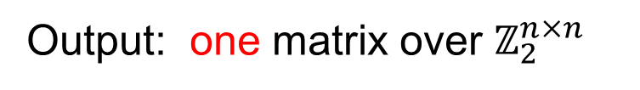



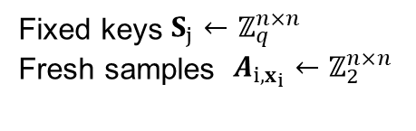
A Different Approach: Keyed Synthesizers
Fixed keys $S_{j}←ℤ_{q}^{n×n}$
Fresh samples $A_{i,x_{i}}←ℤ_{2}^{n×n}$
$$S\left(S, A_{i}, A_{j}\right)= { A}_{i }A_{j }⋅S$$
$$2$$
Input: two matrices over $ℤ_{2}^{n×n}$
Output: one matrix over $ℤ_{2}^{n×n}$
We can chain this using a synthesizer construction easily!

Slide 23



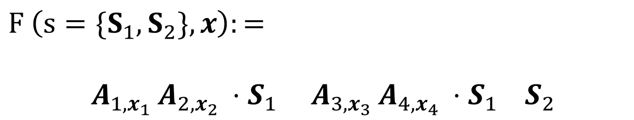
Keyed Synthesizer PRF Construction
Fixed keys $S_{j}←ℤ_{q}^{n×n}$
Fresh samples $A_{i,x_{i}}←ℤ_{2}^{n×n}$
$$F \left(s=\{S_{1}, S_{2}\}, x\right):=$$
${ A}_{1, x_{1} }A_{2,x_{2} }⋅S_{1} { A}_{3, x_{3} }A_{4,x_{4} }⋅S_{1} S_{2}$
$$2$$
$$2$$
$$2$$
< 2 times the matrices and matrix multiplies (public and secret keys) of [BLMR13]
…but much more efficient since q is so much smaller!

Slide 24






Keyed Synthesizer PRF Security
${ A}_{1, x_{1} }A_{2,x_{2} }⋅S_{1} { A}_{3, x_{3} }A_{4,x_{4} }⋅S_{1} S_{2}$
LWE/LWR
LWE/LWR
$$2$$
$$2$$
$$2$$
$${ R}_{12}$$
$${ R}_{34}$$
$${ S}_{2}$$
LWE/LWR
$$2$$
$${ R}_{1234}$$
Never need more than 3 matrix multiplies before rounding →
Noise growth is very small!

Slide 25

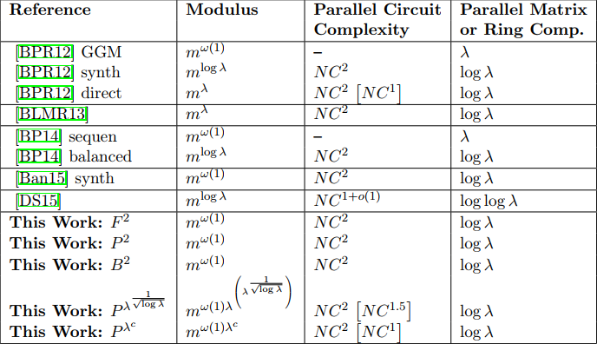
Our Results

Slide 26
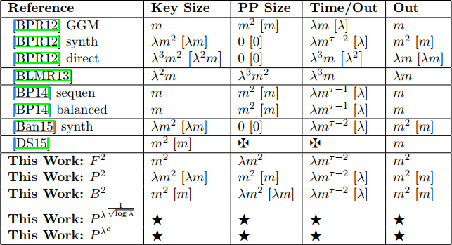
Our Results

Slide 27
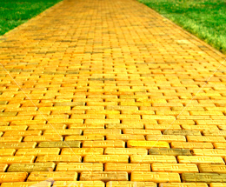
Conclusion/Open Problems
Pseudorandom synthesizers are a powerful tool—may have more applications than known today
Favorite problems in the area:
PRFs from polynomial-modulus LWE—mostly theoretical
Better LWR reduction—theoretical, maybe practical
LWE with few samples and low noise—theoretical AND practical, NIST would love this
Improve MP[13]

Slide 28
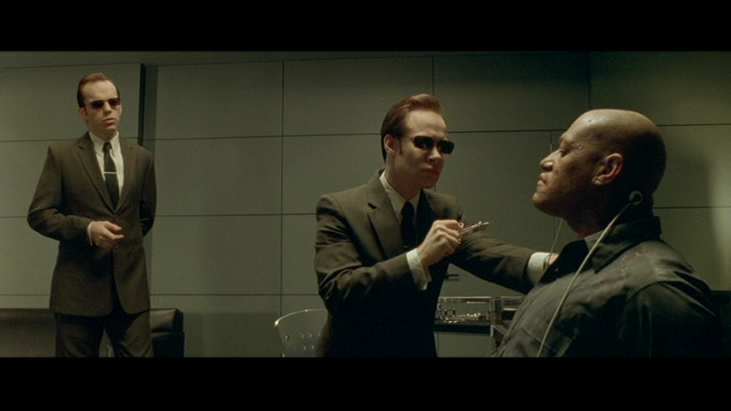
Questions are Welcome!
matrix.wikia.com

